Slide 1
Announcements
Bible Study Merced College Tues 12:00
Bible Study 1195 Pinnacle Dr. Tues 7:30
Bible Study UC Merced Wed 12:00
Fri 6:00 Leave for joint devotional w/ Fresno Alpha Omega
Worship Sun. 10:00
Th June 15 7:00 Lecture: Is the Bible Reliable
Family Fun Day Sat June 17 10:00 Lake Yosemite Park

Slide 2
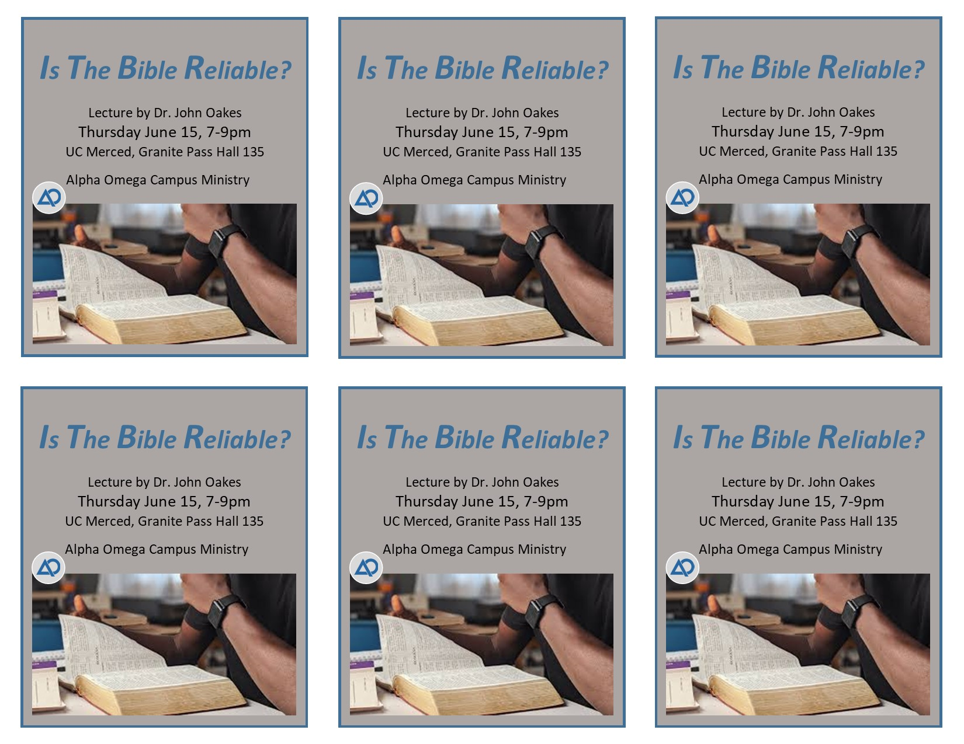

Slide 3
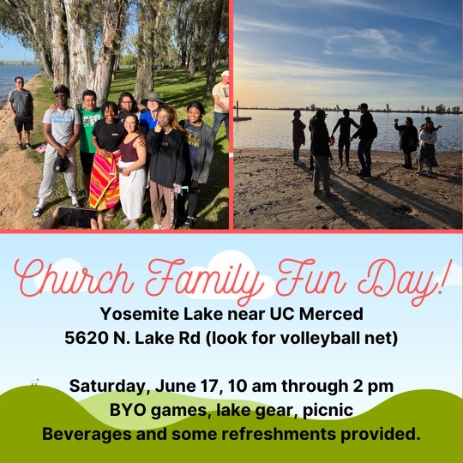

Slide 4
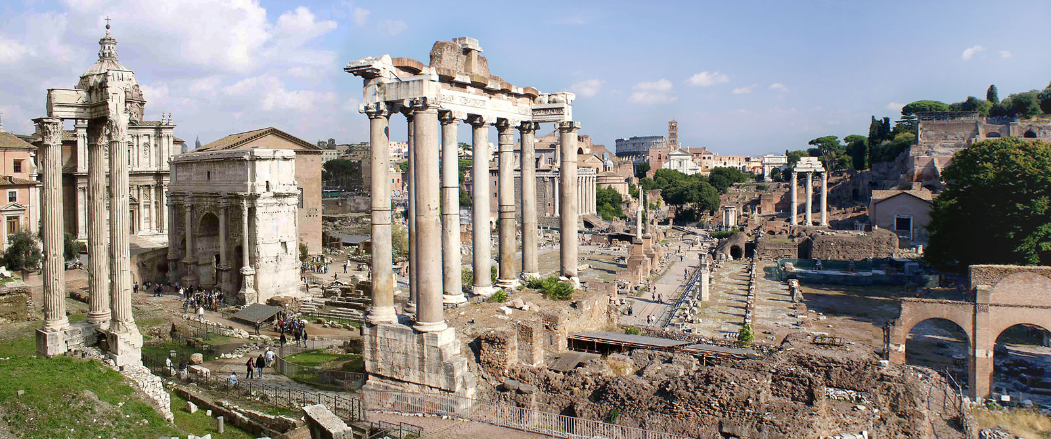
The Book of Romans
John Oakes
Spring, 2023
Merced, CA

Slide 5
Theme of Romans
Salvation is by faith.
Theme passage: Romans 1:17 For in the gospel a righteousness from God is revealed, a righteousness that is by faith from first to last, just as it is written, “The righteous will live by faith.
Sub-theme. In Christ Jew and Gentile/Greek are made one.

Slide 6
A Few Introductory Comments
Style of Romans: A diatribe. A staged “debate” with an unnamed opponent who has been teaching salvation by works.
Date of writing: 51-52 AD based on Acts 18:12 and the fact that Paul is writing from Corinth.
Paul was in Corinth about 1-1/2 years when Gallio was ruling there. This can be dated from an inscription found in Delphi.

Slide 7
Outline of Romans
I. 1:1-17 The righteousness of God.
II. 1:18-2:16 The Gentiles are lost.
III. 2:17-29 The Jews are lost.
IV. 3:1-20 All are lost.
V. 3:21-5:21 Salvation is by faith, through the blood of Jesus.
VI. 6:1-8:39 The Way of Holiness
VII. 9:1-11:36 Man’s unbelief and God’s gracious choice.
VIII. 12:1-16:27 How to live by faith.

Slide 8
I. Romans 1:1-17
The Righteousness of God
Romans 1:1-7 Paul’s greeting.
1:1 Paul a servant and an apostle (in that order)
Matthew 20:24-28
Paul explains why they should listen to him:
v. 2 His message was foretold by prophets
v. 3-4 Confirmed by the Holy Spirit
v. 5 Paul specially chosen apostle to the Gentiles
v. 6-7 Paul connected with all the churches

Slide 9
Romans 1:5 What are we called to?
Answer: We are called to the obedience that comes from faith.
Question: Where does your obedience come from?
Paul’s point: The key to everything is faith.

Slide 10
Romans 1:8-15 Paul: I really wanted to come to you.
Q: Why did Paul want to come to them?
Answer: Because of their faith, of course (v. 8).

Slide 11
Romans 1:16-17 Paul summarizes what he has to say
The Gospel means salvation to all who believe, first for the Jew, then for the Gentile.
Q: Why first for the Jew?
By faith from first to last. Salvation begins with faith and it ends with faith.
The righteous shall live by faith or alternatively, Those who through faith are righteous shall live. (also 3:26, 3:28, 4:5, 4:11, 5:1, Gal 3:11)

Slide 12
II. Romans 1:18-32 The Gentiles are Lost
Paul: The only rational worldview is Christian monotheism.
Therefore the Gentiles who have rejected this are lost.
1:18-20 Unbelief requires that we actively and deliberately suppress the obvious truth.
1:18 God’s wrath is revealed. Q: Is this because God does not love us? No!! It is because he loved us and gave us a choice, and we deliberately chose not to love him.

Slide 13
Romans 1:24-32 God gives us over
1:21-23 Those who choose to worship created things, rather than the Creator of those things become foolish and darkened.
1:24, 26, 28 God gives us over. Q: To what? To the things we chose to give ourselves to.
Why? In the hope that we will come to our senses.
v. 32 All are aware that these things are evil, yet willfully choose to do them.
Q: Do you believe this applies to you?

Slide 14
Right now the Jews are saying, “Yeah, those Gentiles are really depraved.”
Romans 1: The Gentiles are lost
Romans 2: The Jews are equally lost.
Def of Judgemental: “One who forms a lot of opinions—usually critical ones—about other people.”
Romans 2:1-4 You Jews do the very same thing.
Q: Was this true literally?
Paul (v. 4) Being judgemental is showing contempt for God’s kindness.

Slide 15
III. Romans 2 The Jews are lost as well
2:7 Those who persist in doing good…. He will give eternal life. Q: Is this works salvation?
2:9 God is fair. Both salvation and judgement are “first for the Jew, then for the Gentile.

Slide 16
Salvation based on our conscience?
Q: Does Romans 2:12-16 hold out hope that those who have never heard of Jesus can be saved by their own righteousness?
Answer: Perhaps, but that is not Paul’s point here. In fact, his point is the opposite of this. The application is to the Jews who have knowledge, and therefore will be held to more strict judgement. 2:17-29 proves this.
Besides: Romans 3:9 all are under sin. Romans 3:23 All have fallen short. All are lost!

Slide 17
Romans 2:17-29 Paul calls out Jewish (or Christian!) self-righteousness.
v. 28-29 Real Jewishness was spiritual, not physical all along. (Coll 2:11-12)
What was their mistake? Making the outside more important than the inside.
Could this happen to us?

Slide 18
IV. Romans 3:1-20 All Are Equally Lost
The Jews right now are feeling pretty depressed. What good, then, was there in being a Jew?
Romans 3:1-2 Much in every way! (Rom 9:1-5)
You had the very words of God!!!
But…. If you do not combine it with faith, it will be of absolutely no value to you.
3:4 God’s conclusion to the complaining Jews: Let God be true, and every man a liar!

Slide 19
Romans 3:5-8
Paul is being accused of being an antinomian
Wikipedia:
1. Relating to the view that Christians are released by grace from the obligation of observing the moral law.
2. One who rejects a socially established morality.

Slide 20
Romans 3:9-20 Utterly lost
3:9 Are we any better? Q: Who is “we”?
The clear answer: All alike are under sin.
3:10 A key verse! There is no difference.
(read this: There is no essential difference.)
3:11 No one does good, no one loves God.
Right now I am feeling a little defensive!
(Mark 10:17-18)

Slide 21
Is God being unfair here?
No one seeks God. Now, wait a minute! Jeremiah 29:11-12.
Paul, you are exaggerating!
Q: Are you a good person?
Is Romans 3:13-18 true of you without Jesus?

Slide 22
Romans 3:19-20 So, what good, then, was the law?
Through the Law (of Moses, presumably) we become more aware of how truly sinful we are.
“through the Law we become conscious of sin.”
Romans 7:13 …so that through the commandment sin might become utterly sinful. (also Romans 5:20)
Summary of Romans 1:18-3:20 We all are in deep trouble!!!!

Slide 23
V. Romans 3:21-5:21 Salvation by faith, through the blood of Jesus
Romans 3:21-30 is the heart of Romans (and one of the greatest passages in all of scripture)
3:21 The Law and the Prophets testify about a new kind of righteousness that was coming.
Isaiah 53, Daniel 9:24-25, Jeremiah 31:31f, Ezekiel 36:24-27 and many more….
What kind of righteousness?
3:22 Righteous that is by faith!
3:23 There is no difference. (Just in case you hadn’t gotten it yet)

Slide 24
Romans 3:21-30
Some really great words
3:24 Great news!!!! Justified (Gr. dikios)
-aligned with
-declared “not guilty.”
-to be made righteous (even though you are not)
- just-as-if-I’d never sinned
redemption (Gr. apolytrosis)
- payment for
- ransom
Q: What was the payment? Who got paid?

Slide 25
Theories of Redeption (Soteriology)
Deification God became man so that man could become like God. This was the theory of the Cappadocian Fathers (and of Orthodox Christianity)
Ransom Theory Satan owned our souls and he was paid ransom “money” to buy us back for God. This was the favorite theory of the Gregory the Great and of the Medieval Church
Satisfaction Theory The death of Jesus satisfied the penalty owed to God for our sin and releases us from the penalty for our sins. This was proposed by Anselm of Canterbury

Slide 26
Gregory of Nazianzus
Deification.
What has not been assumed has not been healed; It is what is united to his divinity that is saved.

Slide 27
Two more great words
Atonement (Gr. hilasterion)
- a reference to the mercy seat in the tabernacle.
- a removal of the consequences (for us) of sin.
- restoring a relationship that was broken.
- at-one-ment
Faith (Gr. pistis)
- faith in lieu of death
- What kind of faith? Romans 4 will define it for us
-

Slide 28
Romans 3:25-26
A difficult (but beautiful) passage
v. 25 God allowed Jesus to die instead of us to demonstrate his justice.
Q: What does justice demand? Romans 6:23 Ezekiel 18:4
On the face of it, this is not “just.” How can NOT punishing us demonstrate his justice?
This is the mystery. This is the beauty of the gospel.
God is both just and he justifies.
v. 26 Justice and justification were at odds.
But God loved us so much that he gave his one and only Son….

Slide 29
Romans 3:27-31 No Boasting!
v. 27 Where, then, is boasting?
Q: Who was tempted to boast?
Why not? Because of faith. Because God is the God of Jew and Gentile alike.
v. 28 Saved apart from works of the Law
v. 30 Faith upholds the Law (something the Jews will struggle to understand)
Q: How does faith uphold the Law?

Slide 30
Romans 4 The Faith of Abraham
Romans 4:3 My personal favorite scripture in Romans.
Abraham believed God, and it was credited to him as righteousness.
Adam is a type and we are the antitype (if we have the faith of Abraham, of course)
Q: What did he believe?

Slide 31
Abraham Believed God
What did Abraham believe?
Answer: Abraham believed that God would do what he said he would do. Genesis 15:1-6 Romans 4:21
Abraham believed that if he entrusted his entire life to God rather than to himself, God would meet all his needs.
If only we could be like Abraham.
Q: What do you believe?

Slide 32
The Faith of Abraham
Romans 4:4-8 work = obligation.
Q: Which is harder, working or trusting in God?
What do we gain by works? Not much.
What do we gain by faith? Righteousness
Faith (pistos) has a range of biblical meaning
- Belief (Hebrews 11:1,6)
- Trust (Romans 4)
- Obedience (Hebrews 3:18-19)
- A system of beliefs and practices (Medieval Church)

Slide 33
Romans 4:9-12
Paul makes a big deal about circumcision.
What is the big deal here for Paul?
Abraham’s faith (and therefore his righteousness) preceded his circumcision.
v. 12 Who will be made righteous? Those who walk in the footsteps of Abraham.
Where will that take us?

Slide 34
Where will following Abraham take you?
1. Out of Ur. Genesis 12:1-5.
Q: What do you need to walk away from? (Luke 14:33, Luke 9:61-62).
An encouraging verse: Genesis 12:6-7.
2. To Mount Moriah Genesis 22:11-15
Q: What thing that God has given you might you need to lay on the altar?

Slide 35
Abraham’s Offspring
4:13-15 Which do you live by: Law or Faith?
Q: What does “where there is no law there is no trespass mean?
4:16 Abraham is the father of all those who walk in his footsteps—of all those who live and walk by faith.
4:17 If you walk by faith, God will give life to the dead.

Slide 36
What Kind of Belief?
Romans 4:18-23 The biblical standard of belief is I. belief “against hope.”
The facts: Abraham’s body was “as good as dead.”
The promise: Father of many nations
v. 20 Abraham did not waver through unbelief.
v. 21 Abraham was II. fully persuaded.
Q: Are you fully persuaded that God will do what he said he will do?

Slide 37
Romans 5:1-11
Romans 5:1-11 Because of our faith in Jesus Christ:
v. 1 Justified.
v. 1 Peace with God.
v. 2 Access to God.
v. 2 We will stand.
v. 4-5 Hope
5:6-8 At just the right time… How fortunate and blessed we are. How much does God love us? Jesus died.
5:9-11 Aren’t justified and saved equivalent?
No. Justified about the past. Saved about the future.

Slide 38
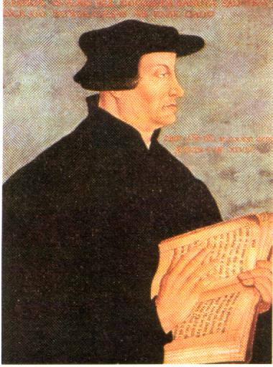
Romans 5:12-19 Adam and Jesus
Adam and Jesus are both very similar and very different.
Romans 5:12, 17, 18 The central question: What was the effect of Adam’s sin?
Does this passage support
“Original Sin”?
Zwingli: “In Adam’s fall,
we sinned all.”
Ulrich Zwingli

Slide 39
The Effect of Adam’s Sin
a. Sin entered the world.
b. Death came to all (physical or spiritual or both?)
c. All sinned
We are not guilty of Adam’s sin, but because of what he did, all of us will sin. We have “fallen.”
5:13 Sin is not taken into account when there is no law… Romans 5:20, Romans 7:13
Q: Do you see sin as utterly sinful?

Slide 40
Romans 5:15-19 Adam and Jesus
5:15 The gift is not (exactly) like the tresspass.
The gift: Jesus
The tresspass: Adam similar but different.
One act let to many sins vs.
The many sins led to one act.
The gift followed many sins, while the condemnation followed one sin.
v. 18-19 condemnation for all and life for all….
(Also: 1 Cor 15:45-49)

Slide 41
Romans Ch 6-8 The Way of Holiness
Romans 6 Practical application of Romans 1-5
What is the application of Romans 5?
Should we take advantage of God’s grace? NO WAY!!!
Why not? Because we are dead in Christ.
Died with Christ = Dead to sin. Answer: We should die to sin, and live a new life (v. 4)

Slide 42
Romans 6:5-14
Paul explains himself with if… then…
Romans 6:5 If we have been united with him in his death…
Q: What if we have not been united with him in his death?
Q: What if we have not been baptized into Christ? (only in Romans 6:3, Gal 3:27)
The only way “into Christ” is in baptism. If we have not been baptized, we are not in Christ.
(in Christ is the most common NT phrase for saved)

Slide 43
Romans 6:5-14 cont.
6:8 If we died with Christ we will live with him.
Q: What if we have NOT died with Christ?
Paul’s conclusion—the practical application of Romans 5: Romans 6:11 Count yourself dead to sin.
Let us strive to become what Christ has already made us.
Romans 6:13 Q: What do you offer yourself to?

Slide 44
Romans 6:15-23
Whose slave are you?
We are all slaves.
Romans 6:21 “How is that working for you?”
Romans 6:23 What does sin earn for us?
Q: What is eternal life the wages of?

Slide 45
Romans 7
The Vicious Circle of Salvation by Law
Romans 7:1-6 Marriage as an analogy to sin and the Law. (similar to the slavery analogy in Romans 6:16-20)
Romans 7:4 We died to the Law. Application: The only way out of a marriage (legally) is death. Similarly, the only way out of salvation by law is death with Christ. (ie baptism)
Romans 7:6 Great News! We serve in a completely new way. “The way of the Spirit.”

Slide 46
Romans 7:7-24
The Vicious Cycle of Sin.
Is Paul talking about himself BC (before salvation) or AC (after salvation) What is the big picture here?
Answer: both! Can you relate to Paul here?
Romans 7:13 (and 7:7-8) So what good was the Law? It made us realize what wretches we are.
Romans 7:25 What is Paul so thankful for? He has stepped off the treadmill of works salvation.

Slide 47
Romans 7:9 An aside….
Romans 7:9 Here is clear evidence from no less than Paul himself that “Original Sin” is false doctrine.
As a child, Paul was not saved, but he was “safe” (alive in Paul’s words)
Paul was not saved but he was alive because he had not yet sinned and was therefore not yet a slave to sin.

Slide 48
Romans 8 Life in the Spirit
Romans 8:1 No condemnation. This may be the most encouraging passage in the Bible.
Romans 8:2 The law of sin and death…
Like the law of gravity
Romans 8:3 Why was the Law powerless?
It had no provision for removing the consequences of sin. James 2:10.

Slide 49
Romans 8:3b
Jesus came in the likeness of sinful man
Q: How was Jesus like us?
Mortal body/human
Tempted in every way like us. (Heb 4:14-5:3)
8:4 What the Law could not do, Jesus did. How?
a. He fulfilled all the requirements of the Law.
b. He paid the penalty required of those who do not keep the Law (Matthew 5:17)

Slide 50
Romans 8:4-14 Living by the Spirit
8:3-4 How to appropriate the sin offering of Jesus?
By living “according to the Spirit.”
Q: What does that mean, Paul?
8:5 Set your mind on the things the Holy Spirt desires in our lives.
8:5-13 Is this a fact or is Paul describing the ideal?
Q: How do we live according to the Spirit? Gal 5:25, Coll 3:1-2, Matthew 6:19-21

Slide 51
Assurance!
Romans 8:11 Absolute assurance if the Holy Spirit lives in us (Eph 1:13-14)
Romans 8:12 The Holy Spirit does not cause us to stop sinning, but to stop being slaves to sin.

Slide 52
Romans 8:15-17 (and 8:23)
Sons and Daughters of God
What kinds of sons and daughters are we?
- Adopted (Ephesians 1:5)
- Chosen
- We say “daddy” by the Holy Spirit
- We are God’s heirs. Q: What do we inherit?
8:17b But we also inherit Christ’s propensity for suffering. (Coll 1:24)

Slide 53
Romans 8:18-25
Another tough passage
Q: What is the big picture here?
“The Creation” is a personification of the physical creation. Do not take this literally.
v. 23 Aren’t we already adopted as sons? Yes: already but not yet.
The point: We should have confident hope in our final salvation with God.

Slide 54
Romans 8:26-28
The Holy Spirit helps us.
8:26 “in the same way…” same as what? 8:16
How does the Holy Spirit help us in our prayers?
By “groans” Our inmost concerns, longings.
What kind of prayer is this? Not talking.

Slide 55
Romans 8:28-39
God’s provision for us
Romans 8:28 Q: Is God’s will always done?
Even the things that are NOT according to his will he can use for our benefit.
Romans 8:29 Does foreknowledge = predestination?
Paraphrase: Those who God, in his foreknowledge, knew would be saved by the blood of Jesus, he predestined the possibility of that salvation.

Slide 56
Romans 8:30
Paraphrase of Romans 8:30 (in a sense) all are predestined, but not all those who are predestined are called (hear the message), and not all those who are called are justified (saved) , and not all those who are justified are glorified (make it to heaven).
But… For those whom God foreknows, all of these are true of all of them.
Who is predestined, called, justified and glorified?
Calvin and Zwingli: a tiny minority who God chooses. All others were created in order to go to hell.
Paul: Those God foreknew would be saved.

Slide 57
TULIP
Does Romans 8:29-30 give support for Calvinism/TULIP?
T Total depravity
U Unconditional Election
L Limited Atonement
I Irresistible Grace
P Perseverance of the Saints (once saved, always saved)
In a word: No!
1 Tim 2:4,1 John 2:2 Deut 30:19-20, 2 Cor 5:15

Slide 58
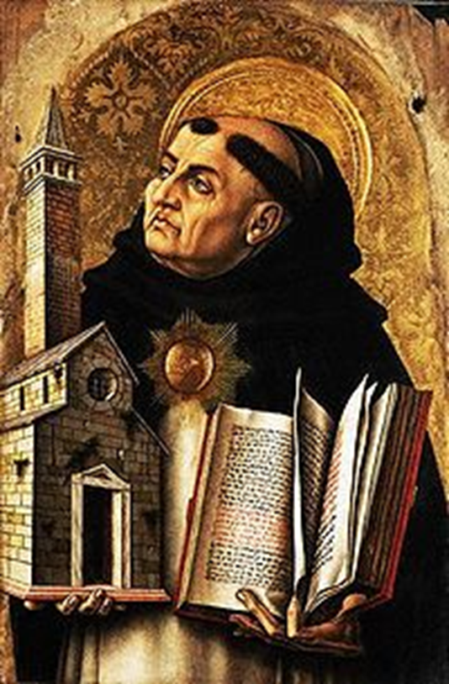
Thomas Aquinas:
“God, therefore, is the first cause, who moves causes both natural and voluntary. And just as by moving natural causes He does not prevent their actions from being natural, so by moving voluntary causes He does not deprive their actions of being voluntary; but rather is He the cause of this very thing in them, for He operates in each thing according to his own nature.”
In other words, Aquinas believed in free will and not a strict monergism.

Slide 59
Ulrich Zwingli
1484-1531
Opposed baptismal regeneration
Double Predestination
Reformed Theology
“Those individuals who end up damned forever in hell are also eternally determined by God for that fate.”

Slide 60
Romans 8:31-39
Security in Christ
Does this passage support “once saved, always saved”? (also John 10:27-29)
Answer: No! Nothing outside ourselves can separate us, and nothing can snatch us out of Jesus’ hand, but we can walk away.
The point: We can and should feel very confident in Christ.
Q: Do you feel this way?

Slide 61
Romans Ch 9-11 God rejects Israel and chooses the Gentiles
Romans 9:1-5 Paul is getting really emotional here.
Why? Because he REALLY loves the Jews, but he is about to deliver some news they do not want to hear.
God has rejected (physical) Israel and has chosen the Gentiles.
The context: There are some Jewish Christians who are jealous and upset with God (and maybe with Paul) that he is allowing Gentiles into the kingdom so easily.

Slide 62
Romans 9:6-9
Not all Israel is Israel
Romans 9:6 Not all Israel are Israel (in two senses)
Romans 9:7 “It is through Isaac that your offspring will be reckoned” (Gal 4:21-31)
Romans 9:8 In other words, the children of promise, who walk by faith (not physical children) will be reconciled.
Q: What should we rely on? The promise.

Slide 63
Romans 9:10-16
God’s Predestination
Q: What is God’s predestination like? TULIP?
9:12-14
The older will serve the younger (Genesis 25:19-26)
Jacob have I loved, Esau I hated (Malachi 1:2-3
I will have mercy on whom I will have mercy (Exodus 33:19)
In all three cases, God chose Israel. Did they complain when that happened?
Answer: It is about God trying to bless his people.

Slide 64
Ouch!
v. 12 the older (Esau) will serve the younger (Jacob).
A foreshadow of Israel/Jewish Christians serving Gentiles.
The point: v. 16 It does not depend on man’s desire or effort.

Slide 65
Romans 9:17-29
More examples of God’s Predestination
Romans 9:17 Did God predestine that Pharaoh would go to hell? What about Judas?
The purpose in both cases: to free God’s people from slavery, physical and spiritual.
9:19 Jews: Fine. If so, then I am not responsible for my own sin.
9:20 Who are you, O man, to talk back to God.
9:22 God: If I use the stubbornness of the Jews in order to help the Gentiles be saved, you should be happy about that!

Slide 66
Summary: God’s Predestination
God is sovereign and his will can trump our will, but:
1. He only intervenes in order to predestine salvation for his people, “first for the Jews, then for the Gentiles.”
2. Even when he “jerks people around” God never steals their ability to choose whether, ultimately, to serve God and to be saved.

Slide 67
Romans 9:30-33
Paul summarizes his argument
If Israel is lost it is because they did not combine law with faith
If Gentiles are saved, despite not having the Law, it is only by faith.
Those who seek salvation by works of Law will find Jesus a stumbling block.
The righteous will live by faith.

Slide 68
Romans CH 10 Israel Rejected So That the Gentiles Can Be Saved
Paul is repeating his earlier argument about Israel.
10:1-2 He starts with some positive things about the Jews
10:3 They did not submit to God’s righteousness….
Q: What is God’s righteousness?
10:4 Christ is the “end” of the Law. Romans 8:4, Matthew 5:17.
10:5 The righteousnes that is by Law…. Lev 18:5

Slide 69
Romans 10:6-13
This was taught in the Old Testament
Romans 10:6-8 The way of righteousness was taught, for example, in Deuteronomy 30:12-14.
Deut 30:16 A seemingly impossible command.
Deut 30:19-20 A seemingly impossible command obeyed.
Romans 10:9-11 Paul’s version of Deut 30:12-14, 19-20
Rom 10:12 For there is no difference….

Slide 70
Does Romans 10:9-13 teach that confession is required for salvation?
10:10 …and it is with your mouth that you confess and are saved.
v. 11 (quoting Isaiah 28:16) The key point is trusting in God.
Did those baptized in Acts 2 and elsewhere in Acts give a verbal confession?
10:13 “Calling on the name of Jesus” = “Anyone who trusts in him.” (see v. 11).

Slide 71
Does Romans 10:9-13 Teach we are saved by confession (apart from baptism)?
“Where does this passage mention baptism? If you add baptism, this is works salvation and false doctrine.”
Response:
1. You cannot use one Bible passage to disprove another.
2. You cannot ignore Acts 2:38-39 and Romans 6:2-4
3. Paul himself already said Romans 6:2-4 before 10:9-13.
4. In Acts 2:36, the people ask what to do in order to call on the name of the Lord (Acts 2:21), and they are told to repent and be baptized.
5. Acts 22:16 Baptism = Calling on the name of the Lord.
6. 2 Tim 2:19 Calling on name of Lord = turn from sin.

Slide 72
Romans 10:14-17
Stop arguing. Start sharing.
Don’t get caught up in the situation of the Jews. Just share your faith. If they put their faith in Jesus, then they will be saved.
10:16 If some Jews do not accept the gospel, that does not invalidate the message.
So get out there and share it!
10:18-21 The stubbornness of the Jews, and the subsequent offer of salvation to the Gentiles was prophesied.

Slide 73
Romans Ch 11 Warning to Gentile about arrogance.
Romans 11:1-6 The Jews are whining. Paul: God did NOT reject Israel. The Jews still can be saved.
Romans 11:7-10 But those who refuse, I will harden.
11:11-12 Besides, it is not too late for the Jews.
11:13-24 A little chat with the Gentile Christians
11:13-16 If not for the Jews, you would not be saved.
11:17-24 Don’tt be prideful. You are unnatural, grafted branches. You are not the root. You do not support the vine. If the natural vine can be removed, so can you! “For there is no difference….”

Slide 74
Romans 11:25-27
All Israel will be saved
Q: Is this a prophecy of salvation of all Jews at end times?
All (true) Israel will be saved.
Q: What is true Israel? (Romans 9:6 Not all Israel is Israel)
Romans 11:28-32 Sure, the Jews who do not confess Christ are your enemies now, but pray for them. It may not be too late for them.
Romans 11:33-36 Doxology Glory to God.

Slide 75
Romans CH 12-16 Living By Faith
Romans 12:1 Therefore…. Q: Therefore, based on what?
If you are saved by grace through faith, then put these things into practice.
Q: Are you motivated by grace? (Titus 2:11 2 Cor 5:14)

Slide 76
Romans 12:1-2 Living Sacrifices
Romans 12:1-2 What does God want from you? He wants you to be a living sacrifice.
Paul uses the burnt offering as an illustration. Lev 1:1-9.
Clean the body, but not the head.
A voluntary offering.
Eph 5:1-2 Jesus gave a burnt offering.
Motivation: “In view of God’s mercy.” We give this offering, not in order to be saved, but because we are saved.

Slide 77
Romans 12:1-2 Transformed Lives
The Result: God will transform your mind.
You will know God’s will
Q: How do we know God’s will?
Scripture 2 Tim 3:16, Prov 15:22
Spiritual advisers Prov 11:14, 1 Kings 12:1-11
Prayer Colossians 1:9
God transforms our minds so that we have personal insight into his will

Slide 78
Romans 12:3-8
How should we view ourselves?
12:3 In Sober Judgement but….
But through the lens of faith.
Q: Which is worse: to think too highly or too lowly of yourself?
12:4-8 View yourself as one who is gifted by God. This is how the Church is to function, as each part does its work. (parallel 1 Pet 4:10-11)

Slide 79
Romans 12:9-13
Relationships in the Body.
The Key: Be devoted to one another. How?
By hating evil v. 9
By loving good v. 9
By being devoted to one another v. 10
By honoring one another v. 10
By being zealous v. 11
By being joyful v. 12
By staying personally faithful v. 12
By meeting needs in the body v. 13
By being hospitable v. 13
Which do you need to work on?

Slide 80
Romans 12:14-21
Relationships with outsiders
Some very difficult advice to put into practice:
Bless your persecutors v. 14
Rejoice with those who rejoice v. 15
Mourn with those who mourn v. 15
Hang out with people from whom you will gain nothing personally. v. 16
Live at peace with people who do not want to live at peace with you. v.18
Give up your freedom to not give offense v. 18
Do not take revenge. v. 19-20
Remember why we are doing this “In view of God’s mercy”

Slide 81
Romans 13 Submission
Romans 13:1-7 Submit to the governing authorities.
Pay your taxes.
Exceptions? Acts 4:18-20, Acts 5:27-32
Only when it is a clear matter of conscience.

Slide 82
Romans 13:8-14
Romans 13:8 Leave no debt outstanding…
…except the continuing debt to love one another.
The key concept here: Clothe yourself with Christ (v. 14).
What does it mean to clothe ourselves with Christ?
v. 14b not gratifying the sinful nature

Slide 83
Romans 14 The Weak and theStrong
Romans 14:1-4
Accept One Another. Why? Because Christ accepted you (Rom 15:7).
What is a “weak” Christian according to this verse?
It is a believer who has a particularly sensitive conscience which does not allow him/her to do something which is not technically sinful.
Accept does not mean agree, but not to judge.

Slide 84
Romans 14:5-12
Romans 14:5-12 Paul’s advice to the “weak” Christian: Do not judge your brother!
But aren’t I my brother’s keeper?
(not on disputable matters)
A Principle: Your bro or sis belongs to God, not to you. They answer to Him.
Q: In what areas might you be “weak”?

Slide 85
Romans 14:13-23 Advice to the “strong”
Strong versus weak is not good versus bad.
Be willing to give up your freedom for the sake of the conscience of the weaker brother or sister.
v. 16 Do not let what is good be spoken of as evil.
Q: How do I do that?
Answer: By not doing it in front of those who consider it “evil.” Ouch!

Slide 86
Rom 14:19 The main point of Rom 14
Let us therefore make every effort to do what leads to peace and to mutual edification. Do not destroy the work of God for the sake of food.
Drink alcohol
Listen to certain kinds of music
Watch certain movies
Go to a casino
Drink coffee

Slide 87
Rom 14:21-23 Two kinds of sin
a. 1. It is sinful for the “strong” to do an otherwise unsinful thing if it can reasonably be thought to be a stumbling block to the “weak.” (v. 21-22)
b. It is sinful for the weak disciple to do what he or she believes to be wrong in their heart. (v.23) Any action which we cannot do in good faith, we should not do.
Do not give in to peer pressure from fellow disciples!

Slide 88
Rom 15 Unity in the Body
Rom 15:1-13
v. 1 Bear with one another’s failings. Bear with means tolerating people and things you simply do not like.
v. 5-6 Unity with one another. Find consensus and try to speak with one voice.
v. 7 Accept one another. Accept means getting along with people you disagree with
Rom 15:14 Competent to counsel one another

Slide 89
Rom 15:16 Our Priestly Duty
Priests make intercession/mediate.
1 Tim 2:5 Jesus the only mediator.
But… Our priestly duty is to mediate to the lost by proclaiming the gospel.
15:20-29 Paul: I want to go to Rome and then Spain.

Slide 90
Romans 15:17-32
Paul: I am coming to Rome!
Little did he know at this time how that would happen!
Did Paul make it to Spain?

Slide 91
Romans 16 Greetings
A few things to note:
The primitive church was like a big extended family.
Rome met in house churches. (v. 5)
Paul had living relatives (v. 7, 11, 21)
Women played a significant role in church life and were close friends of Paul
Rom 16:17-19 Paul’s parting concern: Unity.

