Slide 1
How to Study the Bible With Our Friends
John Oakes
Merced Christian Church

Slide 2
Purpose vs. Mission
Our purpose: To love God and to be loved by Him: to give glory to God through our lives.
Our mission: To be used by God to win souls for Christ.
1 Cor 5:17-20
Romans 15:14-16

Slide 3

The Jesus Study Series
The Gospel of Jesus
The Life of Jesus
The Death and Resurrection of Jesus
The Promise of Jesus
The Response to Jesus
The Lordship of Jesus

Slide 4
But I Do Not Have the Bible Study Series!
Go to www.mercedchurch.com
Click on Resources. Click on Bible Studies
Click on the appropriate study series

Slide 5
Let’s Get Started
1. Ask them to study.
2. Bring along a friend.
First study: Do a “spiritual timeline”
Do you believe the Bible is the Word of God/inspired?
Why do you believe this?
Do you believe you are a Christian? Do you believe you are saved?
When and how (and please be VERY specific) were you forgiven of your sins?
What was your frame of mind at the time?
Do NOT tell them they are wrong or try to talk them out of this

Slide 6
Two Possibilities
1. Is this person relatively religious? Does the person think he or she is probably saved? Do they, at least theoretically believe the Bible is from God?
This person should do the His Steps/First Principles Bible study series.
Or
2. This person has almost no or only a limited background in Christianity. He or she is not even completely sure that they believe Jesus is the Son of God or that the Bible is inspired by God.
This person should do the Jesus study series.

Slide 7
Person #1 The Studies in the His Steps Series
Seeking God optional
The Word Study
The Discipleship Study
Light and Darkness
The Cross Study
Salvation/Sound Doctrine
The Church
Count the Cost

Slide 8
An Alternative Order
Seeking God optional
The Word Study
The Cross Study
Light and Darkness
The Discipleship Study
Salvation/Sound Doctrine
The Church
Count the Cost

Slide 9
Person #2
The goal: Help them come to have faith in Jesus.
Start by reading John together?
Word study optional.
The Gospel of Jesus (introduction: Start The Life of Jesus immediately?)
The Life of Jesus (meet Jesus: prophecy fulfillment, miracles, claims)
The Death and Resurrection of Jesus (cross study)
The Promise of Jesus (salvation study)
The Response to Jesus (a call to repentance and teaching on baptism)
The Lordship of Jesus (a call to discipleship)

Slide 10


Seeking God
and
The Word of God
Bible Study Series

Slide 11
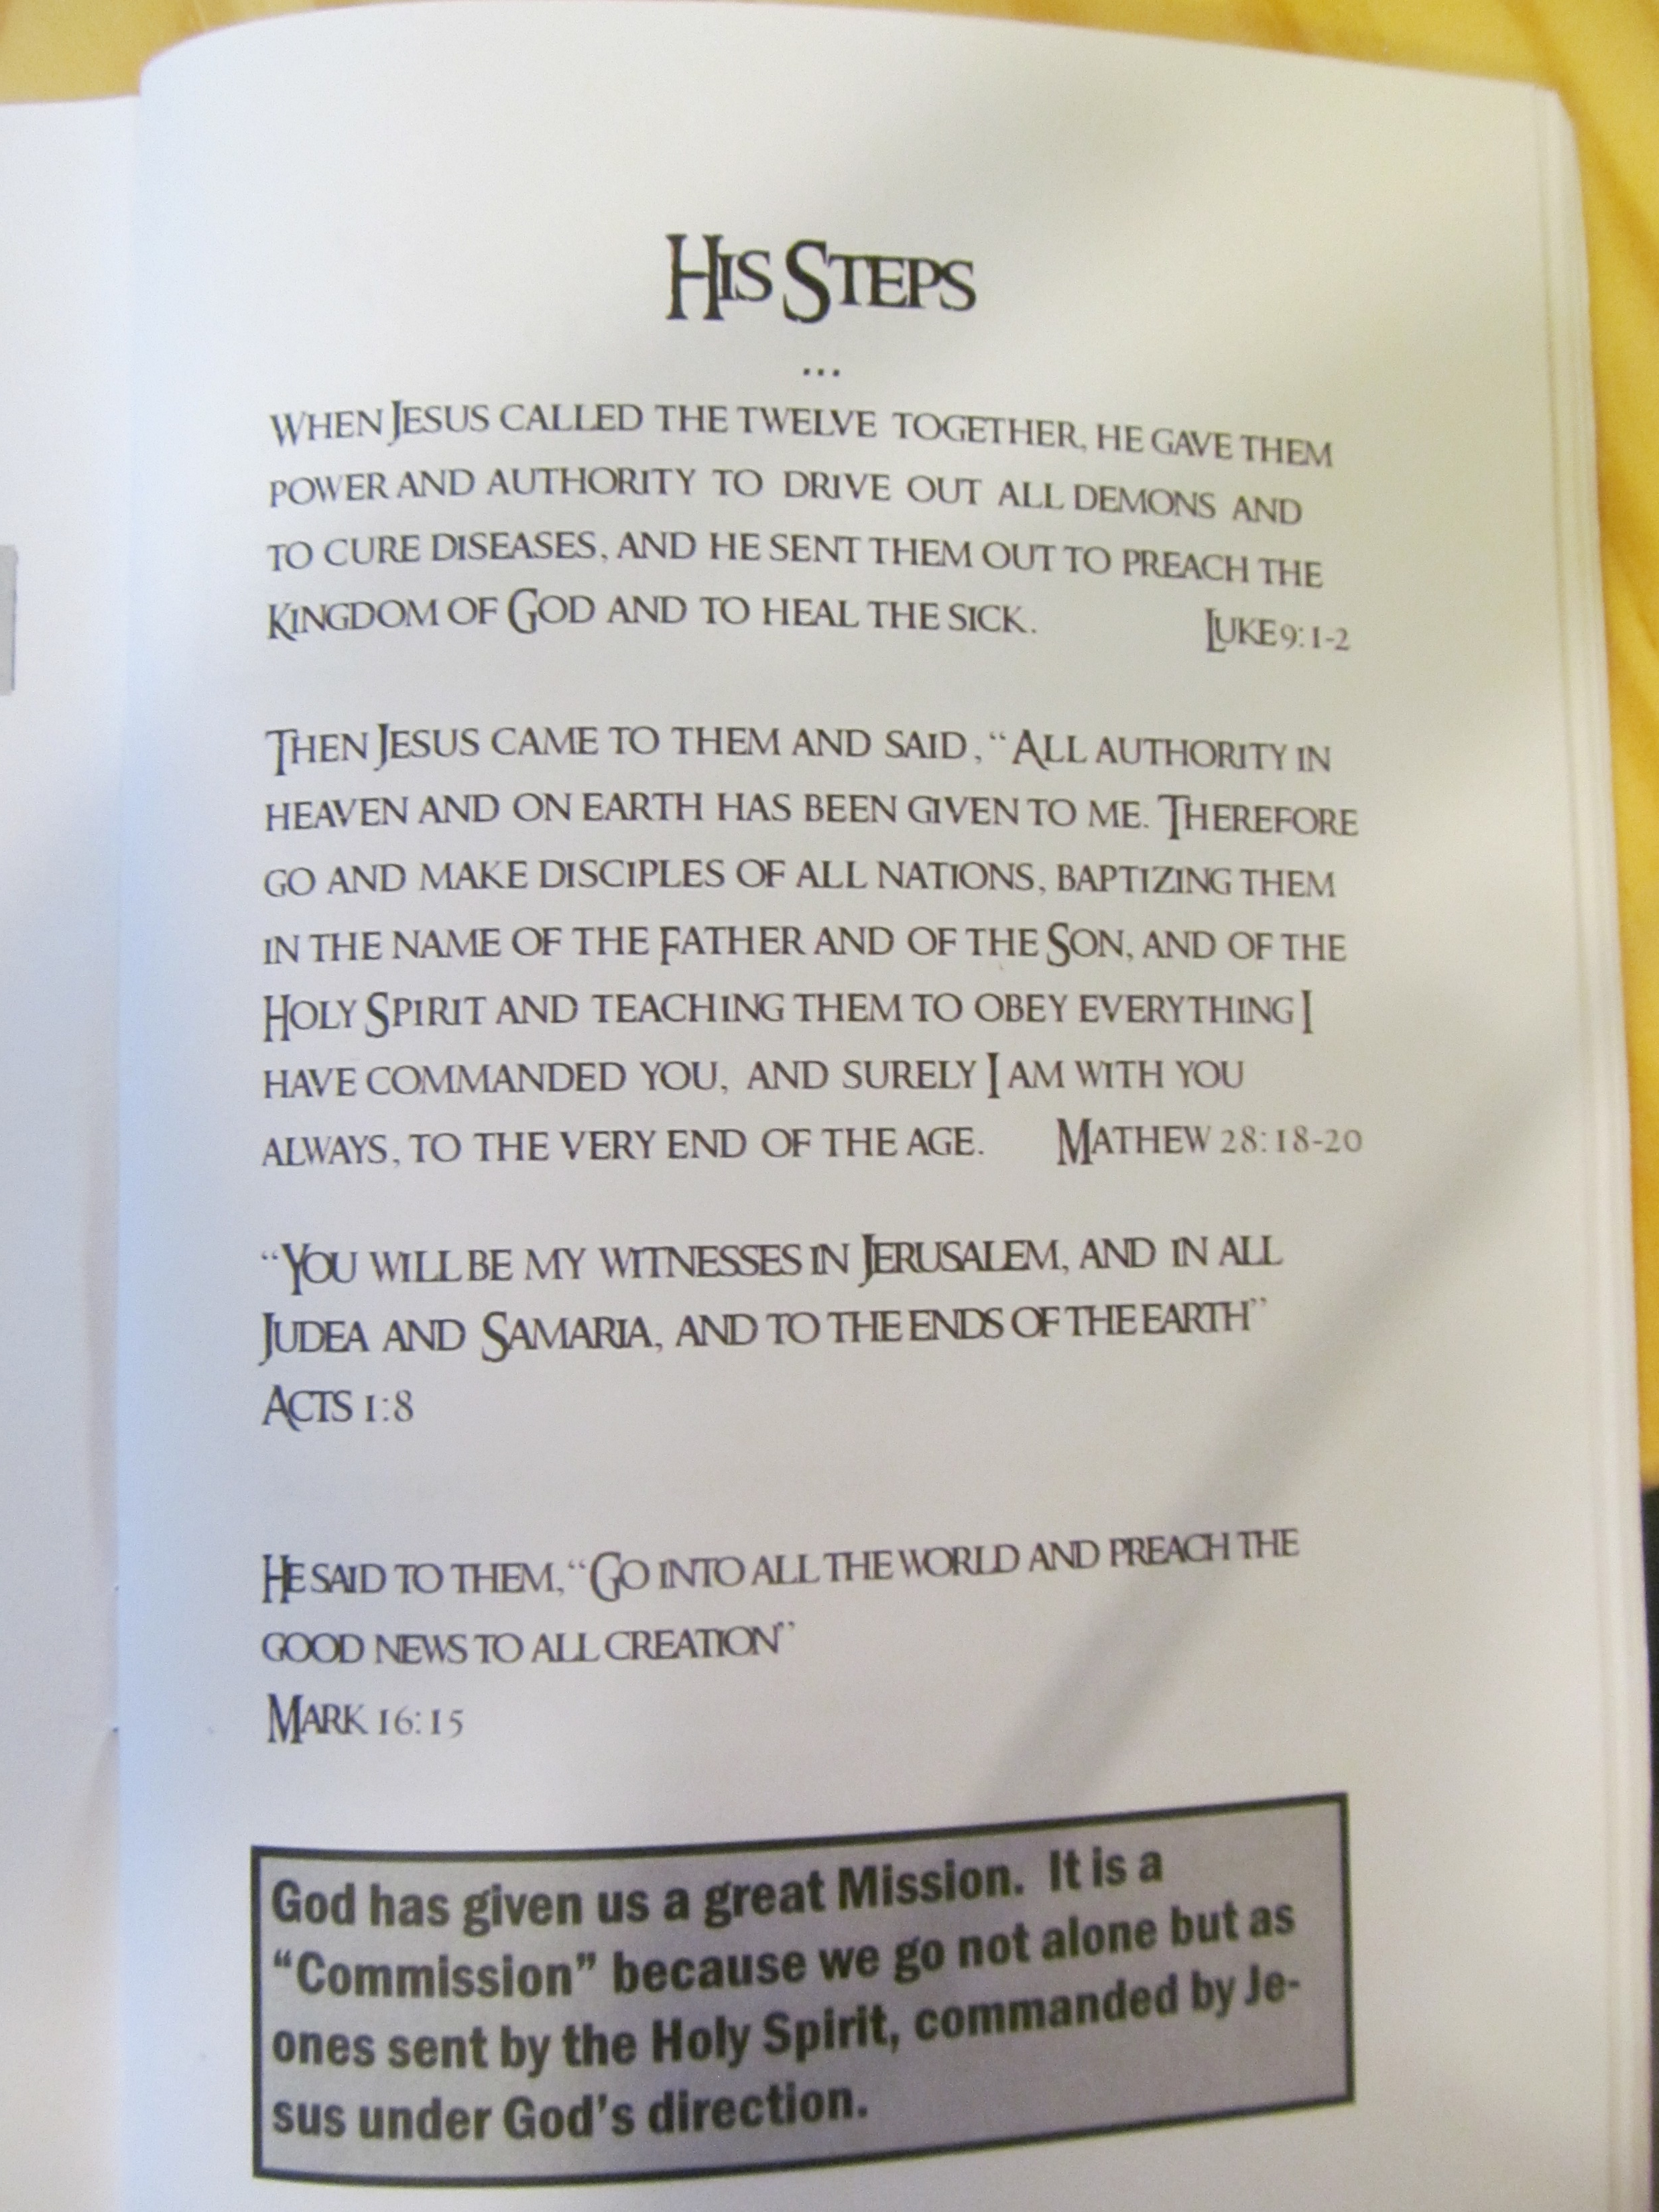

Slide 12
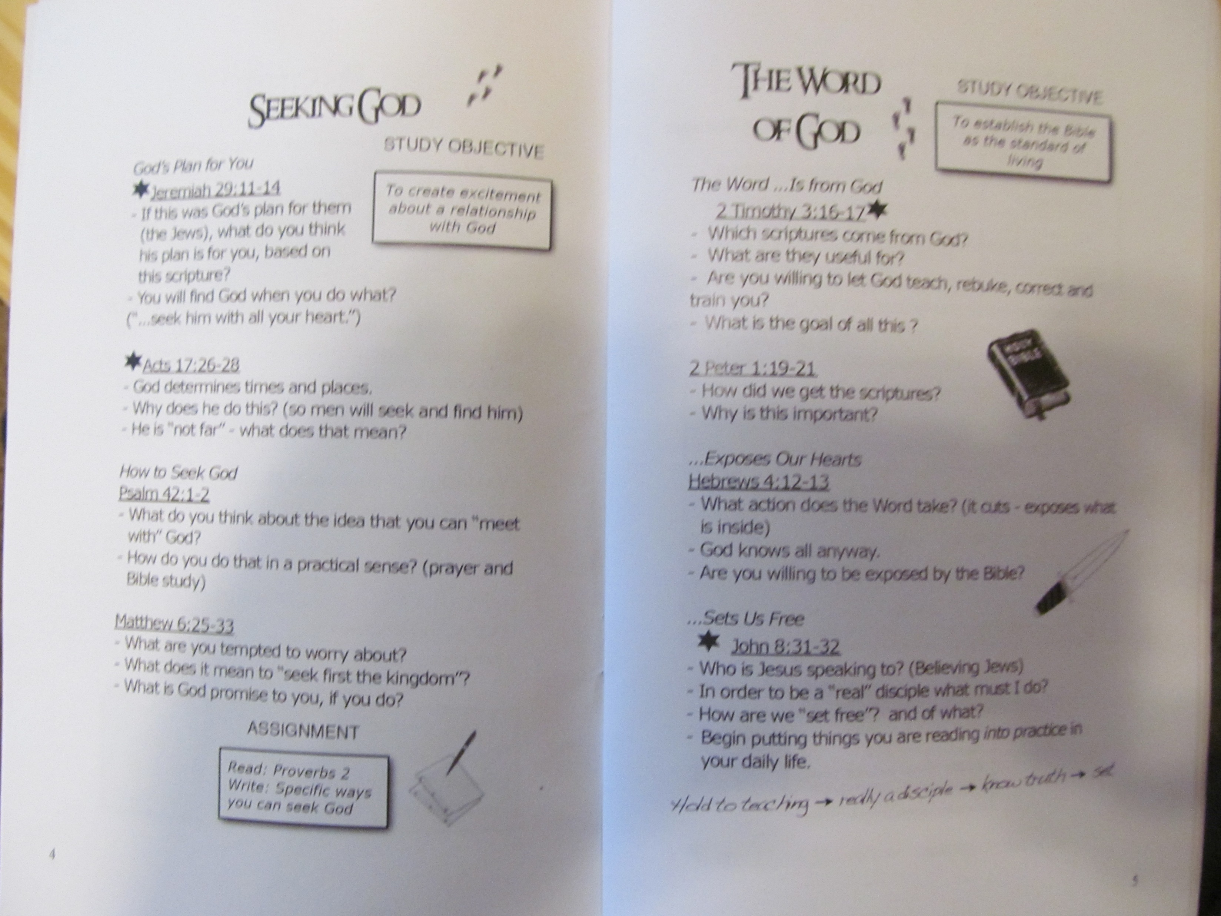

Slide 13
Seeking God Study
Jeremiah 29:11-14
Q: What does God have in mind for you acc this passage?
Q: How do we find God acc to this passage?
Q: Are you prepared to “seek God with all your heart?”
Acts 17:26-28
Q: What has God been doing in order to “find” you?

Slide 14
Seeking God Study
Psalm 42:1-2
Q: How do you feel about the opportunity to meet with God?
Q: What will you do this week to make this happen?
Matthew 6:33
Q: What does it mean to you to “Seek the Kingdom first?”
Q: What specific steps will you take to do this?
Set up the next study: Date, time, place

Slide 16
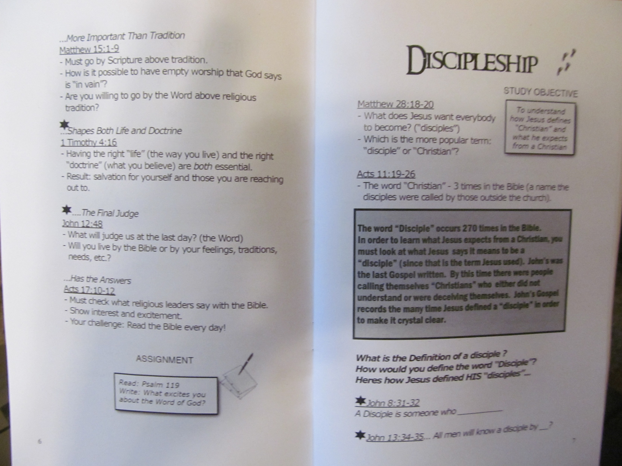

Slide 17
The Word of God Study
2 Tim 3:16-17
Q: What does “All Scripture is inspired by God mean?
Q: Do you believe this?
Q: Why?
Q: What is it useful for? Why?
2 Pet 1:19-21
Q: What does this passage say about Scripture?
Q: What does that mean for you and me?

Slide 18
The Word of God Study
Heb 4:12-13
Q: In what sense is the Word of God living and active?
Q: What is it active in doing?
Q: What does it separate between?
Q: Are you willing for the Bible to “expose” you?
John 8:31-32
Q: Who is Jesus speaking to?
Q: Is “belief” sufficient to be a disciple of Jesus?
Q: What is required?
Q: Are you prepared to hold to his teaching?

Slide 19
The Word of God Study
Matthew 15:1-9
Q: What is it that can make our worship worthless?
Q: Can you commit that you will put the Word of God ahead of the traditions you have learned?
1 Tim 4:16
Q: Which is more important: right life or right doctrine?
Q: What will be the result if you are far off on either?

Slide 20
Word Study (cont.)
John 12:48
Q: What will be the standard by which we will be judged on Judgment Day?
Q: What does that mean about you?
Acts 17:10-12
Q: What was more noble about the Bereans than the Thessalonians?
Challenge: Will you commit right now to daily Bible reading, and to doing what it says?

Slide 21
Final Challenge
Write down and share with your partner the names of 3-5 people you are going to ask to study the Bible with you. Then pray about it and go out and make it happen.
1 Cor 3:6 I planted, Apollos watered, God gave the increase.
Kevin planted, Katie watered, but God gave the increase

Slide 22
Discussion Groups
Have you been seeking God with all your heart recently?
Does your life agree with your belief that the Bible is the Word of God? Explain.
Who are you thinking of asking to study the Bible with you?

Slide 24
The Discipleship Study
Purpose:
1. To establish a biblical definition of what it means to be a disciple of Jesus.
2. To challenge the one we are studying with to make the decision to be that kind of disciple.

Slide 25
Matthew 28:18-20
Jesus’ last instructions
Q: What three things does Jesus ask us to do?
Q: What is a disciple, generally?
Acts 11:19-26
Q: What is a follower of Jesus normally called in the Bible?

Slide 26
John 8:31-32
Q: Who is Jesus talking to (Jewish believers)
Q: Were they disciples?
Q: What is the standard of a disciple here?
Q: Have you done this?
John 13:34-35
Q: What is the mark of discipleship here?
Q: Who will this be a mark to?

Slide 27
John 15:5-8
Q: What is the mark of discipleship here?
Q: What does “bearing fruit consist of?
Q: Have you been bearing fruit?
Mark 1:14-18
Q: What is Jesus calling disciples to do?
-follow
-fish for people
Q: Is this something you have been doing?
Q: How did they respond?

Slide 28
Luke 9:23-26
Q: What is Jesus commanding all his disciples do? Is this optional?
Q: What does it mean to deny self and take up our cross?
Luke 14:25-33
Q: What does Jesus mean in v. 26?
Q: Who are you closest to?
Q: What is Jesus’ point in v 27, 28-30?
Q: Are you ready to count the cost?
Q: What will be the hardest thing for you to give up?

Slide 29
Matthew 28:18-20
Q: Does the order matter here? (disciple, then baptized, then learn to obey all)
Q: Are you ready to make this decision?
Homework: Read the Book of John

Slide 30
Discussion groups:
1. Is there an aspect of discipleship in this study that you feel particularly challenged by?
2. Do you feel confident you could lead this study? If not, what could you do to get ready?

Slide 31
The Sin Study
AKA Light and Darkness
Bible Study Series

Slide 32
The Sin Study aka Light and Darkness
Purpose:
1. To help people come to the point of repentance for their sins.
2. To help people think carefully about whether they are in the light or in the darkness.

Slide 33
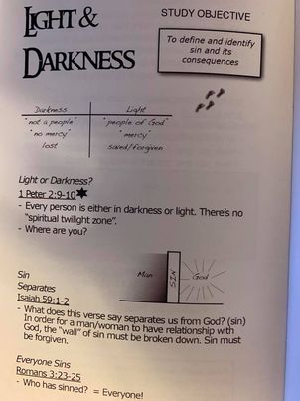
1 Pet 2:9-10
Q: Is there a grey area?
Q: What is the situation for those in the darkness?
Q: Right now, where do you believe you are?

Slide 34
Isaiah 59:1-2
Q: What does sin do to us?
Q: Is the blatant sinner any more or less separated from God than the “good” person?
Definition of sin: harmateo—missing the mark.

Slide 35
Galatians 5:19-21
Q: What is the result of sin according to this scripture?
Note: act, mind, act, mind, act, mind
Sexual immorality pornea
Witchcraft pharmaceo
Q: What are some of the sins that fall under the “and the like?”
James 4:17 Sins of omission
Q: Are there any obvious examples in your life?

Slide 36
Romans 6:23
Q: What are the ultimate consequences of unrepented sin?
Q: Why?
Homework: Write a letter to God in which you open up with yourself and Him about the sins you have committed. Spend time thinking about and praying about this list.
Extra Scriptures: 2 Tim 3:1-5, Colossians 3:5-11

Slide 37
The Cross Study
Bible Study Series

Slide 38
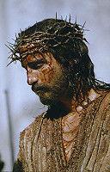
The Cross Study
Purpose: To get people to understand what Jesus did for them and their need for Jesus and the forgiveness he offers.
Suggestions:
Make it personal—even putting in your names as you read.
Express your response, and get their response.

Slide 39
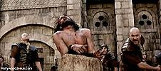
The Crucifixion Account
Matt 26:36-46 Self-denial, Emotional pain
Matt 26:47-56 Betrayal
Matt 26:57-68 Falsely Accused
Matt 26:69-75 Betrayed again
Matt 27:11-26 Physical pain.
Matt 27:27-44 Mocked and crucified.
Matt 27:45-56 Death.

Slide 40
After the reading of the crucifixion account:
Read the medical account of the death of Jesus
Or
Watch together the flogging scene from the Passion of the Christ.

Slide 41
Isaiah 53:3-6 about 700 BC
Despised, rejected
Pierced for our transgressions
By his wounds we are healed.
The Lord laid in Him all of our sin.
2 Corinthians 5:14-15
Q: Are you compelled by this kind of love?

Slide 42
Discussion Questions
Are you in touch, emotionally, with what Jesus did on the cross for us?
Do you feel that Christ’s love compels you in your daily walk with God?

Slide 43
The Salvation Study
Purpose: To establish a solid doctrine on how and when a person is saved, and to help the person to evaluate their current position with God.
Ephesians 2:1-10
v. 1-3 Q: What is the problem? Who has this problem?
v. 4-8 Q: What is the solution?
Note: the idea of being raised (v. 6) will come up later)
v. 9 Q: What definitely does NOT save us?
Q: Does this mean that does not require us to do something in order to be saved?

Slide 44
What Response is Required?
John 3:16 We must believe.
Q: What kind of belief is this? Is it mere intellectual assent to the truth of certain facts? Or is it a belief that includes trusting and acting on that trues?
John 3:3-6 We must be born again.
Q: What MUST happen in order for us to enter the kingdom of God?
Q: What does being born again of the water and the Spirit refer to?

Slide 45
Our Response
Acts 2:36-41 Repent and be baptized.
Q: What does “cut to the heart” mean?
Q: What two things did Peter tell them to do?
Q: What does repent mean? (metanoia, 180^{O})
Q: What does be baptized mean? (immerse)
Q: What two things will God do for us if we repent and are baptized into Christ?
Q: Who is this for?

Slide 46
Our Response
Romans 6:1-7 Note: the only thing in the Bible connected to coming into Christ is baptism.
Q: What happens when we are baptized into Christ according to this Scripture?
Q: What will be the result if we are not baptized into Christ?
Note: this explains the language about being born again and raised in John 3:3-6 & Eph 3:1-10.

Slide 47
Our Response
1 Peter 3:21-22
Q: What does the water of Noah’s flood symbolize?
Q: According to this Scripture what does baptism do?
Romans 10:8-10
What act on our part is associated with our salvation?
Summary: In order to receive the gift of salvation:
1. Biblical belief
2. Repent of our sins
3. Confess Jesus as Lord
4. Be baptized Q: Does the order matter?

Slide 48
Definition of Repentance
2 Corinthians 7:8-11
Q: What is worldly guilt like?
Q: How can you put into effect these different qualities of godly sorrow?
Assignment: Review your letter to God, spend time praying, and complete the process of repentance.

Slide 49
Discussion Questions
Do you feel that you could lead the sin study and the salvation study? Why or why not?
What aspect of the qualities of godly sorrow has meaning for you right now? What might you do this week in response?

Slide 50
The Church Study
Bible Study Series

Slide 51
The Studies in the His Steps Series
Seeking God optional
The Word Study
The Discipleship Study
Light and Darkness
The Cross Study
Salvation/Sound Doctrine
The Church
Count the Cost

Slide 52
The Church Study
Purpose: To establish the importance and role of the church/body in the life of a Christian.
Church: Four definitions
The thing Jesus died for.
A local fellowship of believers.
A denomination
A building
Colossians 1:15-18
Q: What metaphors does Paul use for the role of Christ and of the church in this passage?
Q: What are the implications for us, individually and as a church?

Slide 53
The Family of God
Ephesians 2:19-21
Q: What metaphor for the church is used here? (household, family)
Point: Being part of a family comes with its privileges and its responsibilities
Q: What are the privileges and the responsibilities?
Q: What does it mean that Jesus is the cornerstone?
Q: What does it mean that the apostles and prophets are the foundation of the church? Implication?

Slide 54
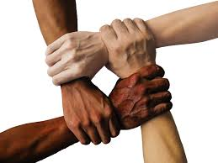
Unity
Eph 4:3-6 Q: What word is repeated many times?
God’s plan is that there be only one church, and that unity be based on a small list of essential teachings.
Q: (rhetorical) What about denominations?

Slide 55

Family
1 Corinthians 12:12-27
Q: When/how do we become part of the church?
Q: What does v. 15-20 say about our relationship with the body? (All are needed, all important, stronger together than apart)
Q: What does v. 21-26 say about the body?
(I need the body. Apart from the body I die spiritually)

Slide 56
We Need Each Other
Hebrews 3:12-13 Q: What does he mean “see to it”?
Q: How often do we need encouragement? (daily)
Q: Why? (because otherwise we will be hardened)
Q: What is at stake? (our salvation)
Hebrews 10:23-25
Q: What does “spur one another on” mean?
Point: We need to be at all the meetings of the church, with few exceptions.
Explain when we meet at this point.

Slide 57
Optional Passages
2 Cor 6:14-15 If dating and marriage are an issue.
Principle: We do not want people to feel surprised after they become part of our church. Oh… You did not tell me that.
Malachi 3:6-12 (or 2 Cor 9:6-8) We need to give to the church sacrificially. Q: Are you ready to do this?
1 Pet 4:10 Q: What gifts do you bring to the family? How will you use those gifts to serve?

Slide 58
Discussion Questions
Any progress toward our mutual goal to do at least one study with someone this year?
What aspect of the qualities of godly sorrow has meaning for you right now? What might you do this week in response?
How do you feel about your own church life? Are there any areas you were challenged with personally from the church study?

