Slide 1

Welcome to the Merced Christian Church!

Slide 2
Thank You, Lord
(700)

Slide 3
Thank You, Lord for loving me;
And thank You Lord for blessing me.
Thank you Lord for making me whole and saving my soul.

Slide 4
Than you Lord, for loving me.
Thank you Lord, for saving my soul

Slide 5
Let us all with accord sing praises to Christ the Lord.
Lets us all unite in song and praise Him all day long.

Slide 6
Than you Lord, for loving me.
Thank you Lord, for saving my soul

Slide 7
Please reveal Your will for me so I can serve You for eternity.
Use my life in every way, take hold of it today.

Slide 8
Than you Lord, for loving me.
Thank you Lord, for saving my soul
[End]

Slide 9


Slide 10
Rejoice In The Lord Always
(111)
Psalm 3:6-7

Slide 11
Rejoice in the Lord always,
And again I say rejoice!
(x2)

Slide 12
Rejoice! Rejoice! And again I say rejoice!
(x2)

Slide 13
Rejoice in the Lord always,
And again I say rejoice!
(x2)

Slide 14
Rejoice! Rejoice! And again I say rejoice!
(x2)

Slide 15
Rejoice in the Lord always,
And again I say rejoice!
(x2)

Slide 16
Rejoice! Rejoice! And again I say rejoice!
(x2)
[End]

Slide 17


Slide 18
Oceans

Slide 19
You call me out upon the waters
The great unknown where feet may fail
And there I find You in the mystery
In oceans deep my faith will stand

Slide 20
I will call upon Your Name
And keep my eyes above the waves
When oceans rise
My soul will rest in Your embrace
For I am Yours and You are mine

Slide 21
Your grace abounds in deepest waters
Your sovereign hand will be my guide
Where feet may fail and fear surrounds me
You’ve never failed and You won’t start now

Slide 22
I will call upon Your Name
And keep my eyes above the waves
When oceans rise
My soul will rest in Your embrace
For I am Yours and You are mine

Slide 23
Spirit lead me where my trust is without borders
Let me walk upon the waters
Wherever You would call me
Take me deeper than my feet could ever wander
And my faith will be made stronger
In the presence of my Savior

Slide 24
I will call upon Your Name
Keep my eyes above the waves
My soul will rest in Your embrace
I am Yours and You are mine
I am Yours and You are mine
[End]

Slide 25
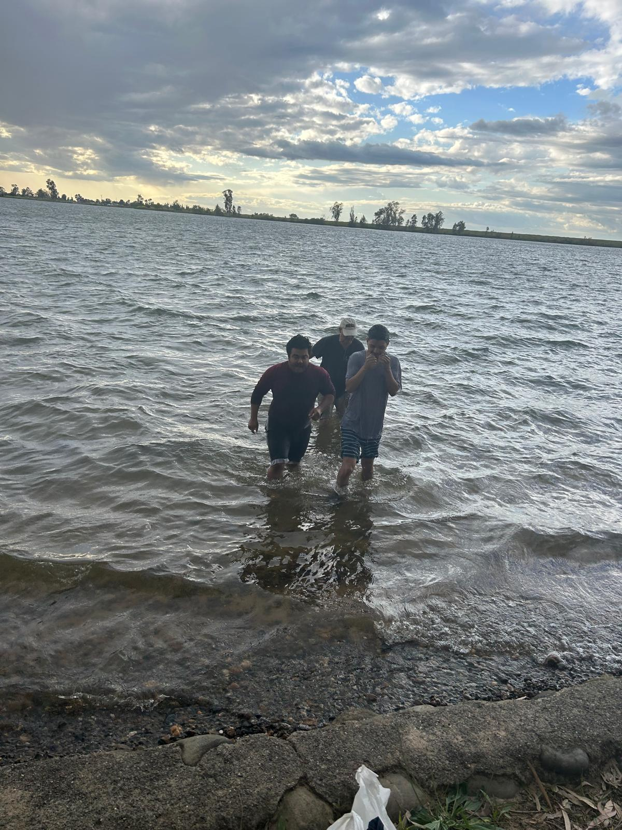

Slide 26
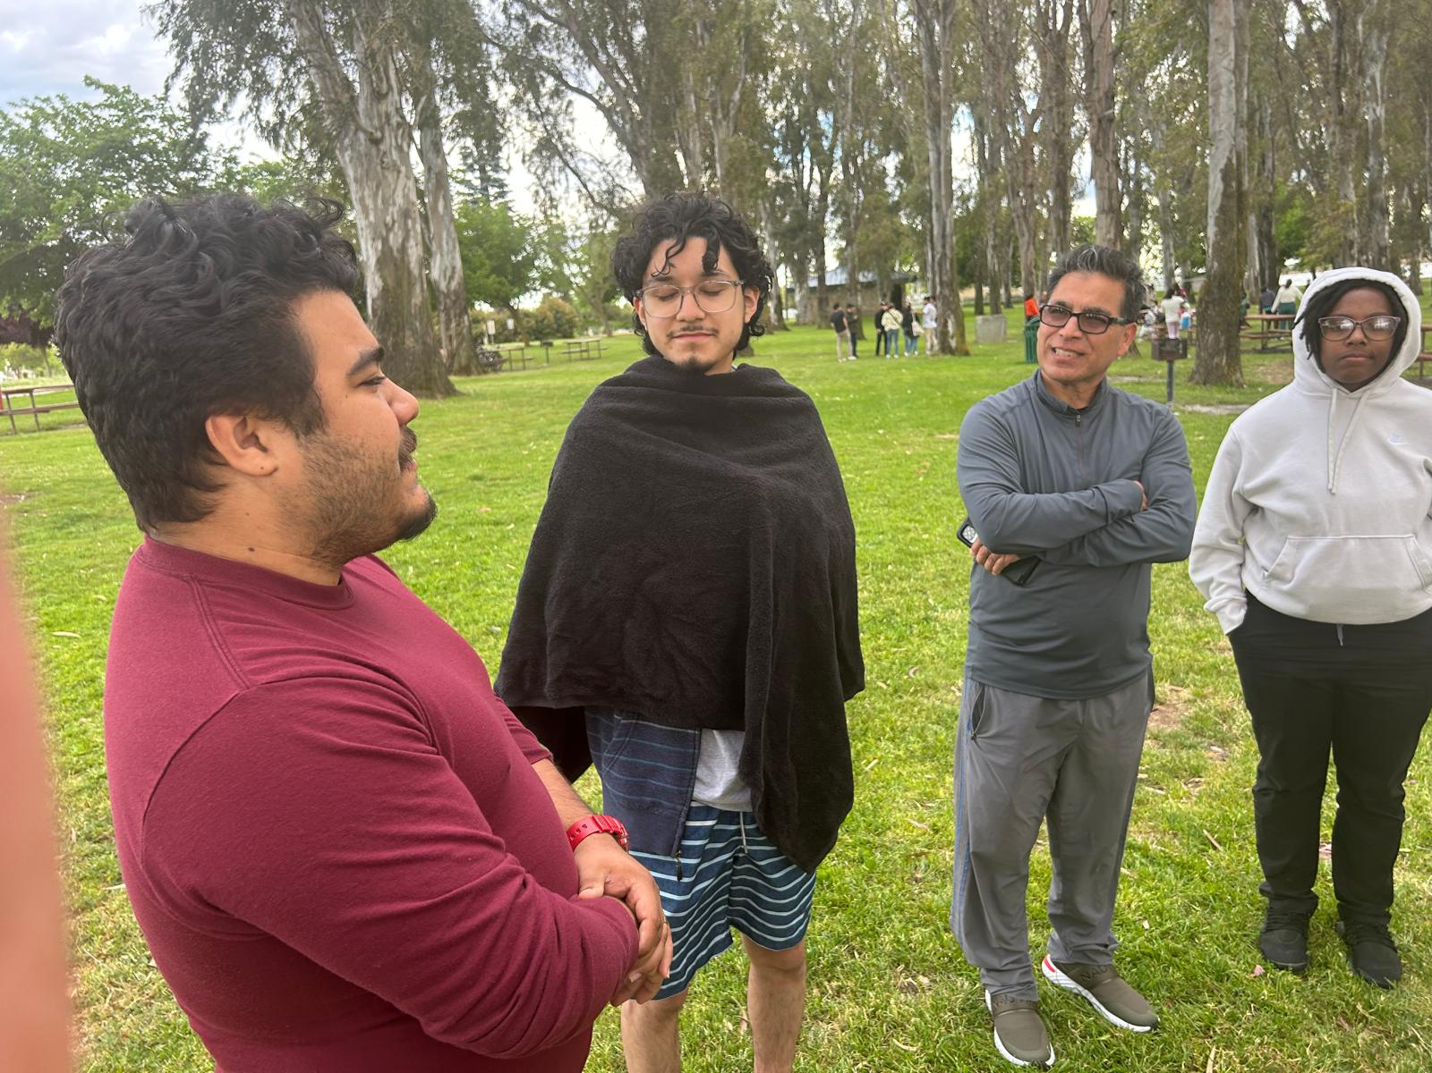
Welcome to the family, Garek!

Slide 27
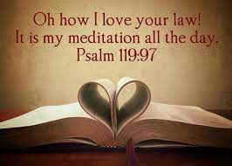
Palms V Wisdom Psalms
Psalm 119 Oh! How I Love Your Word

Slide 28
Psalm 119: A Wisdom Psalm
An acrostic 22 Hebrew letters x 8 = 176 verses.
Imagine writing eight poetic verses startine with the letter x or q!

Slide 29
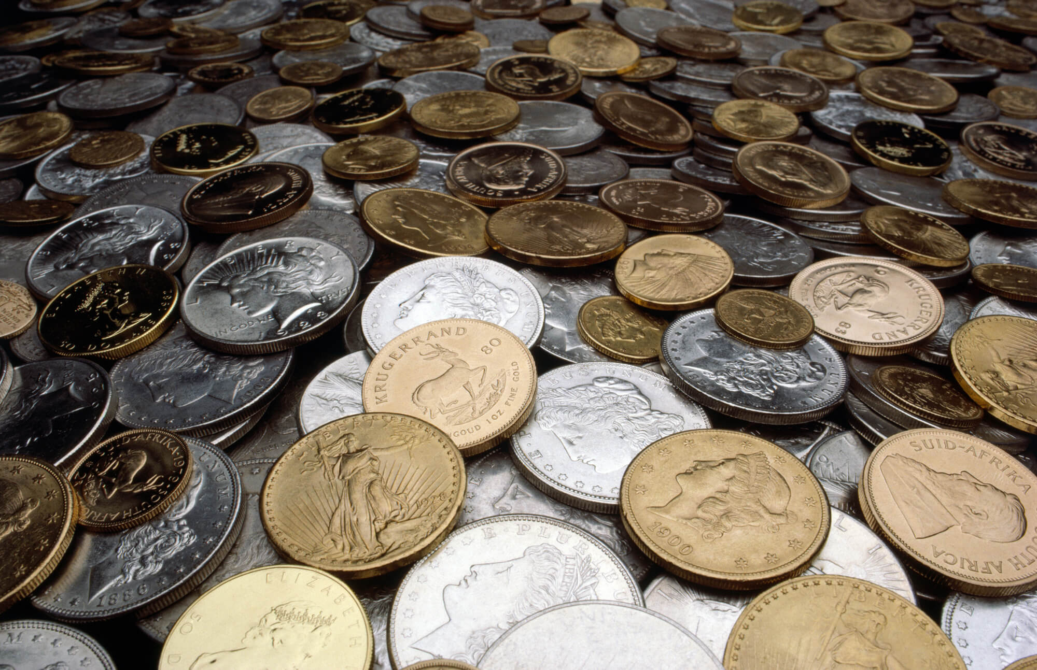
Psalm 119:72
The law from your mouth is more precious to me than thousands of pieces of silver and gold.
1. The law from your mouth.
2. Is precious to me

Slide 30

The Law From Your Mouth… Psalm 119:160
All your words are true; all your righteous laws are eternal.
1. All true
2. Eternal

Slide 31
All True: An Example
Jesus-only baptism: A proof text?
Hermeneutical “rules.”
4. Interpret a passage in its context.
7. Interpret every passage in light of all other relevant passages.
8. All passages on a subject must be studied before a conclusion is drawn.

Slide 32
All Your Words Are True
Q: What New Testament passage might lead to a different conclusion—that true, saving baptism is not “Jesus only?”
Answer: ___________________

Slide 33
Suggestions for New/Strange Teachings:
1. Consider the source.
2. Ask yourself it a passage might be taken out of context, and whether there are other relevant passages. Acts 17:11.
3. Talk to an expert.
Ephesians 4:11-15

Slide 34
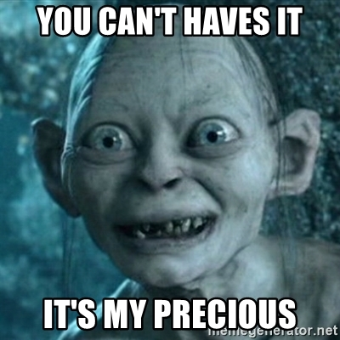
Back to Psalm 119:72
…precious to me.
What is precious to you?
Your spare time
Your health
Your mode of transportation
Your 401-K
Your home

Slide 35
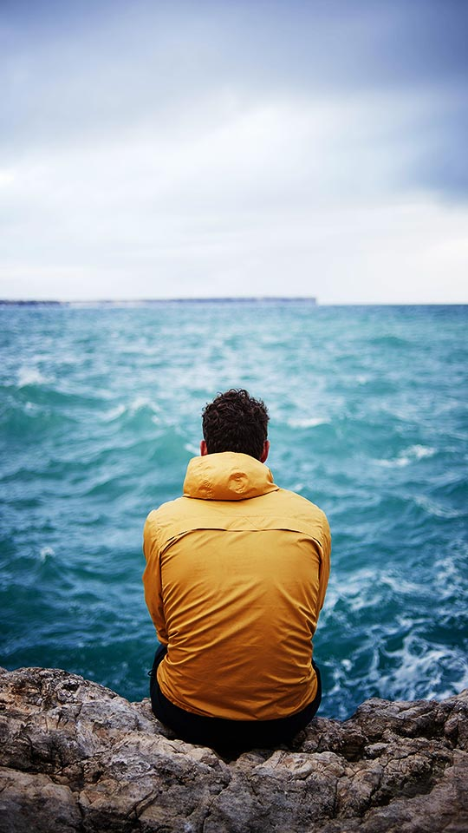
Psalm 119:97
Oh how I love your law!
I meditate on it all day long.
1. I love your law.
2. I meditate on it
all day long.
Suggestion: memorize Scripture

Slide 36
Psalm 119:16
I delight in your decrees: I will not neglect your word.
Are you guilty of neglecting God’s word?
Antidote: 1. Love His Word. 2. Meditate on it all day.

Slide 37
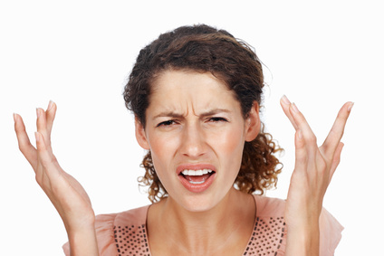
Psalm 119:53
Indignation grips me because of the wicked who have forsaken your law.

Slide 38
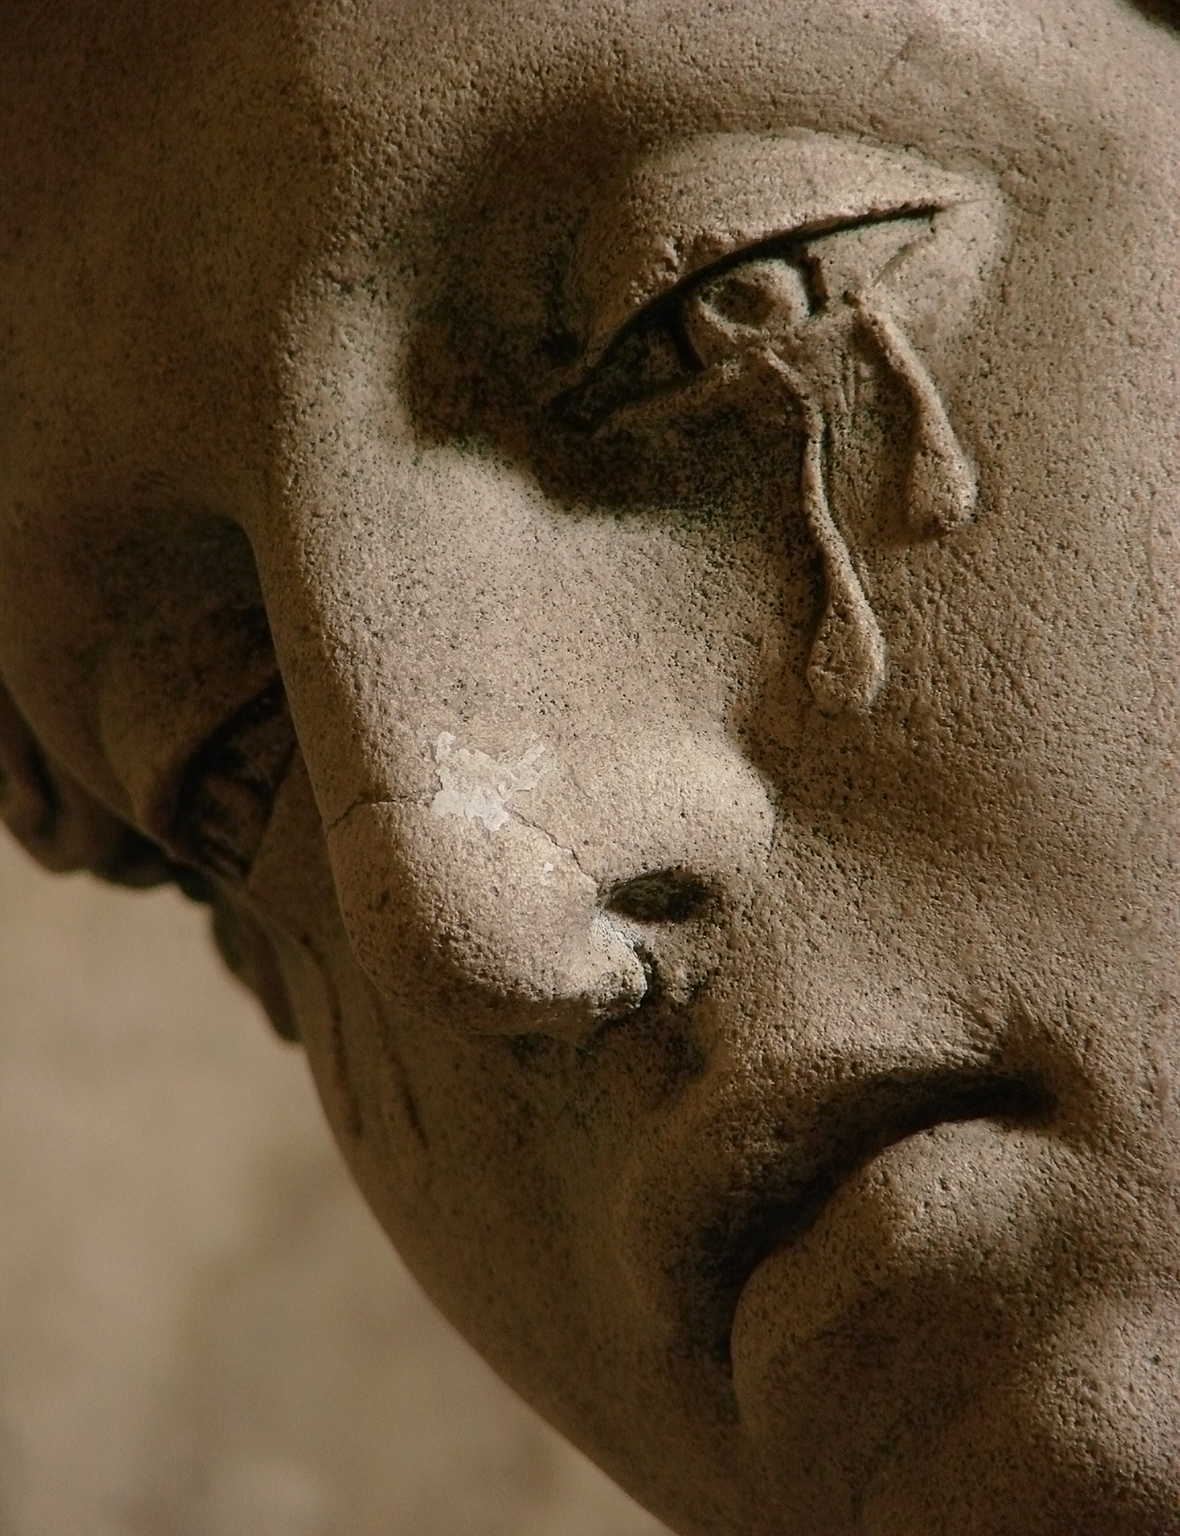
Psalm 119:136
Streams of tears flow from my eyes, for your law is not obeyed.
anger
sadness

Slide 39
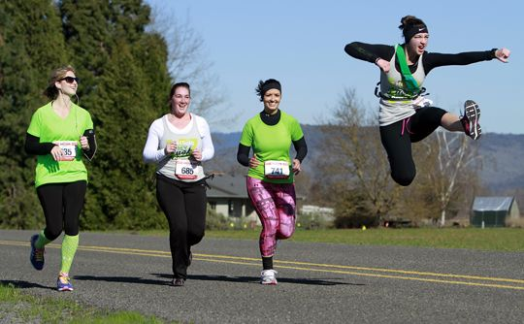
Psalm 119:139
My zeal wears me out, for my enemies ignore your words.
anger
sadness
zeal

Slide 40
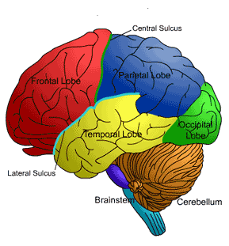
Psalm 119:9
How can a young man keep his way pure? By guarding it according to your word.
Who do I hang with?
What do I read?
What career to pursue?

Slide 41
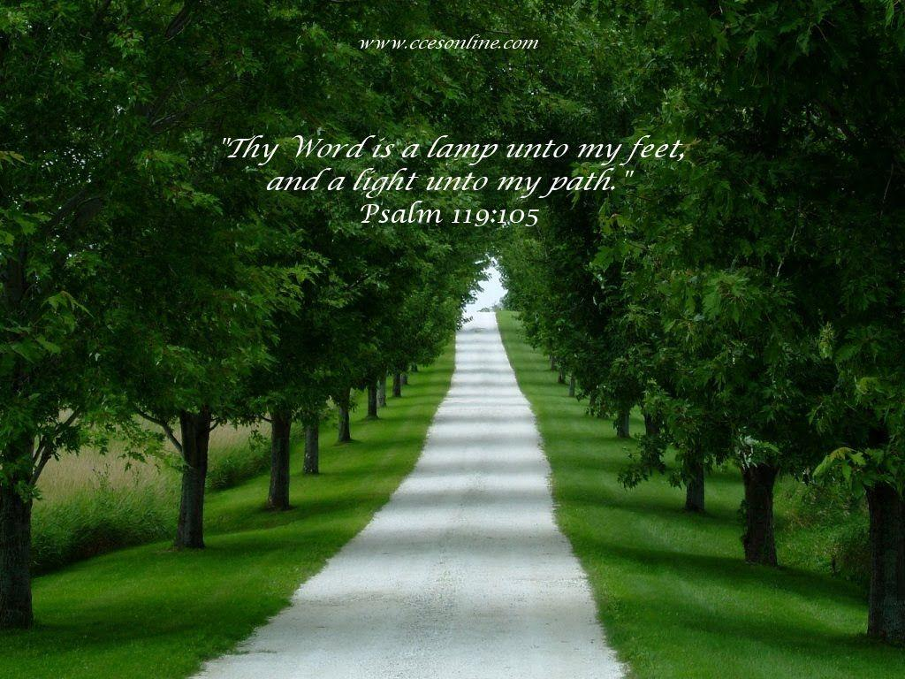
Psalm 119:105
Your word is a lamp to my feet and a light unto my path.
Thy Word

Slide 42
For Those Tears I Died
(362)

Slide 43
You said you’d come and share all my sorrows
You said you’d be there for all my tomorrows
I came so close to sending you away
But just like you promised you came here to stay
I just had to pray

Slide 44
And Jesus said:
“Come to the water, stand by my side
I know you are thirsty, you won’t be denied.
I felt every tear drop
When in darkness you cried,
And I strove to remind you
That for those tears I died.”

Slide 45
Your goodness so great, I can’t understand.
And dear Lord, I know that all this was planned
I know you’re here now, and always will be.
Your love loosed my chains and in you I’m free
But Jesus why me?

Slide 46
And Jesus said:
“Come to the water, stand by my side
I know you are thirsty, you won’t be denied.
I felt every tear drop
When in darkness you cried,
And I strove to remind you
That for those tears I died.”

Slide 47
Jesus, I give you my heart and my soul
I know that without God I’ll never be whole
Savior you opened all the right doors
And I thank you and praise you from Earth’s humble shores
Take me, I’m yours

Slide 48
And Jesus said:
“Come to the water, stand by my side
I know you are thirsty, you won’t be denied.
I felt every tear drop
When in darkness you cried,
And I strove to remind you
That for those tears I died.”
[End]

Slide 49
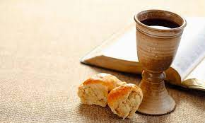
Communion

Slide 50
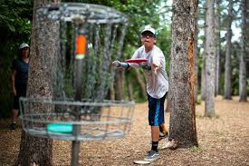
Announcements
Brianna is being baptized today!
Bible Talks back on schedule
Wed 7:00 AM Prayer for Merced
Wed 7:30 PM Midweek Devotional men/women
Fri 6:00 Frisbee golf at Fahrens Park

Slide 51
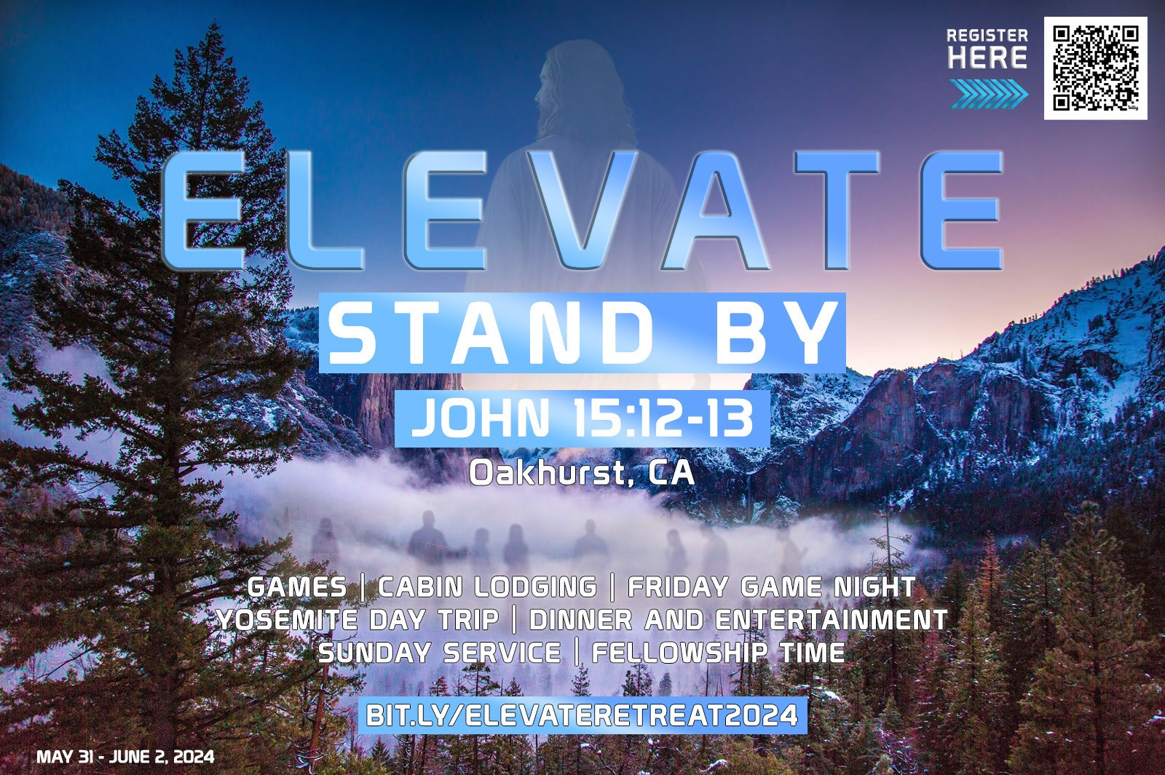
Coming Up
Singles Conference in Oakdale May 31-June 2 Elevate
ICMC Aug 1-4 North Carolina!
Notes:
2-24

Slide 53


Slide 54

Contribution
www.mercedchurch.com click give
Or use the basket
in the back

Slide 55
Take The Lord With You
(733)

Slide 56
You’ve got to take the Lord with you children, everywhere you go
You’ve got to take the Lord with you children, everywhere you go
You’ve got to take the Lord with you children, everywhere you go

Slide 57
In the street
(In the street)
In the home
(In the home)
On the job
(On the job)
All alone
(All alone)

Slide 58
Highway
(Highway)
By the way
(By the way)
Everywhere you go

Slide 59
You’ve got to make disciples daily children, everywhere you go
You’ve got to make disciples daily children, everywhere you go
You’ve got to make disciples daily children, everywhere you go

Slide 60
In the street
(In the street)
In the home
(In the home)
On the job
(On the job)
All alone
(All alone)

Slide 61
Highway
(Highway)
By the way
(By the way)
Everywhere you go

Slide 62
You’ve got to love your brothers daily children everywhere you go
You’ve got to love your brothers daily children everywhere you go
You’ve got to love your brothers daily children everywhere you go

Slide 63
In the street
(In the street)
In the home
(In the home)
On the job
(On the job)
All alone
(All alone)

Slide 64
Highway
(Highway)
By the way
(By the way)
Everywhere you go
[End]

Slide 65
Have a great Jesus week!

