Slide 1


Slide 2
Hannah, A godly mother

Slide 3
1 Sam 1:1-8
v. 2 Peninnah had children, but Hannah had none.
v. 6 the Lord had closed Hannah’s womb.
v. 8 Typically clueless Elkanah: “Hannah, why are you weeping? Don’t I mean more to you than ten sons?”

Slide 4
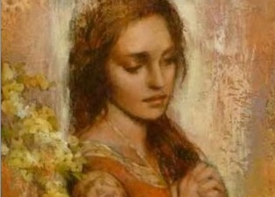
Barren Women in the Bible
Sarah
Rebekah
Rachel
Samson’s mother
Hannah
Elizabeth
God does not want us to be barren

Slide 5
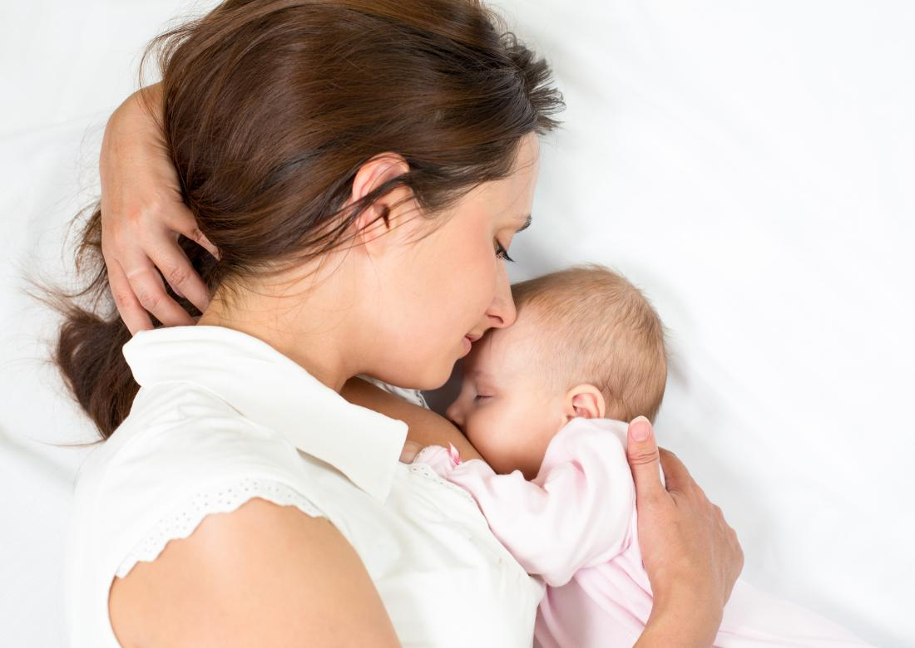
Psalm 113:4-9
God settles the childless woman in her home as a happy mother of children.
Isaiah 49:15-16 Can a mother forget the baby at her breast, and have no compassion on a child she has borne? Though she may forget, I will never forget you.

Slide 6
1 Samuel 1:9-20
v. 10-11 God hears the fervent prayer of mothers.
v. 11 Samuel will be a Nazirite.
v. 20 Samuel: “Heard by God.”

Slide 7
1 Samuel 1:21-28
Hannah loves Samuel, but she loves God more.
Mothers: Can you give your children over to God?
Isaiah 54:1 Sing, barren woman, you who never bore a child; burst into song, shout for joy; because more are the children of the desolate woman than of her who has a husband.
We, too, were desolate, but God gave us children.

Slide 8
1 Sam 2:1-11 Hannah’s Prayer
God lifts the lowly
God helps his faithful servants

Slide 9
Samuel: A Prefigure of the Messiah
1 Sam 2:34-35 Like Jesus, a faithful priest.
1 Sam 3:19-21 Samule a priest, a prophet and a king/judge.
All because a mother loved God even more than she loved her son.
Mom’s: Your sacrifice is not in vain!

Slide 10
Isaiah 54:1-5
God wants you to be a spiritual mom or dad.
He will enlarge your tent.
He will lengthen your cords.
He will give you many descendants.
Thanks, Mom!!!

