Slide 1
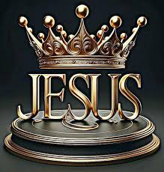
Royal Psalms: Psalm 110
King Jesus!

Slide 2
Psalm 2:1-6 King Jesus Reigns
v. 1-2 The people plot in vain.
Revelation 12:4-5 a child who will rule all the nations with an iron sceptre.
v
v. 3 The world says: “Let us break their chains.”
v. 5 The kings of the earth rise up… against the Lord and against his anointed.

Slide 3
Psalm 2 Fulfilled: Acts 4:1-31
They were greatly disturbed because the apostles were teaching the people.
It is by the name of Jesus Christ of Nazareth!

Slide 4

Psalm 118:22-24
The stone you builders rejected has become the cornerstone

Slide 5
Stop Preaching!!!
Salvation is found in no one else!!!
…they were unschooled, ordinary men. But…
They had been with Jesus!!!
Do not speak or teach at all in the name of Jesus
Mistake city!
We cannot help speaking about what we have seen and heard.
v. 29 Enable your servants to speak your word with great boldness.

Slide 6
Psalm 2:7-12 King Jesus
Ps 2:7 You are my son. Today I have become your father.
Acts 13:33-35
Psalm 16:10 You will not let your faithful one see decay.
Psalm 89:3-4, 35-37 I have sworn to David my servant, “I will establish your line forever.”

Slide 7
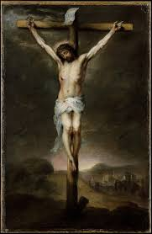
Psalm 22 They killed King Jesus, But…
v. 1 My God, my God, why have you forsaken me?
Psalm 31:5 Into your hands I commit my spirit.
v. 7-8 They mock me and hurl insults at me.
v. 14-18 They have pierced my hands and my feet.
They divide my garments among them, and cast lots for my clothing.

Slide 8
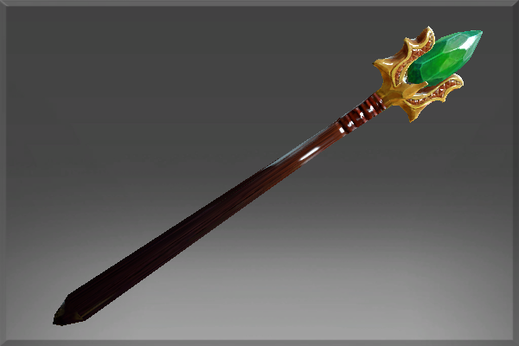
Psalm 110
The Lord (father) said to my Lord (Son, Jesus, Messiah) Sit at my right hand…
The Lord will extend your mighty scepter from Zion.

Slide 9
Psalm 110:3
Your troops will be willing on your day of battle. Arrayed in royal splendor.
Are you ready and willing?

Slide 10
Psalm 110:4
You are a priest forever in the order of Melchizedek
(Hebrews 7)
Jesus is Priest and King
Let us “speak God’s word with great boldness
Let us stand with Priest and King Jesus

Slide 11
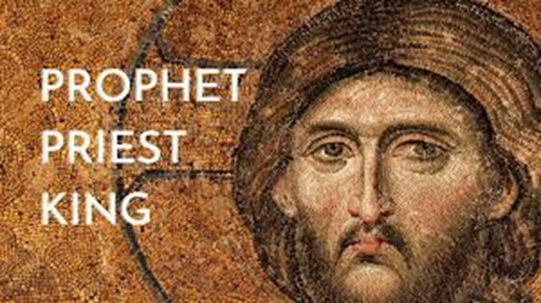
The nations conspire and the people plot in vain.
Let us stand with King Jesus.
Let us sit with High Priest Jesus

