Slide 1

Proverbs III: Wisdom For Relationships
What kind of person do you want to be?

Slide 2

Our Outline: Categories
I. Wisdom, generally
II. Self-discipline
III. Laziness, finances
IV. Pride vs. Humility
V. Taking council and advice.
VI. Relationships
VII. The Poor

Slide 3

Wisdom
Prov 1:7 Fear is the beginning of wisdom/knowledge.
Do you respect God?

Slide 4
Wisdom in our plans
Prov 14:12, 16:25 There is a way which seems right, but in the end it leads to death.
Prov16:3 Commit to the Lord whatever you do, and he will establish your plans.
Self-Discipline
Prov 16:32 Better a patient person than a warrior, one with self-control than one who takes a city

Slide 5

Don’t Be a Sluggard!
Prov 6:6-11 Go to the ant you sluggard!
Prov 12:11 Do not chase fantasies

Slide 6
Proverbs and Wealth
Proverbs 13:11 Dishonest money dwindles away, but whoever gathers money little by little makes it grow.
Don’t go for quick money schemes or pie-in-the-sky plans.
Work hard and build wealth slowly.

Slide 7
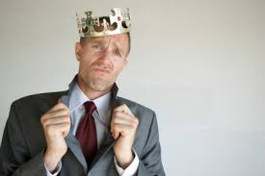
Pride and Humility in Proverbs
Prov 16:18 Pride goes before destruction, a haughty spirit before a fall.

Slide 8
Seeking Advice
Prov 12:1 Whoever loves discipline loves knowledge, but whoever hates correction is stupid.
Prov 12:15 The way of fools seems right to them, but the wise listen to advice.
We need a culture of seeking advice.

Slide 9

As Iron Sharpens Iron…
Prov 27:17 As iron sharpens iron, so one person sharpens another.

Slide 10

Proverbs III Relationships
A. Peace-making
Prov 12:16 Fools show annoyance at once, but the prudent one overlooks an insult.
Are you easily offended?
Prov 15:1 A gentle answer turns away wrath, but harsh words stir up anger

Slide 11
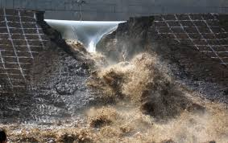
Relationships
B. Stop Quarreling!
Prov 17:14 Starting a quarrel is like breaching a dam: so drop the matter before a dispute breaks out.
Prov 29:22 Are you hot-tempered?

Slide 12
Relationships
Prov 25:15 A gentle tongue can break bone.
George Havins: Gentle pressure, relentlessly applied…

Slide 13
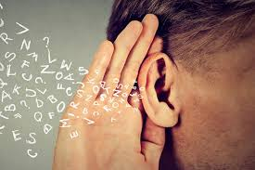
Relationships
C. Listen First!
Prov 17:18 Even fools are thought wise if they keep silent.
Prov 18:2 Fools… delight in airing their own opinion.
Prov 18:13 To answer before listening—that is folly and shame.

Slide 14

Listen First
Prov 29:20 Do you see someone who speaks in haste? There is more hope for a fool than for them.

Slide 15

Relationships
D. Gossip
Prov 18:8 The words of a gossip are like choice morsels, they go down to the inmost parts.

Slide 16
Relationships
E. Advice to wives
Prov 19:13
Prov 21:29
Prov 25:24

Slide 17
Relationships
F. Sarcasm
Prov 26:18-19 Like a maniac shooting flaming arrows of death is the one who deceives their neighbor and says, “I was only joking.”

Slide 18
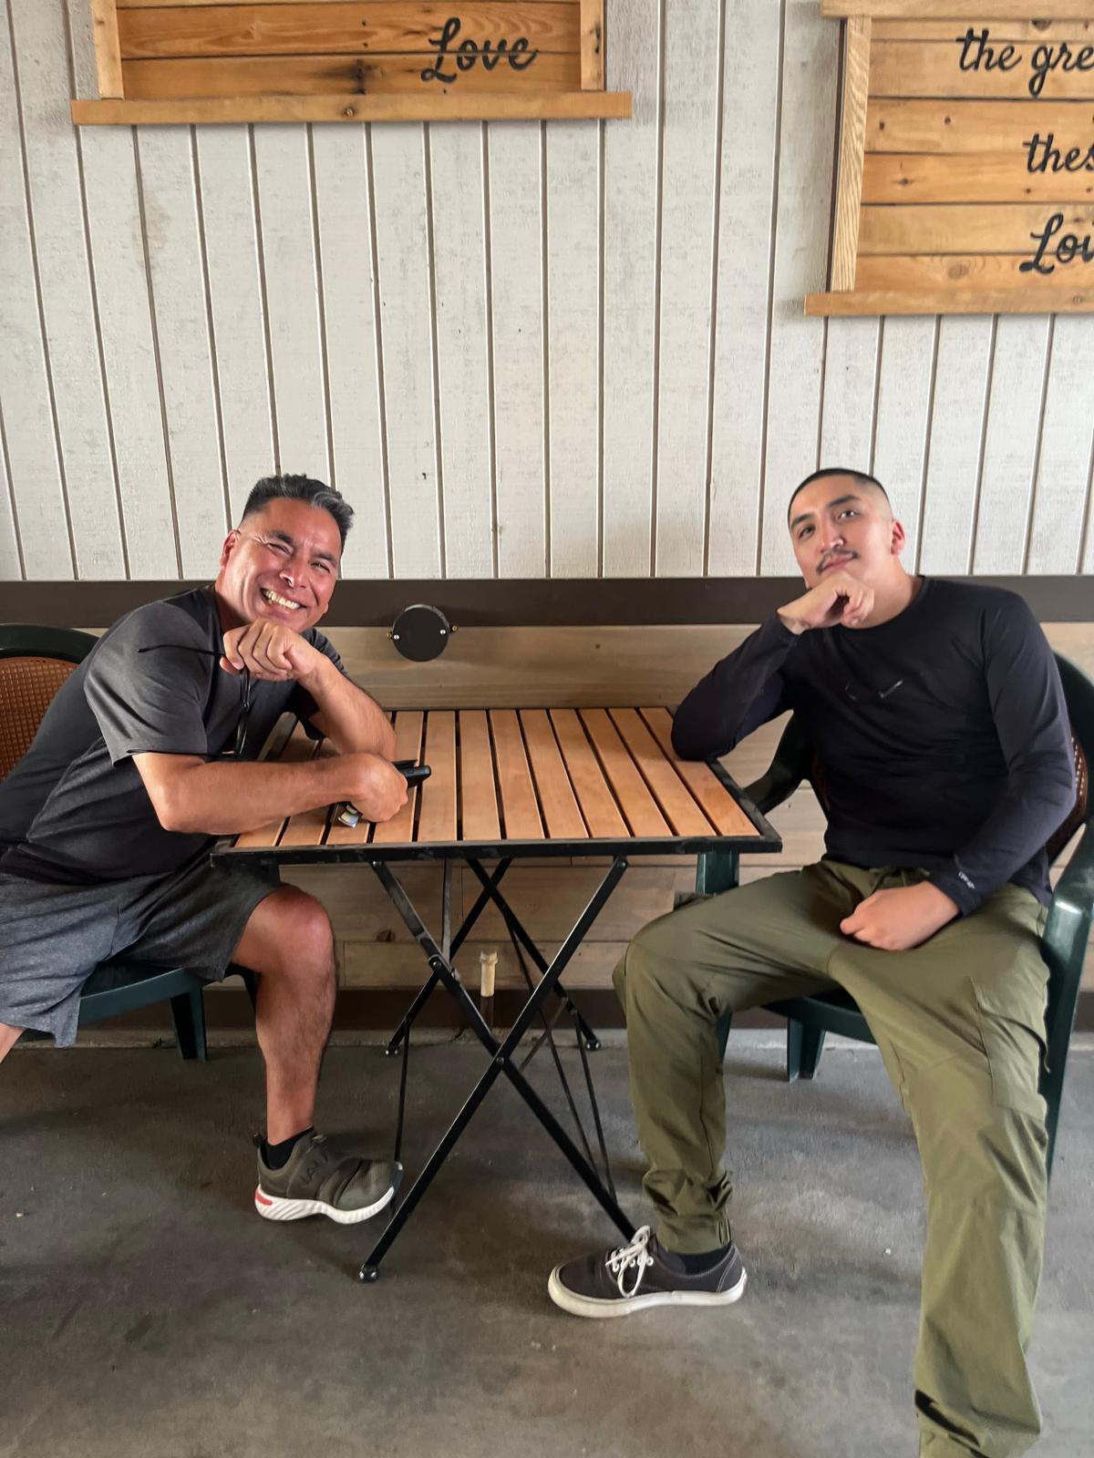
Relationships
G. Friendships
Prov 18:24 One who has unreliable friends soon comes to ruin, but there is a friend who sticks closer than a brother.
Prov 20:6 Many claim to have unfailing love, but a faithful person, who can find.

Slide 19
Relationships: Last Piece of Advice
Prov 18:17 In a lawsuit the first to speak seems right, until someone else comes forward and cross-examines.

Slide 20
Proverbs and the Poor
Prov 14:31 Whoever oppresses the poor shows contempt for their Maker, but whoever is kind to the needy honors God.
Prov. 29:7 The righteous care about justice for the poor, but the wicked have no such concern.
Prov 31:9 Speak up and judge fairly; defend the rights of the poor and needy.

Slide 21
Wisdom From Proverbs
Fear God
Seek God’s will in all major decisions
Live a self-disciplined life
Work hard and build wealth through hard work
Accept correction and seek advice
Do not quarrel—be a peace-maker
Listen
DO NOT GOSSIP
Defend the poor

