Slide 1
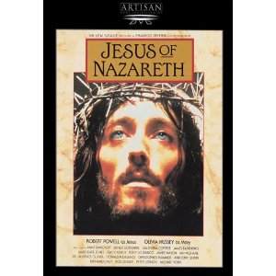
Who Is the Real Jesus?
Dr. John Oakes,
UC Merced
Spring, 2024

Slide 2
Who Was Jesus?
Sage
Prophet
Liar
Crazy person
Messiah
Son of Man
God in the flesh
Legend/Myth
Man (ie. mere man)
An important religious leader among many

Slide 3
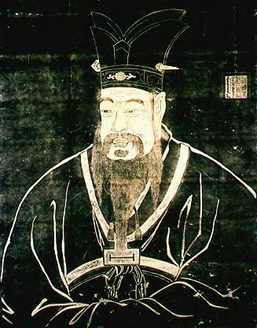
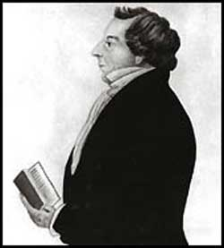
I. Is Jesus just one of many similar religious leaders?
Confucius
Joseph Smith

Slide 4
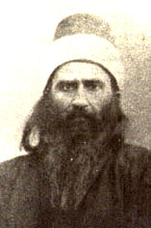
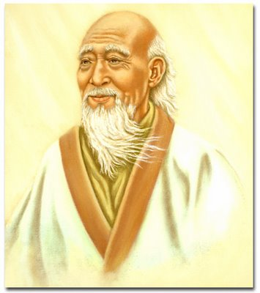
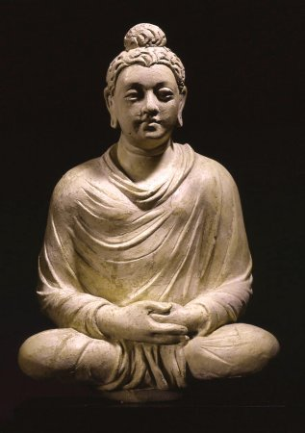
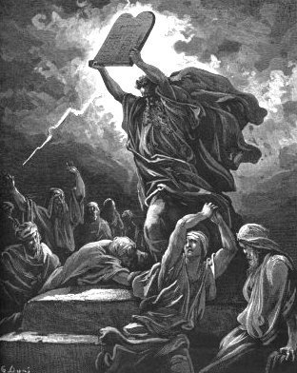
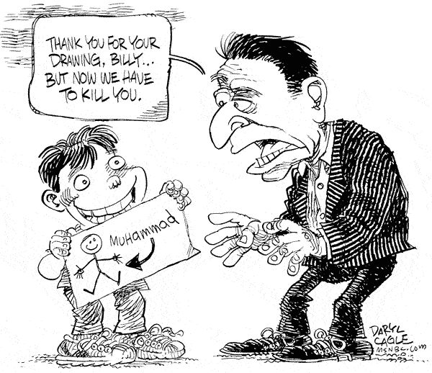
Lao Tzu
Baha’u’llah
Buddha
Moses
Is Jesus a Guru?
A Great Prophet?
One of Many Important Spiritual Leaders?
Muhammad?

Slide 5
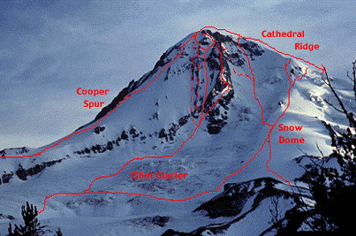
Another Point of View: Different Paths to the Same Goal?
God
Islam
Ba’hai
Mysticism
Buddhism

Slide 6
Our Outline
I. The Claims of Jesus
II. Messianic Prophecies
III. The Resurrection

Slide 7
II. The Claims of Jesus
If we can assume the gospels faithfully record the claims of Jesus then he is either:
  Crazy
  A manipulative liar Or
  The Messiah and Son of God.

Slide 8
Jesus:
“ These are the scriptures that testify about me” John 5:39
Imagine the audacity!

Slide 9
Who Does This Man Think He Is?
The Claims of Jesus
John 6:35, 51 I am the bread of life
Response: They argued among themselves
John 8:46 Can anyone prove me guilty of sin?
Response: Is this guy crazy?
John 8:58 Before Abraham was born, I AM
Response: Picked up stones to stone him.
John 10:30 I and the Father are one.
Response: Picked up stones to stone him.

Slide 10
The Claims of Jesus
John 11:25-26 I am the resurrection and the life
Response (v.45-47, 53) Killed him.
Matthew 28:18 All authority in heaven and earth has been given to me.

Slide 11
Was Jesus Insane?
Mark 3:20-30
His family: “He is out of his mind.” (v. 21)
Rabbis: “He is possessed by a demon.” (v. 22)
Jesus: This is totally illogical
Question: How do crazy people act? Did Jesus act this way?

Slide 12

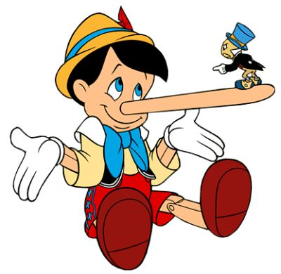
Was Jesus a Liar?
What do liars do?

Slide 13
VIII. Messianic Prophecies
Luke 24:44
He said to them, “This is what I told you while I was still with you: Everything must be fulfilled that is written about me in the Law of Moses, the Prophets and the Psalms.
John 5:39-40
You diligently study the Scriptures because you think that by them you possess eternal life. These are the Scriptures that testify about me, yet you refuse to come to me to have life.

Slide 14
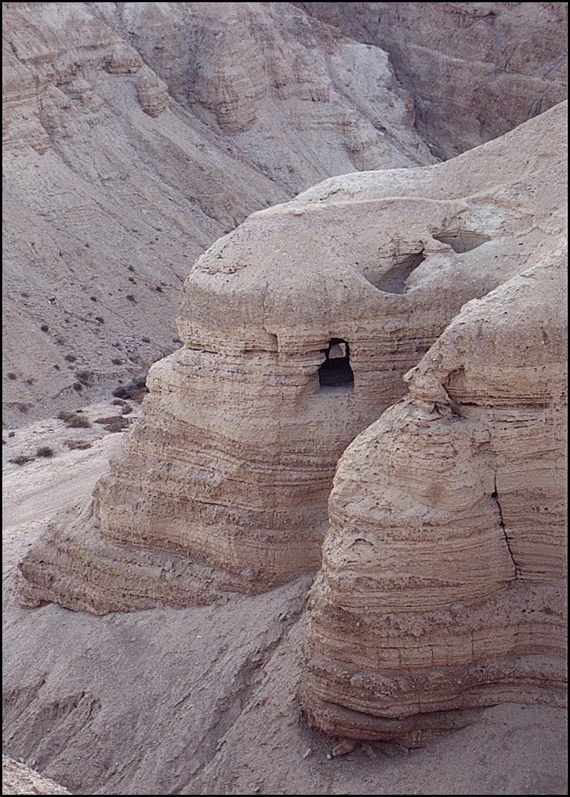
Question #1: Were these prophecies really written hundreds of years before the events?
Septuagint translation of the Old Testament into Greek 220-150 BC
Dead Sea Scrolls.250-50 BC

Slide 15
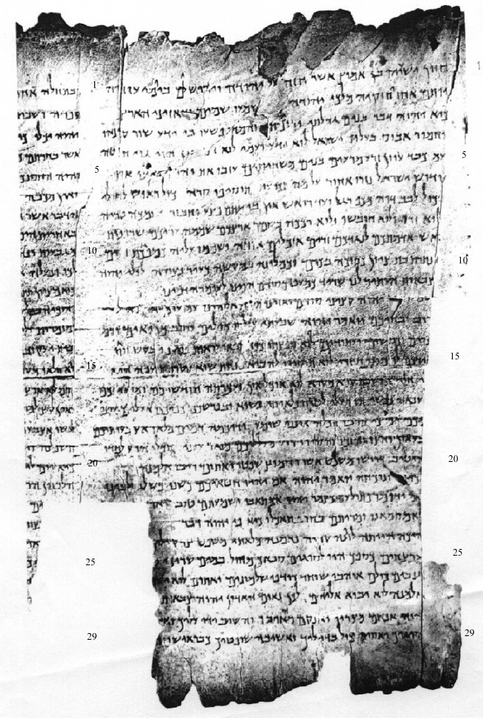
Column I
The Great Qumran Isaiah Scroll
150 BC

Slide 16
Question #2: How do I know these things really happened?
Josephus: “When Pilate, at the suggestion of the principal men among us, had condemned him to the cross, those that loved him at the first did not forsake him… And the tribe of Christians so named from him are not extinct to this day.”
Cornelius Tacitus: “Hence, to suppress the rumor, [Nero] falsely charged with the guilt and punished with the most exquisite tortures, the persons commonly called Christians, who were hated for their enormities. Christus, the founder of the name, was put to death by Pontius Pilate, procurator of Judea in the reign of Tiberius…
Jewish Talmud “On the eve of the Passover they hanged Yeshu and the herald went before him for forty days saying Yeshu… has practiced sorcery and beguiled and led astray Israel.

Slide 17
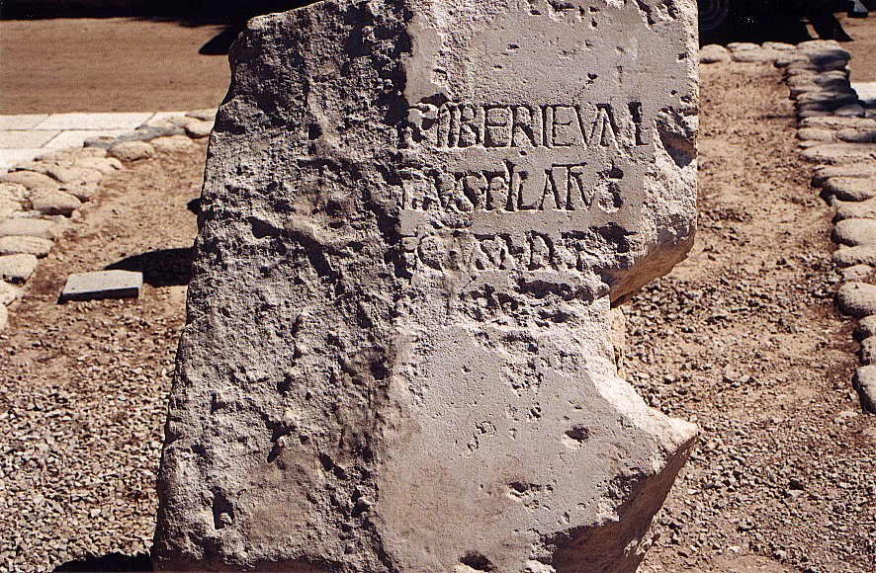
Tiberius Pontius Pilatus Procurator Judea

Slide 18
Question #3 Are these, in fact, prophecies of the Messiah? (or are we taking them out of context)
Hint: If the Jews themselves acknowledged them to be messianic, that is very strong evidence.

Slide 19
Question #4 Could Jesus, planning on deceiving the people into believing he was the Messiah, have read the Old Testament and tried to fulfill all the prophecies?

Slide 20
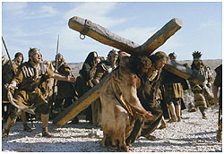

Slide 21
Isaiah 53:1-13:
He was despised and rejected by men, a man of sorrows, familiar with suffering. (v. 3)
But he was pierced for our transgressions, he was crushed for our iniquities; the punishment that brought us peace was upon him, and by his wounds we are healed. (v. 5) (John 19:31-37)
He was oppressed and afflicted, yet he did not open his mouth; he was led like a lamb to the slaughter and as a sheep before her shearers is silent, so he did not open his mouth. (v. 7)

Slide 22
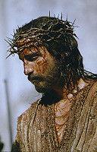

Slide 23
Micah 5:2
But you, Bethlehem Ephrathrah, though you are small among the clans of Judah, out of you will come for me one who will be ruler over Israel, whose origins are from old, from ancient times.
Isaiah 9:1,6
In the past he humbled the land of Zebulun and the land of Naphtali, but in the future he will honor Galilee of the Gentiles, by the way of the sea, along the Jordan…. For to us a child is born… And he will be called Wonderful Counselor, Mighty God, Everlasting Father, Prince of Peace.

Slide 24
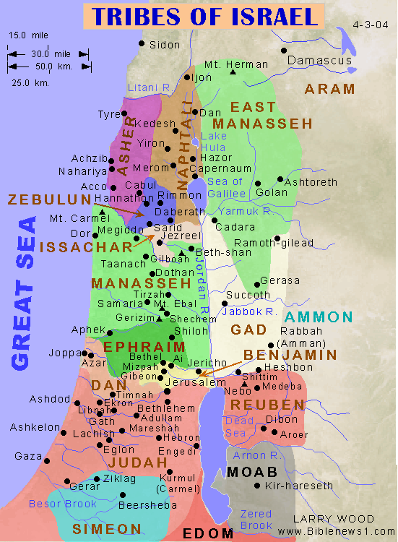

Slide 25
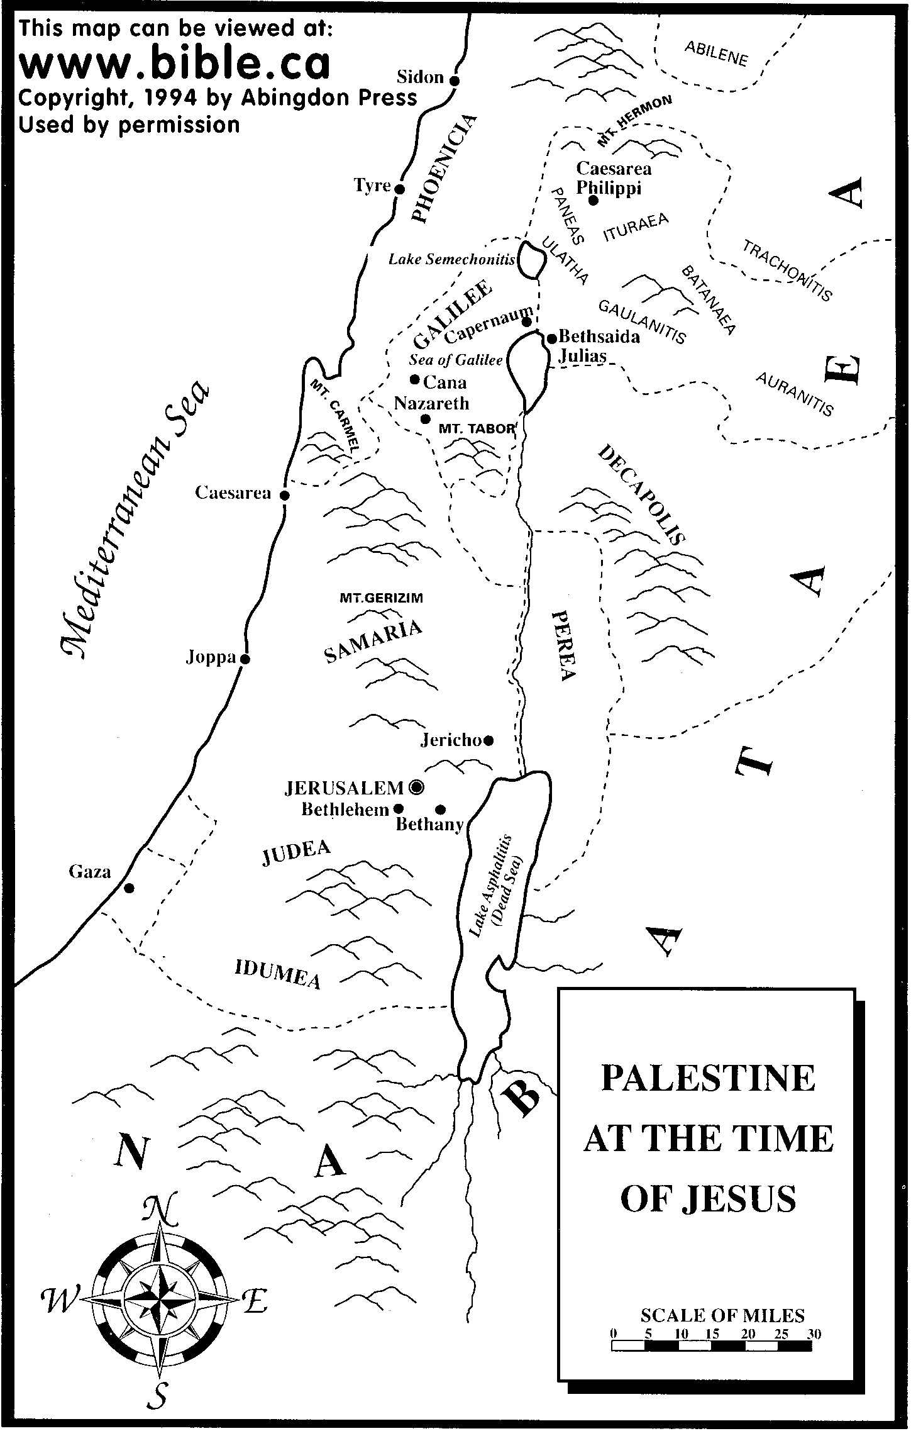

Slide 26
Psalm 22:16-18
Dogs have surrounded me;
a band of evil men have encircled me,
they have pierced my hands and my feet.
I can count all my bones; (John 19:3-37)
people stare and gloat over me.
They divide my garments among them
and cast lots for my clothing. (John 19:23,24)

Slide 27
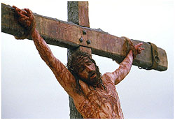

Slide 28
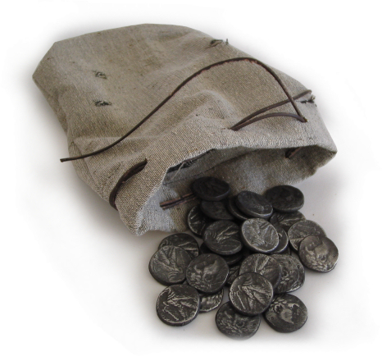
Zechariah 11:12,13
I told them, “If you think it best, give me my pay; but if not, keep it.” so they paid me thirty pieces of silver. (Matthew 26:14-16)
And the Lord said to me, “Throw it to the potter”—the handsome price at which they priced me! So I took the thirty pieces of silver and threw them into the house of the Lord, to the potter. (Matthew 27:3-8)

Slide 29
Daniel 9:24-26
Seventy ‘sevens’ are decreed for your people and your holy city to finish transgression, to put an end to sin, to atone for wickedness, to bring in everlasting righteousness, to seal up vision and prophecy and to anoint the most holy.
Know and understand this: From the issuing of the decree to restore and rebuild Jerusalem, until the Anointed One, the ruler comes, there will be seven ‘sevens’ and sixty two ‘sevens’
Decree of Artaxerxes (Ezra 7:12-26) 458 BC
458 BC - 490 years = -32 (no zero BC)

Slide 30
According to the Old Testament, the Messiah must:
Be born in Bethlehem
Be raised in Galilee near Nazareth
Be despised and rejected by men
Be meek and silent before his accusers
Be “pierced”
Be crucified
Have his garments divided and gambled over
Be betrayed for 30 pieces of silver
Come to Jerusalem to make atonement for sin in about AD 33
And many more….
Was all this an accident, or did God plan all along for the death of Christ for forgiveness of sins? What do you think?
Man, Myth or Messiah?

Slide 31
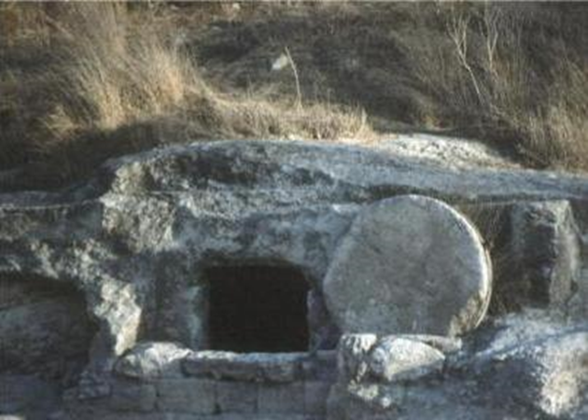
The Resurrection of Jesus from the dead
John 3:19 “Destroy this temple, and I will raise it again in three days.”
Fact: The tomb was empty.
Fact: The resurrection was preached, beginning in Jerusalem.
Fact: There were more than 500 eye-witnesses to the resurrection. 1 Cor 15:3-6.

Slide 32
Fact #1
Jesus of Nazareth was crucified under Pontius Pilate in Jerusalem

Slide 33
Josephus AD 38-100
About this time there lived Jesus, a wise man. For he was one who wrought surprising feats and was a teacher of such people as accept the truth gladly. He won over many Jews and many of the Greeks. When Pilate, upon hearing him accused by men of the highest standing amongst us, had condemned him to be crucified, those who had in the first place come to love him did not give up their affection for him. The prophets of God had prophesied these and countless other marvelous things about him. And the tribe of Christians, so called after him, has still to this day not disappeared.
Antiquities 18:3:3

Slide 34
Cornelius Tacitus approx. AD 114
To squelch the rumor [that he had started the Great fire in Rome], Nero created scapegoats and subjected to the most refined tortures those whom the common people called ‘Christians,’ [a group] hated for their abominable crimes. Their name comes from Christ, who, during the reign of Tiberius, had been executed by the procurator Pontius Pilate.
Annals 15.44

Slide 35
Talmud (1st and 2nd Century AD)
On the eve of Passover they hung Yeshu
Babylonian Sanhedrin 43a-b

Slide 36
Fact #2
From the very beginning, the church unanimously claimed that Jesus was resurrected
Acts 2:24 But God raised him from the dead…
How else to explain the growth of the church?

Slide 37
Fact #3
The tomb was empty
If not….
They could not have preached the resurrection

Slide 38
Fact #4?
1 Cor 15:6 After this he appeared to more than five hundred of the brothers at the same time, most of whom are still living, though some have fallen asleep.

Slide 39
Question:
What is the most reasonable explanation of the facts?
Jesus’ body was taken from the tomb.
Jesus did not actually die (swoon theory).
Jesus was bodily resurrected from the dead.

Slide 40
The Stolen Body Theory
Who would have stolen the body?
  The Jews?
  The Romans?
  The disciples?
Could they have stolen the body?
Did they, in fact, steal the body?

Slide 41
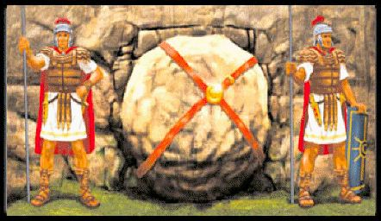
Matthew 27:62-66

Slide 42
The Swoon Theory
Beaten to the point of near death.
No food or water for more than two days.
Crucified and died.
Pierced with a sword.
Separated blood and “water” (plasma)

Slide 43
The Mass Hallucination Theory
The women at the tomb.
Peter and John.
The twelve apostles, including doubting Thomas.
Many other appearances.
Over 500 witnesses.
Do hallucinations eat fish?

Slide 44
The Resurrection Simplifies Things
But what about those who never heard?
But what about the supposed contradiction in the Bible?
Jesus was raised from the dead…..

Slide 45
Conclusion
Because Jesus fulfilled the prophecies of the Messiah and because he was resurrected, the only reasonable conclusion is that Jesus is who he said he is. Messiah, Lord, God-in-the flesh and the one with all authority in our lives.
What is your response?

Slide 46
VIII. Jesus and Miracles
Four Possibilities:
  He neither worked miracles nor claimed to work miracles
  He claimed to work miracles, but he was a charlatan.
  He worked genuine miracles, but as a sorceror/by the power of Satan.
  He worked genuine miracles and his claims about himself are validated by those miracles.

Slide 47
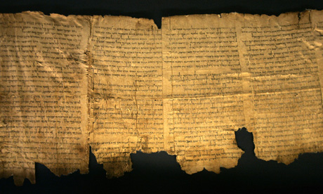
The Jews Expected the Messiah to Give Miraculous Signs
4Q5:21

Slide 48
Reasons to believe Jesus worked miracles
1. A great number of the miracles were done publicly, often in front of the greatest skeptics and harshest critics of Jesus.
2. There were tens of thousands of eyewitnesses from every background to these events.
3. The apostles openly proclaimed that Jesus worked a great variety of miracles during the lifetime of those who could have refuted the claims.

Slide 49
Reasons to believe Jesus worked miracles
4. Both Roman and Jewish histories report at least the general fact that Jesus worked “wonders.”
5. Pharisees and Rabbis did not deny miracles, but instead claimed Jesus did his signs by the power of demons.
6. Those who recorded the miracles as eye-witnesses (the gospel writers except Luke) have every appearance of being credible.

Slide 50
Why Did Jesus Do Miracles?
Because he had compassion. Matt 14:14
To fulfill prophecy. Matt 12:40
To validate his message. John 10:36-39
Because of people’s faith. Matt 15:21-28
To create faith in people. John 20:30-31
Because his mom asked him to. John 2:1-11

Slide 51
III. Jesus and Extra-Biblical Sources
Roman (7)
Jewish (2)
Christian (33)

Slide 52
Cornelius Tacitus approx AD 114
Not all the relief that could come from the man, not all the bounties that the prince could bestow, nor all the atonements which could be presented to the gods, availed to relieve Nero from the infamy of bbeing believed to have ordered the conflagration, the fire of Rome. Therefore, to squelch the rumor, Nero created scapegoats and subjected to the most refined tortures those whom the common people called ‘Christians,’ [a group] hated for their abominable crimes. Their name comes from Christ, who, during the reign of Tiberius, had been executed by the procurator Pontius Pilate. Suppressed for the moment, the deadly superstition broke out again, not only in Judea, the land which originated this evil, but also in the city of Rome, where all sorts of horrendous and shameful practices, from every part of the world converge and are fervently cultivated.
Annals 15.44

Slide 53
Josephus AD 38-100
About this time there lived Jesus, a wise man, if indeed one ought to call him a man. For he was one who wrought surprising feats and was a teacher of such people as accept the truth gladly. He won over many Jews and many of the Greeks. He was the Messiah. When Pilate, upon hearing him accused by men of the highest standing amongst us, had condemned him to be crucified, those who had in the first place come to love him did not give up their affection for him. On the third day he appeared to them restored to life, for the prophets of God had prophesied these and countless other marvelous things about him. And the tribe of Christians, so called after him, has still to this day not disappeared.
Antiquities 18:3:3

Slide 54
Talmud (1st and 2nd Century AD)
On the eve of Passover they hung Yeshu and the crier went forth for forty days beforehand declaring that "[Yeshu] is going to be stoned for practicing witchcraft, for enticing and leading Israel astray. Anyone who knows something to clear him should come forth and exonerate him." But no one had anything exonerating for him and they hung him on the eve of Passover. Ulla said: Would one think that we should look for exonerating evidence for him? He was an enticer and G-d said (Deuteronomy 13:9) “Show him no pity or compassion and do not shield him.” him? He was an enticer and G-d said (Deuteronomy 13:9) "Show him no pity or chow him no pity or compassion,”
Babylonian Sanhedrin 43a-b

Slide 55
Seutonius (about AD 120)
"As the Jews were making constant disturbances at the instigation of Chrestus, he (Claudius about AD 50) expelled them from Rome”

Slide 56
Lucian of Samosata
The Christians, you know, worship a man to this day—the distinguished personage who introduced their novel rites, and was crucified on that account… You see, these misguided creatures start with the general conviction that they are immortal for all time, which explains the contempt of death and voluntary self-devotion which are so common among them; and then it was impressed on them by their original lawgiver that they are converted, and deny the gods of Greece, and worship the crucified sage, and life after his laws.
(Lucian The Death of Peregrine)

Slide 57
Pliny the Younger AD 112
Those who denied that they were or had been Christians, when they invoked the gods in words dictated by me, offered prayer with incense and wine to your image, which I had ordered to be brought for this purpose together with statues of the gods, and moreover cursed Christ — none of which those who are really Christians, it is said, can be forced to do — these I thought should be discharged. Others named by the informer declared that they were Christians, but then denied it, asserting that they had been but had ceased to be, some three years before, others many years, some as much as twenty-five years. They all worshiped your image and the statues of the gods, and cursed Christ

Slide 58
Thallus AD 50
We know of Thallus only from a third century Christian historian named Julius Africanus who wrote a three-volume treatise of world history in the 50s AD. In discussion the darkness at the time of the resurrection of Jesus, Julius Africanus mentions that in the 3rd book of Thallus’ history, he mentions the darkness and calls it an eclipse of the sun. Africanus believes that Thallus is wrong. Whether or not this source proves the darkness at the time of Jesus’ crucifixion is dubious, but it does seem to support the idea that even non-Christians were aware of the resurrection as early as the 50s AD—at about the time the first book of the NT was written. It also supports the claim, not necessarily of the darkness having occurred, but of the darkness having been claimed and believed by the Christians. Because we do not have Thallus’ history and because we have a Christian interpreting rather than quoting it, this is rather dubious support to Christian claims.

Slide 59
Are the Gospel Witnesses Reliable?
Martyrdoms. (Romans 5:6-8)
  James, the brother of Jesus AD 62 (Josephus Ant 20.9.1)
  Apostle James, brother of John (Acts 12:1-2)
  Peter and Paul in Rome about AD 64
  Tradition: all but John
Compare to the Book of Mormon.
  Three witnesses
  Eight witnesses

Slide 60
Reliability of the Gospel writers
The embarrassment factor.
Written and read in Jerusalem when could be refuted.
Galatians AD 49 1 Corinthians AD 55 Mark AD 60?
Luke the historian.

Slide 61
Sir William Ramsay
I found myself brought into contact with the Book of Acts as an authority for the topography, antiquities, and society of Asia Minor. It was gradually borne upon me that in various details the narrative showed marvelous truth. In fact, beginning with a fixed idea that the work was essentially a second century composition, and never relying on its evidence as trustworthy for first century conditions, I gradually came to find it a useful ally in some obscure and difficult investigations.
Luke is a historian of the first rank; not merely are his statements of fact trustworthy; he is possessed of the true historic sense; he fixes his mind on the idea and plan that rules in the evolution of history, and proportions the scale of his treatment to the importance of each incident. He seizes the important and critical events and shows their true nature at greater length, while he touches lightly or omits entirely much that was valueless for his purpose. In short, this author should be placed along with the very greatest of historians.
Sir William Ramsay, St. Paul, the Traveler and the Roman Citizen, (Hodder and Stoughton, 1920).

Slide 62
VI. The Jesus Myth Myth
Is the biblical Jesus an interpolated “Christian” myth?
Adonis (Greek)
Osiris (Egypt)
Tammuz (Egypt)
Dionysus (Greek)
Mithra (Persia)
Krishna (India)
Appolonius of Tyana
Peregrinus
Empodocles
Attis
Hercules
Romulus
Baal

Slide 63
Osiris
An Egyptian god/man. Very obviously a mythical figure.
Killed by his brother. Body cut up into 13 pieces. His wife Isis reassembles and sews back together 12 of the 13 pieces (see the parallel to the apostles?) He comes back to life and goes to rule in the underworld to judge the living and dead.

Slide 64
Appolonius of Tyana
A miracle worker. A Pythagorean in the city of Tyana in 1st century AD. Saves a friend in Corinth. Predicts a plague in Ephesus. Says: stone this beggar to death to end the plague. The do so, and when they remove the stones they find a large dog alive and well. Appolonius disappears and is never seen again.
No death. No resurrection. No ascension.
Only one very unreliable source. 100+ years after he died. No eye witness testimony. Which story is mythical?

Slide 65
Christian Myths
Acts of Peter (3rd century) Peter squares off with Simon Magus. A dog tells Simon Magus to repent. Jesus raises a smoked fish to life.
Gospel of Thomas. Jesus works whacky miracles as a baby which seem quite silly. Jesus kills a child for carelessly bumping into him.
There is nothing like this is the New Testament.

