Slide 1
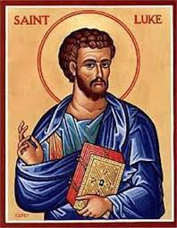
Luke

Slide 2
Recap
Jesus enters Jerusalem!
Weeps over Jerusalem because they will reject him
Jesus schools the Pharisee’s scribes, and Sadducee’s
They plan to kill him

Slide 3
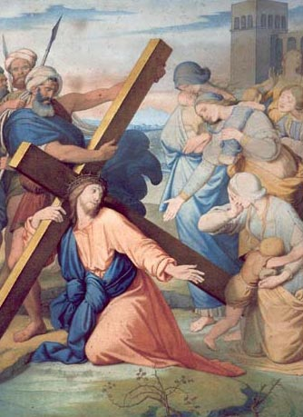
Luke 23:26-35
Jesus tells “women mourn for yourselves, not me”
If this happens to the innocent, what about the guilty?
“Father forgive them”
What if we prayed harder than we condemned?

Slide 4
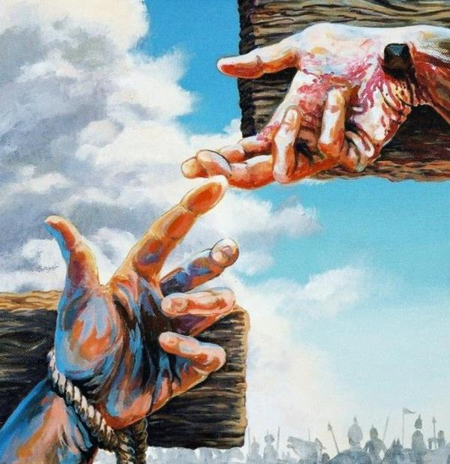
Luke 23:39-43
Both criminals mocked Jesus (Matthew 27:44)
But the penitent was humbled by Christ’s example
He saw a King when he saw himself differently
How do you see Jesus?

Slide 5
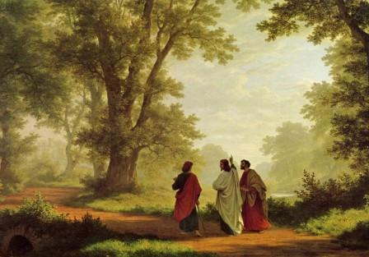
Luke 24:13-35
Is Jesus a stranger to you?
The disciples expected a conqueror
Is our hope misplaced?
Jesus desires intimacy with us! Rev 3:21

Slide 6
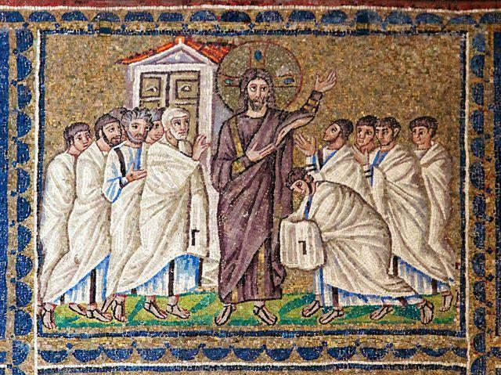
Luke 24:36-50
Jesus brings peace to us
His scars are his testimony!
Look at the price for our peace
Do we need fresh eyes?

Slide 7
Closing
Jesus set out resolutely to die in Jerusalem
Q: Will we go with him?
Jesus gives his disciples the mission to bring the gospel to all nations.
Q: Will you go for him?

