Slide 1
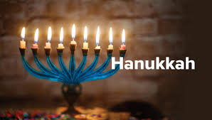
Jesus and Hanukkah

Slide 2
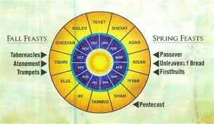
Old Testament Festivals
Seven-day festivals:
Unleavened Bread
Tabernacles
One-day festivals:
Passover
Firstfruits
Pentecost
Trumpets
Day of Atonement

Slide 3
Mosaic Covenant Festivals as Types
Jewish Festival
Christian Antitype
Passover (pesach)
The Sacrificial Death of Jesus
Feast of Firstfruits
The Resurrection of Jesus
Feast of Unleavened Bread
Celebrate Being Free of Sin
Feast of Weeks/Pentecost
Harvest/Holy Spirit
Feast of Trumpets
Judgment Day, Jesus’ Return
Day of Atonement (yom kippur)
Atonement through Christ
Feast of Booths (Tabernacles)
Celebrating God dwelling in us The Holy Spirit

Slide 4
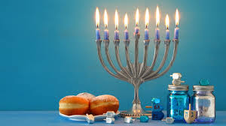
John 10:22-24 Jesus at the Feast of Dedication
Jesus is the antitype to the Feast of Dedication.
Hanukkah
Celebrates the rededication of the temple on 25th of Chislev (December, 164 BC)

Slide 5
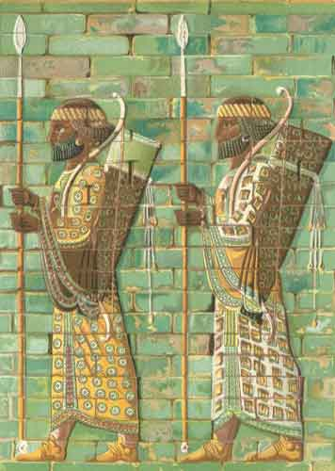
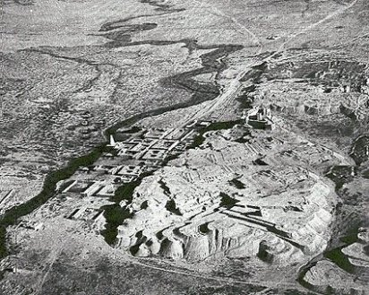
Daniel Chapter Eight: A Ram and a Goat
Ancient Susa: the Ulai Canal

Slide 6
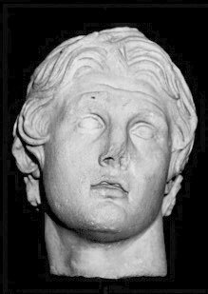
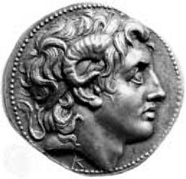
Alexander the Great

Slide 7
The Four Horns of Daniel Seven
Horn (King) | Territory Ruled
Antigonus | The East. From Syria to India.
Cassander | The West. Macedonia and Greece.
Lysimachus | The North. Thrace and Asia Minor.
Ptolemy | The South. Egypt and Palestine.

Slide 8
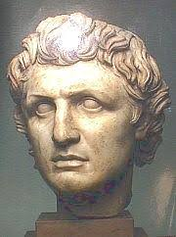
Out of one of these horns…
Seleucus I Nicator 321-285 BC
South: Syria
East: Persia
Beautiful Land:
Canaan

Slide 9
Daniel’s Prophecy Fulfilled
1 Maccabees 1:46-47 sacrifices banned, pigs slaughtered in temple, death for circumcision of children.
1 Maccabees 1:57-58, 60, 62 The Abomination of Desolation. Antiochus Epiphanes. Many stood firm.
1 Maccabees 2:42 The Hasidim/Pharisees

Slide 10
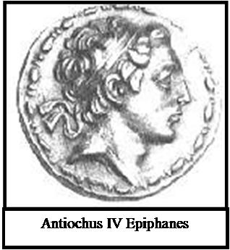
Daniel 8:14 The Abomination of Desolation
How long?
2300 Evenings and Mornings = 1150 days
Nov 167 BC – Dec 25, 164 BC = 1150 days

Slide 11
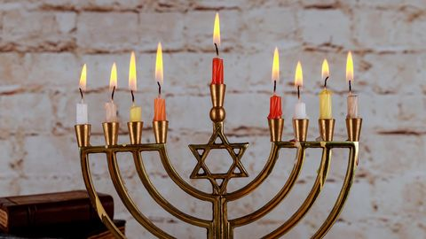
Hanukkah: God Saves His People
What is Hanukkah about? It is about God saving his people.
Judas Maccabeeus is a prefigure of the Messiah.
He defeated Antiochus Epiphanes, and rededicated the temple.
His people are raised from the dead on the 8th day.

Slide 12
John 10:24-39
v. 24 If you are the Messiah, tell us plainly.
v. 25, 32, 38 Believe the miracles/signs!
v. 28 I give them eternal life.
v. 30 I and the Father are One!
John 10:34-36 A surprising argument. Psalm 82:6

Slide 13
Jesus Fulfills Hannukah/Dedication
John 10:36 Jesus: I am the one whom the Father has set apart (dedicated)
1. I am the one dedicated to God.
2. I am God’s Son.
3. The Father is in me and I am in the Father. I am God.

Slide 14
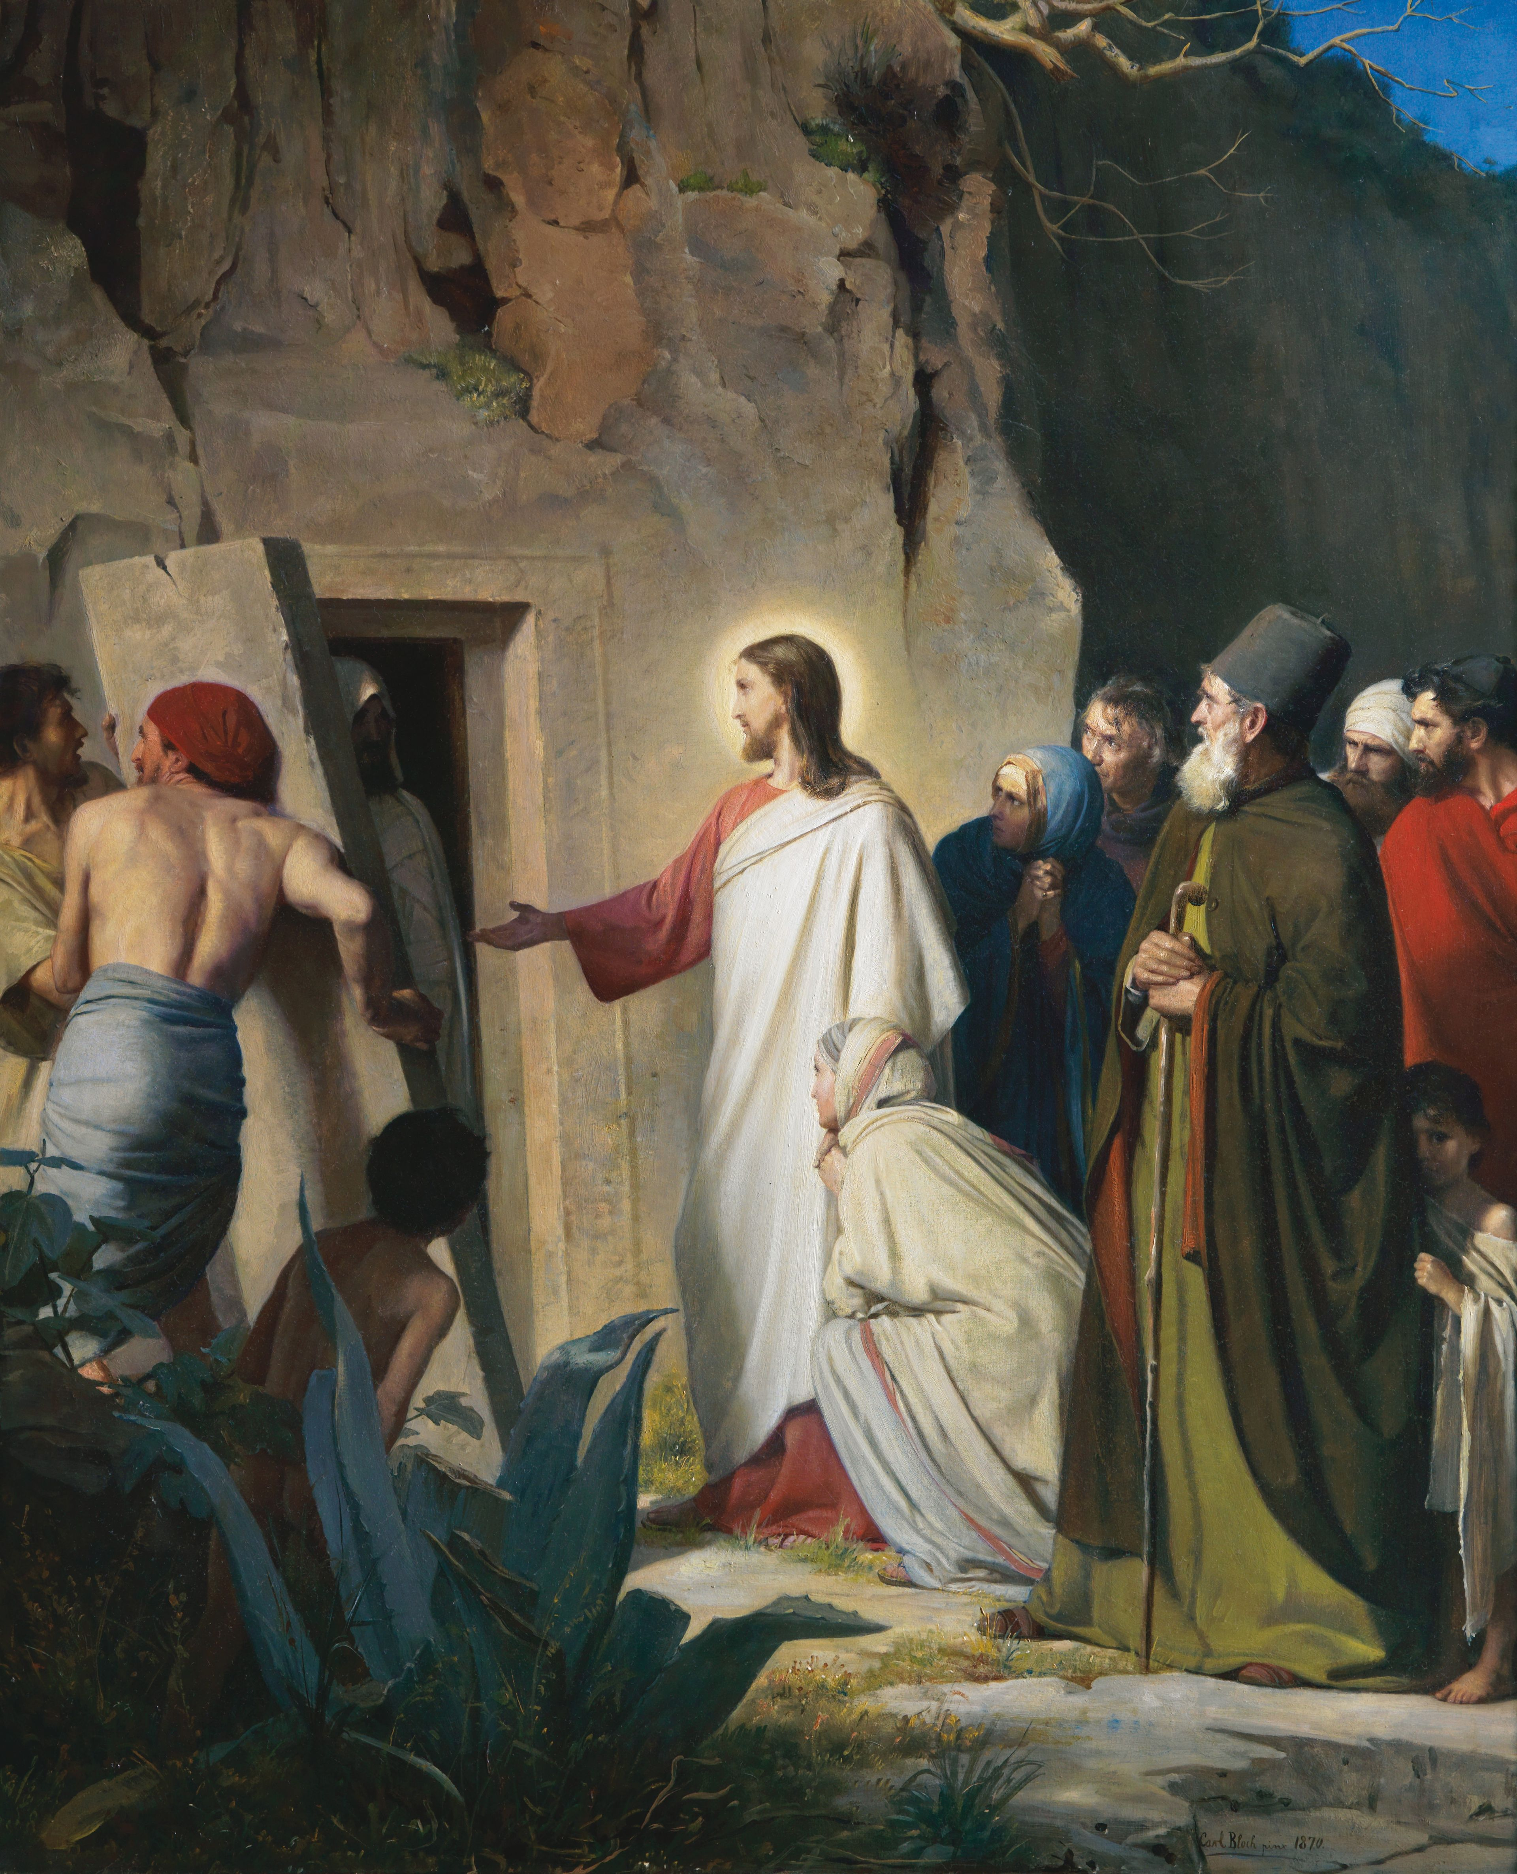
John 11 Look what Jesus did next!
Jesus fulfills the expectation of Hanukkah:
Jesus is the one dedicated to God.
Like Jacob Maccabeeus, Jesus will bring his people back from the dead. John 11:25

Slide 15
What Do We Learn From Hanukkah/Feast of Dedication?
Jesus celebrated Hanukkah.
God is in control.
God will save and resurrect his people.
Jesus fulfills the expectation of Hanukkah/Dedication.
Jesus gives eternal life
Jesus is God’s Son. Jesus is Messiah. Jesus is God

