Slide 1
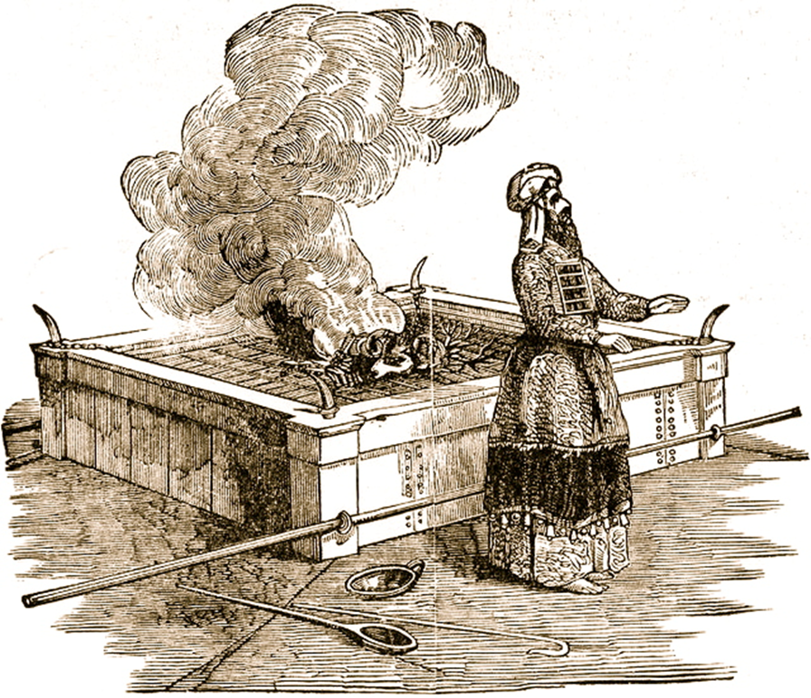
Leviticus II Offerings and Sacrifices
(cont.)

Slide 2
Leviticus
Name means priesthood-book
Theme verse:
Leviticus 11:45 I am the Lord who brought you up out of Egypt to be your God; therefore be holy because I am holy.

Slide 3
Sacrificial Type and Antitype
Old Testament Sacrifice
New Testament fulfillment
Scriptures
Sweet Savor Sacrifices
The Burnt Offering
Jesus’ and our devotion to God
Ephesians 5:1,2 Romans 12:1,2
The Grain Offering
Giving back to God
Matthew 6:19-21
Romans 8,9
The Drink Offering
Pouring out our life for God
Luke 22:20 Philippians 2:16
The Fellowship Offering
Celebrating blessings from God
John 10:10
1 Thess 5:16
Blood Sacrifices
The Sin Offering
Jesus’ sacrifice for our sins
1 Peter 1:18,19
2 Cor 5:21
The Guilt Offering
Maintain relationship with one another
Matthew 5:23,24

Slide 4
Outline of Leviticus
Ch 1-7 The five main sacrifices
Ch 8-10 The Levitical Priesthood
Ch 11-22 The Laws of Moses
Ch 23-25 The Sabbath and Festivals
Ch 26 Punishment and Reward
Ch 27 More laws.
Not covered: The Tabernacle

Slide 5
Gifts/Offerings/Sweet Smelling Sacrifices
The Burnt Offering olah Leviticus 1
The Grain Offering minchah Leviticus 2
The Drink Offering nesek Leviticus 23
The Fellowship Offering shelem Lev 3

Slide 6
The Drink Offering
Exodus 29:41, Leviticus 23:13, Numbers 28:31
Drink Poured out on the altar.
Application: Pouring out our life on the altar.
Usually given on top of the grain offering.
Application: We give our tithe, but God wants much more. He wants us to be “all in.”

Slide 7
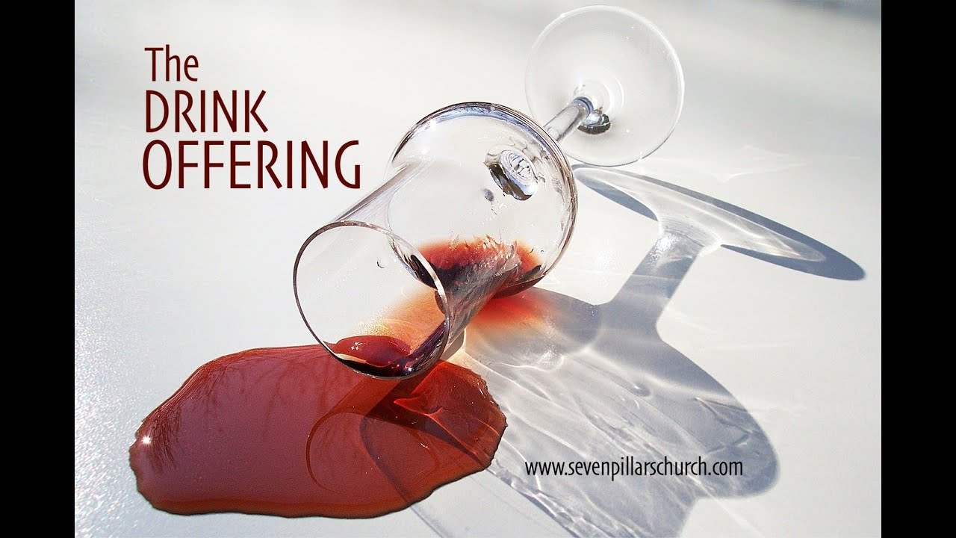
The Drink Offering
Jesus gave a drink offering Luke 22:20
Paul gave a drink offering Phil 2:16-17 2 Tim 4:6-8
The greatest joy comes from giving a drink offering.

Slide 8
The Fellowship Offering
Party Time!!!!! Celebrate the blessings of God.
Voluntary
Vow Offering Leviticus 11:16
  Blessings hoped for Future
Thank Offering Leviticus 7:11-15
  Blessings already received. Past
FreeWill Offering Leviticus 22:23
  Thankful for blessings in general Present

Slide 9
Blood Sacrifices
Hebrews 9:13-14
No sacrifice for willful sin! Leviticus 4:1,13-14 (Heb 10:26)
The Sin Offering chatat Leviticus 4:1-5:13
  For sins against God
The Guilt Offering asham Leviticus 5:14-6:7
  For offenses against a fellow Jew

Slide 10
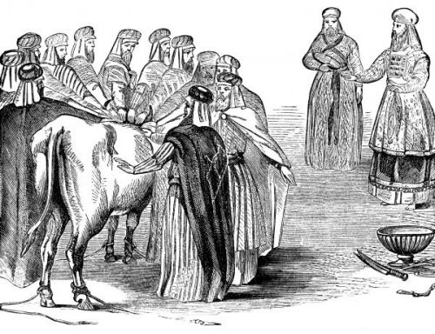
The Sin Offering Lev 4:1-5:13
Unblemished bull or goat (like Jesus)
Offender laid their hands on the animal (God put our sins on Jesus on the cross) Isaiah 53:6

Slide 11
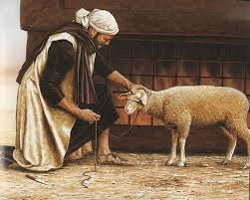
The Sin Offering (cont.)
Offender killed the animal. (We killed Jesus) Matt 27:25
Blood sprinkled on the altar, as well as on the curtain.
Body burned outside the camp (like Jesus) Heb 13:11-13

Slide 12
The Guilt Offering Lev 5:14-6:7
Only for offenses of individuals, not groups.
Did not cover willful sin against another
Offender must make restitution first before bringing the sacrifice. Lev 5:16 (Matthew 5:23-24)
Is 53:10 Jesus offered himself as a guilt offering.

Slide 13
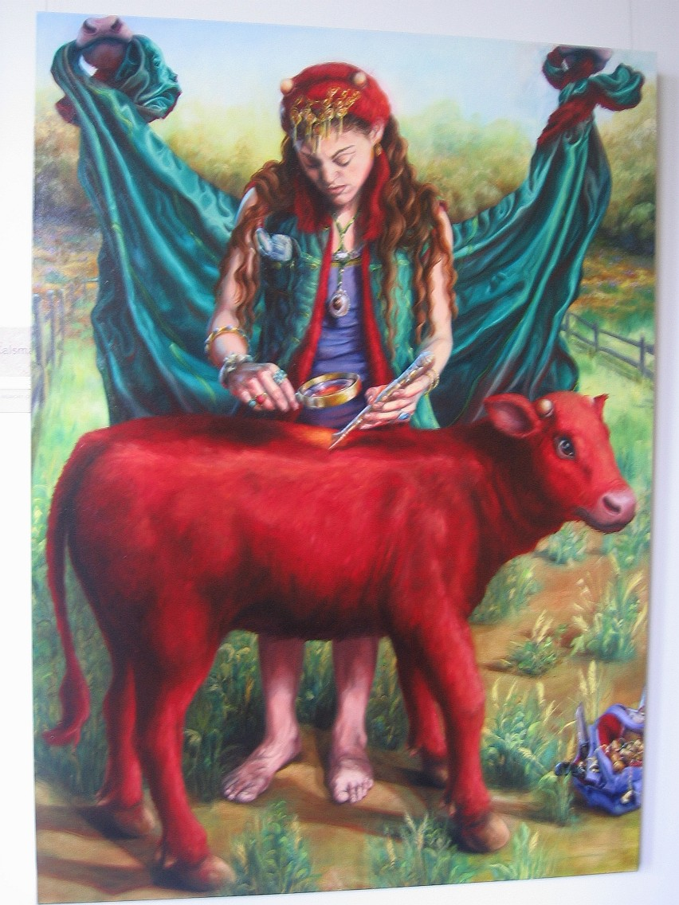
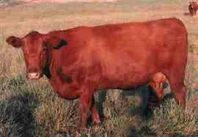
The Red Heifer Sacrifice
Numbers 19:1-22

Slide 14
The Red Heifer Sacrifice as a Prefigure
The Red Heifer Sacrifice | The Sacrifice of Jesus
A very rare red heifer | A unique son
Sacrificed outside the camp (on the Mount of Olives) | Sacrificed outside the camp (on the Mount of Olives)
To purify both Jews and Gentiles | To purify both Jews and Gentiles
A sacrifice without blemish (not even one black hair!) | A sacrifice without blemish
Never been yoked (voluntary, not sinned) | A voluntary sacrifice, without sin
Scarlet wool and wood | Blood on wood
Hyssop (purification from infection) | Purifies from the infection of sin
Combines ashes from sacrifice with water for purification. | Combine the blood of Jesus with baptism for purification

Slide 15
A Better Sacrifice
Hebrews 9:23 It was necessary, then, for the copies of the heavenly things to be purified with these sacrifices, but the heavenly things with better sacrifices than these.
The lesser sacrifice: Bulls, goats, red heifer | The greater sacrifice: Jesus
Outward (appearance) | Inward (reality)
Temporary, repeated many times | Eternal, done only once for all.
Ceremonial | Real
Not voluntary | Voluntary

Slide 16
A Better Sacrifice
Hebrews 10:19-22 Enter God’s presence with confidence.
Let us give a burnt offering
Let us give the required grain offering sacrificially
Let us give a drink offering
Let us give a fellowship offering
Let us be grateful for the sin and the guilt offering of Jesus. It is a better sacrifice!

