Slide 1
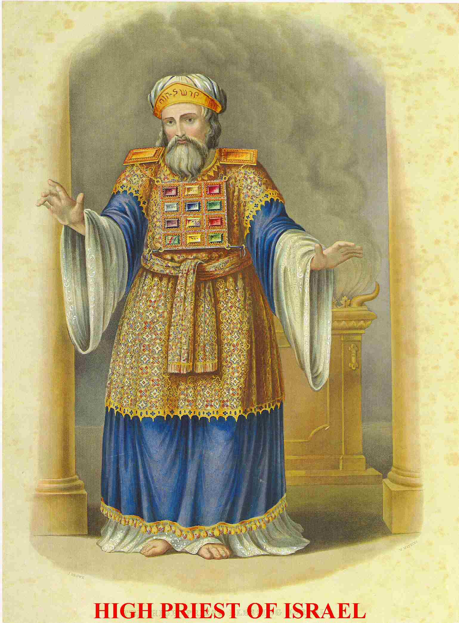
Leviticus IV: The High Priest

Slide 2
Leviticus
Theme verse:
Leviticus 11:45 I am the Lord who brought you up out of Egypt to be your God; therefore be holy because I am holy.

Slide 3
Outline of Leviticus
Ch 1-7 The five main sacrifices
Ch 8-10 The Levitical Priesthood
Ch 11-22 The Laws of Moses
Ch 23-25 The Sabbath and Festivals
Not covered: The Tabernacle

Slide 4
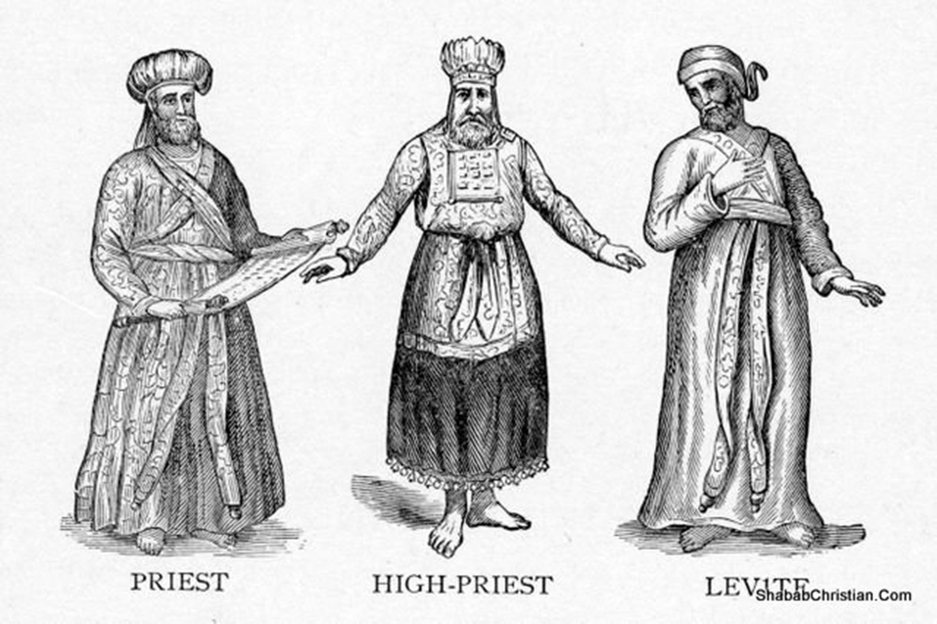
The OT Priesthood prefigures the NT Priesthood
The Levites
The Aaronic Preisthood
The High Priest
The Melchizedek Priesthood

Slide 5
Christian Priesthood: A Summary
As Christian priests we ought to:
Honor and obey God’s Word
Distinguish between the holy and the profane
Be devoted to the Kingdom of God, not worldly things.
Maintain personal holiness and teach others as well
Fulfill our priestly duty to save the Gentiles

Slide 6
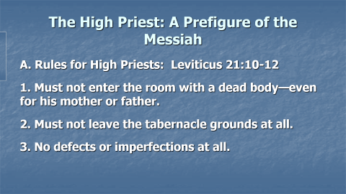

The High Priest: A Prefigure of the Messiah
A. Rules for High Priests: Leviticus 21:10-12
1. Must not enter the room with a dead body—even for his mother or father.
2. Must not leave the tabernacle grounds at all.
3. No defects or imperfections at all.

Slide 7
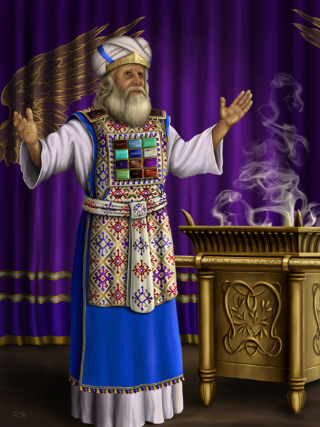
B. The High Priest: Special Garments
Exodus 28
1. Ephod
2. Breastpiece
3. Urim and Thummim
4. Turban

Slide 8
C. Yom Kippur: The Day of Atonement
1. Wash hands and feet in the laver
2. Change into perfectly white linen clothes
3. Lay hands on a bull paid for by the High Priest and sacrifice it
4. Sprinkle the blood in the Holy Place for sin of the High Priest
5. Fill a censer with incense and fill the MHP with the smoke.
6. Select two goats, kill one, as well as a bull for the sin of the people (the other goat is the scape goat)
7. Enter the Most Holy Place, first with the blood of the goat, then the blood of the bull, to sprinkle it on the Mercy Seat.
8. Lay hands on scape-goat and send it out into the wilderness.

Slide 9
Jesus the Perfect High Priest
  Hebrews 2:17 For this reason, he had to be made like them, fully human in every way, in order that he might become a merciful and faithful high priest in service to God, and that he might make atonement for the sins of my people.

Slide 10
Jesus the Perfect High Priest
What is a priest?
A Pontifex Literally, a bridge-builder. A mediator. An advocate. A representative. One who give access. One who can speak the language of both the worshipper and the one worshipped.
The bridge before Jesus:
  The Law
  The Priesthood of Aaron

Slide 11
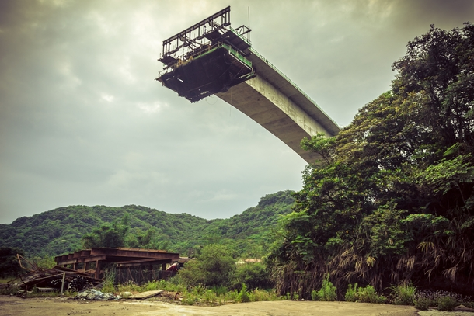
The Law: An Incomplete Bridge

Slide 12
Jesus the Great High Priest
Like other high priests:
  Can relate to us (Heb 4:15)
  Makes intercession before God for us (Heb 4:16)
  Offer gifts (fragrant offerings) and sacrifices (sin, guilt offering) (Heb 5:1)
  Selected by God from men (Heb 5:1,4-5)
  Represents man to God (Heb 5:1)

Slide 13
Jesus the Great High Priest
Greater than any High Priest
  Serves in the Heavenly Tabernacle, not the earthly one. (Heb 4:14)
  Tempted, yet was without sin. (Heb 4:15)
  Did not need to offer sacrifices for his own sin. (Heb 5:3)
  A priest forever (Heb 5:6)
  A priest from the order of Melchizedek (Heb 5:6)

Slide 14

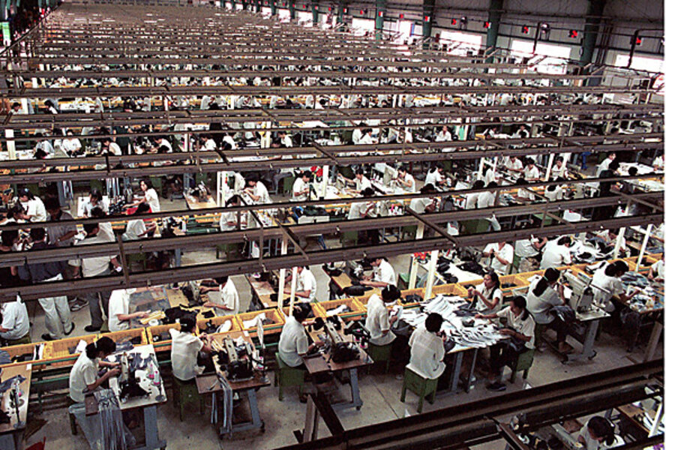
Hebrews 4:15 sympatheo
Jesus can relate to us

Slide 15
A wonderful word…
metriopatheia Heb 5:2
Empathy, Sympathetic feeling,
Bear with people without becoming angry
Completely unlike the Greek concept of God
(God cannot possibly feel anything or he is weak).

Slide 16
Hebrews 5:2 cont.
“He deals gently with those who are ignorant and going astray.” This is accidental sin, not willful sin.
There was no sacrifice for willful sin in the Law of Moses. Hebrews 10:26, Leviticus 4:13, Numbers 15:30-31
Willful sin is defiance, rebellion, willful (obviously)
Unwillful sin is an act of impulse or thoughtlessness or ignorance.

Slide 17
Hebrews 5:7-9
5:8 Jesus learned obedience through suffering.
“learned” in the sense of experiencing.
5:9 once made perfect (teleio) = complete

Slide 18
Jesus the Great High Priest Summary
Pure, holy, undefiled
In the true, heavenly tabernacle 24/7
Without defect, without sin.
Clothed in majesty—with God’s people on his heart
Very wise—omniscient!
A great intercessor—a bridge
Speaks the language of God and of humans
Able to sympathize—to show empathy
A priest forever—of the Order of Melchizedek!

