Slide 1
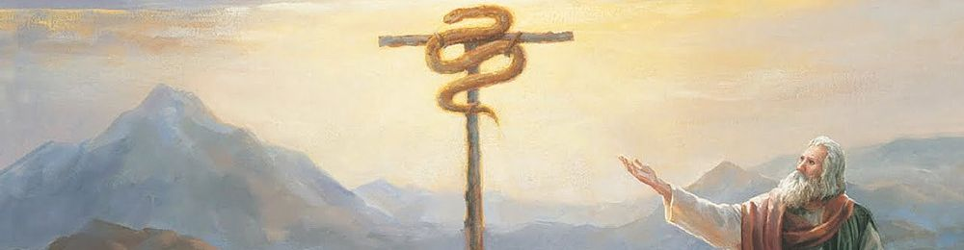
Numbers I
Grumbling and Complaining

Slide 2
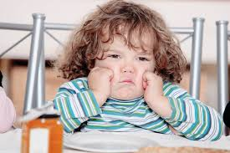
Numbers
Theme: The stubbornness of Israel and God’s patience, mercy and faithfulness
Grumbling!

Slide 3
Numbers Sub-Themes
1. God’s presence with his people.
2. Stubbornness and rebellion among God’s people.
3. God’s judgment for stubbornness and rebellion, but…
4. God’s continued mercy, patience and faithfulness despite our stubbornness and rebellion.
4. Leadership of God’s people
5. Preparation for the Promised Land.

Slide 4
Why Record All This Bad Behavior?
1 Cor 10:1-13 These things are recorded for our sake…
Be careful that you do not fall…

Slide 5
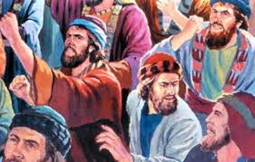
Numbers 11 The Rabble
It was so much better back in Egypt… Grumble, grumble, grumble.
Philippians 2:14-16 No grumbling and complaining!

Slide 6
Numbers 11:10-23 Moses Needs Help
Hebrews 13:17 Encourage your leaders!
Numb 11:16-17 God raises up leaders and gives them an extra measure of the Holy Spirit.
Who will it be here in Merced?

Slide 7
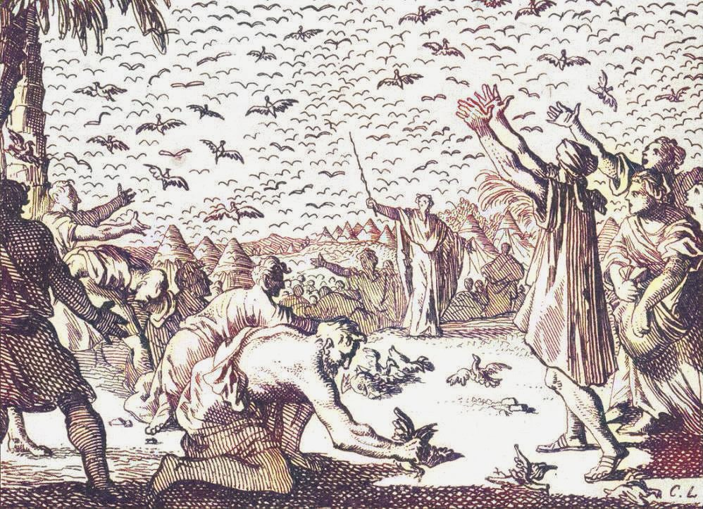
Numbers 11:18-20, 31-34
Consequences!
Our stubbornness and lack of faith has negative consequences.
v. 31-34 A lot of quail!
Message: Do not crave other food.

Slide 8
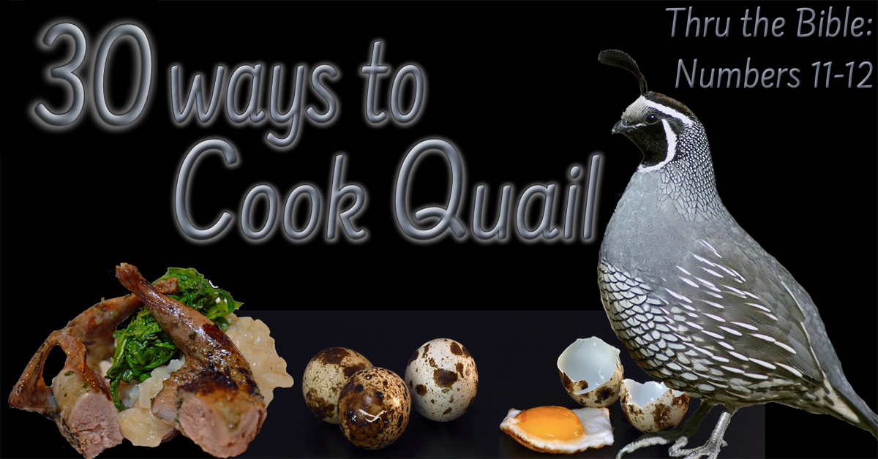

Slide 9
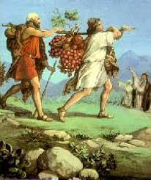
Numbers 13 & 14 Exploring the Land
A question: Can God do great things through us?
Numbers 13:16-25 An abundant land! Flowing with milk and honey

Slide 10
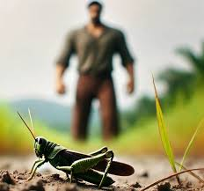
Numbers 13:26-33 Two Different Reports!
The ten: Giants!!!!!
It’s too hard! We felt like grasshoppers.
Caleb: Si’ Se puede!
Which are you? The ten or the two?

Slide 11
Numbers 14 Who Will You Listen To?
Numbers 14:5-24
Not believing in God’s providence and giving in to fear is rebellion.
v. 11 It is contempt for God.
v. 17-19 Two themes: consequences and mercy

Slide 12
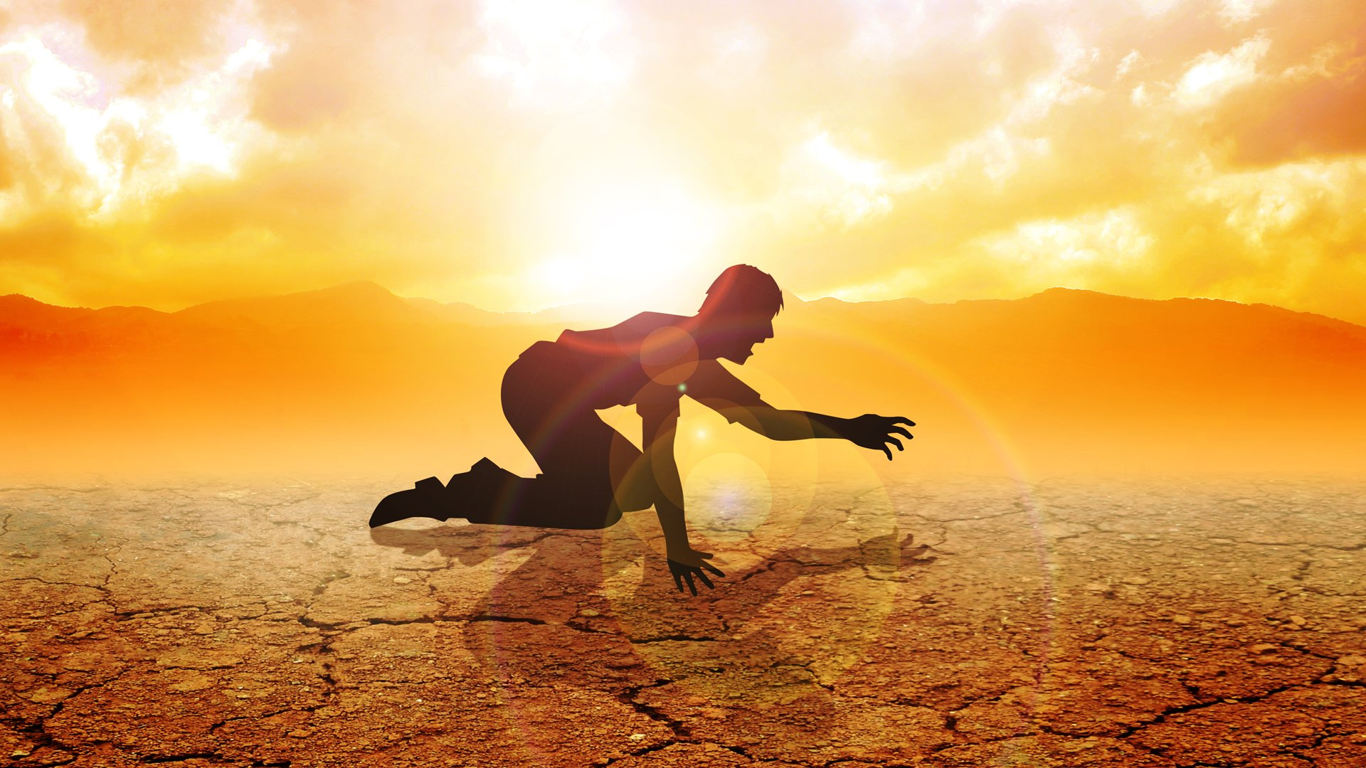
Numbers 14:20-40 Consequences!
Your bodies will fall in the desert.
You will suffer for 40 years!
The next generation will enter.
v. 39-40 Too late to change your mind.

Slide 13
Summary
Do not grumble and complain about your circumstances.
Remember the amazing things God has already done.
Remember God’s mercy and the consequences of lack of faith.
Consider leading God’s people to the Promised Land.

