Slide 1
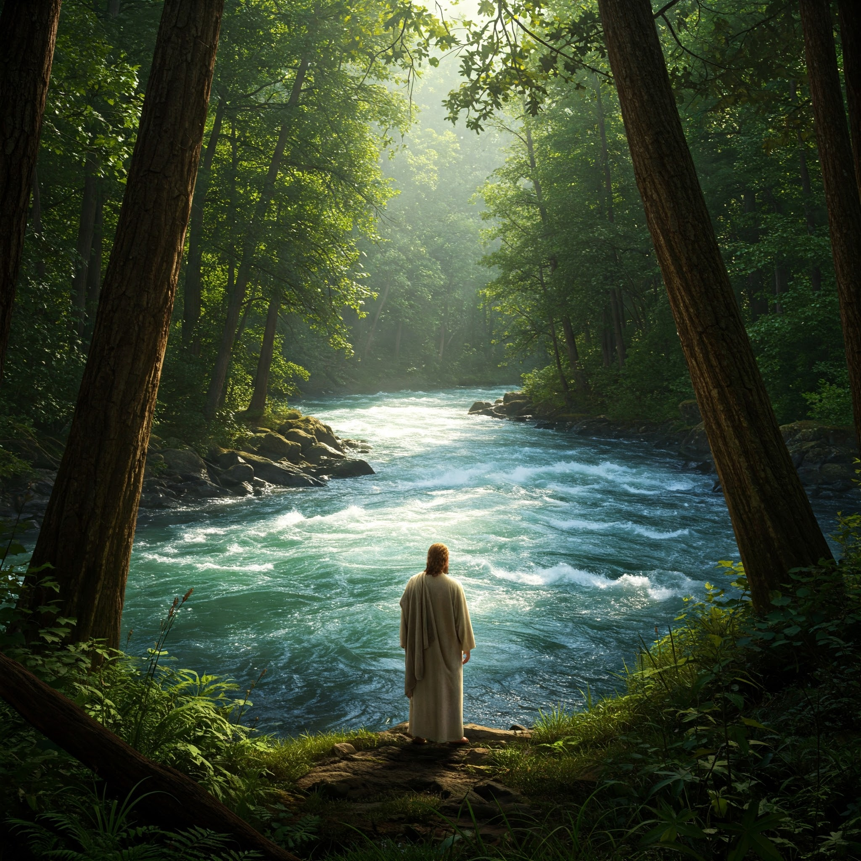
John VII Come Away To The River

Slide 2
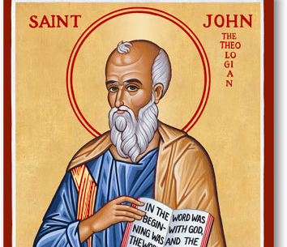
Recap
John Explores Jesus As The Son Of God Who Reveals The Father
- Theme Verse: John 1:14

Slide 3
Recap Cont..
Jesus feeds 5000
Establlishes himself as the greater Moses
John 6:48-51
Q: Will You Let Jesus Sustain You Daily?

Slide 4
John 7
Last Week, We Saw Jesus Declare, 'I Am The Bread Of Life.’
This Week, He Gives Us Another Image: Living Water.
But Also God's Timing & His Glory

Slide 5
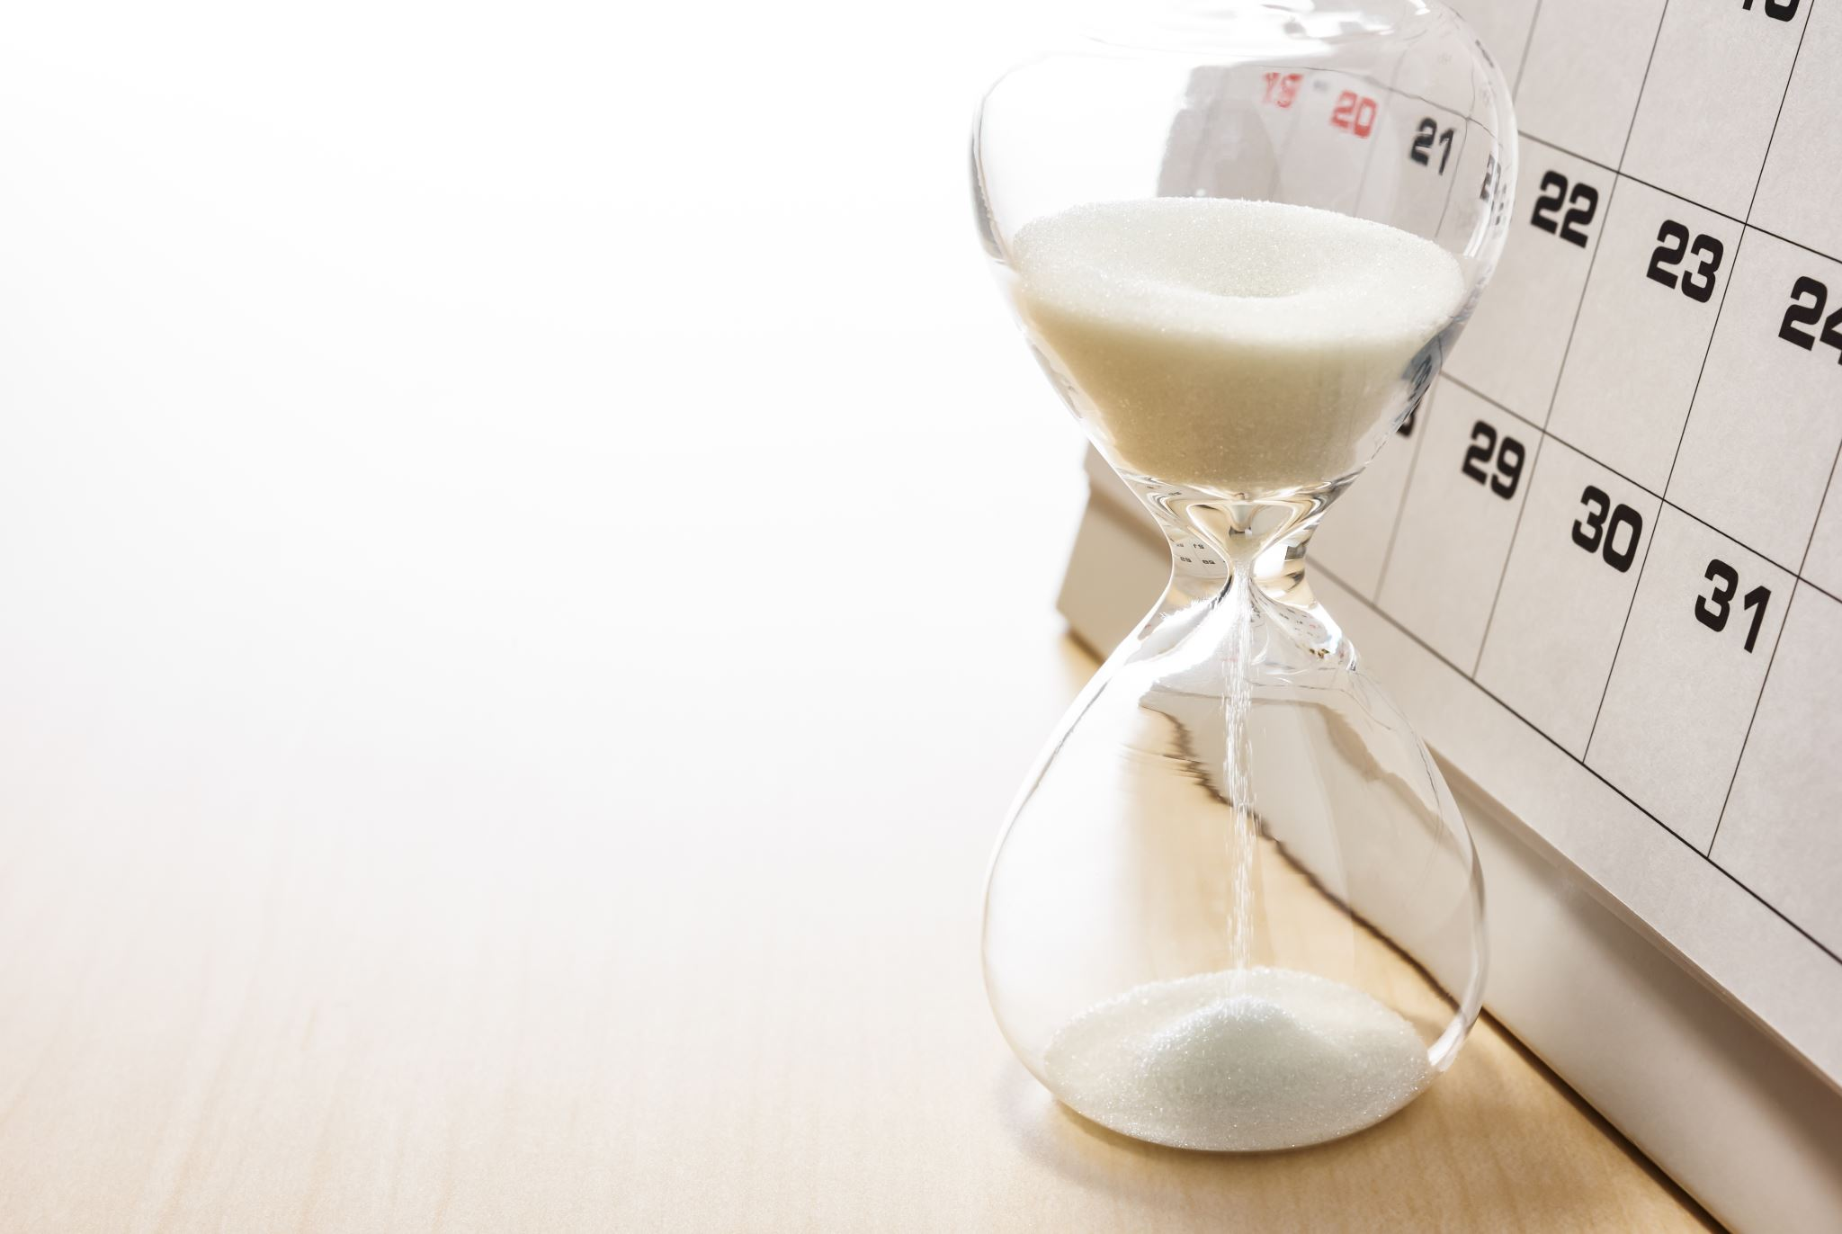
John 7:1-13 (What Time Is It?)
Jesus Brothers Want Him To Reveal Himself
" It’s Not My Time" "For You Anytime Will Do!
Kairos Meaning The Appointed Time
Q: Are We Looking for Our Time Or God's Time (James 5:13-16)
Did Jesus Lie? NO!

Slide 6
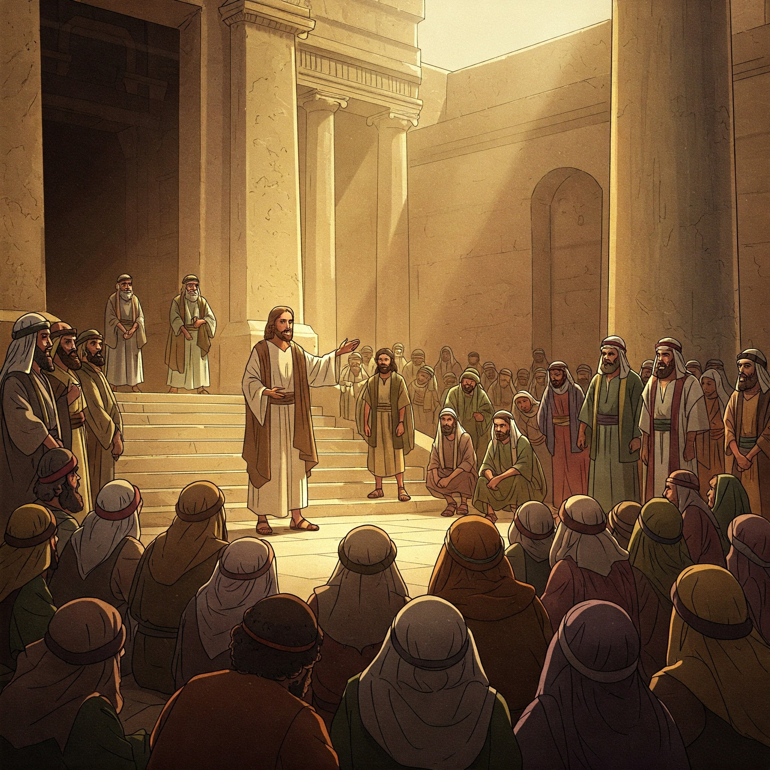
John 7: 14-24 (Glory seeking)
Jesus's Teaching Is Not His Own
Want To Test It? Just Do It!
Imagine If Everyone Just Followed One Command Of Jesus?
Q: Who's Glory Are We Seeking?
Q: Are We Willing To Be Unseen If God Gets The Glory

Slide 7
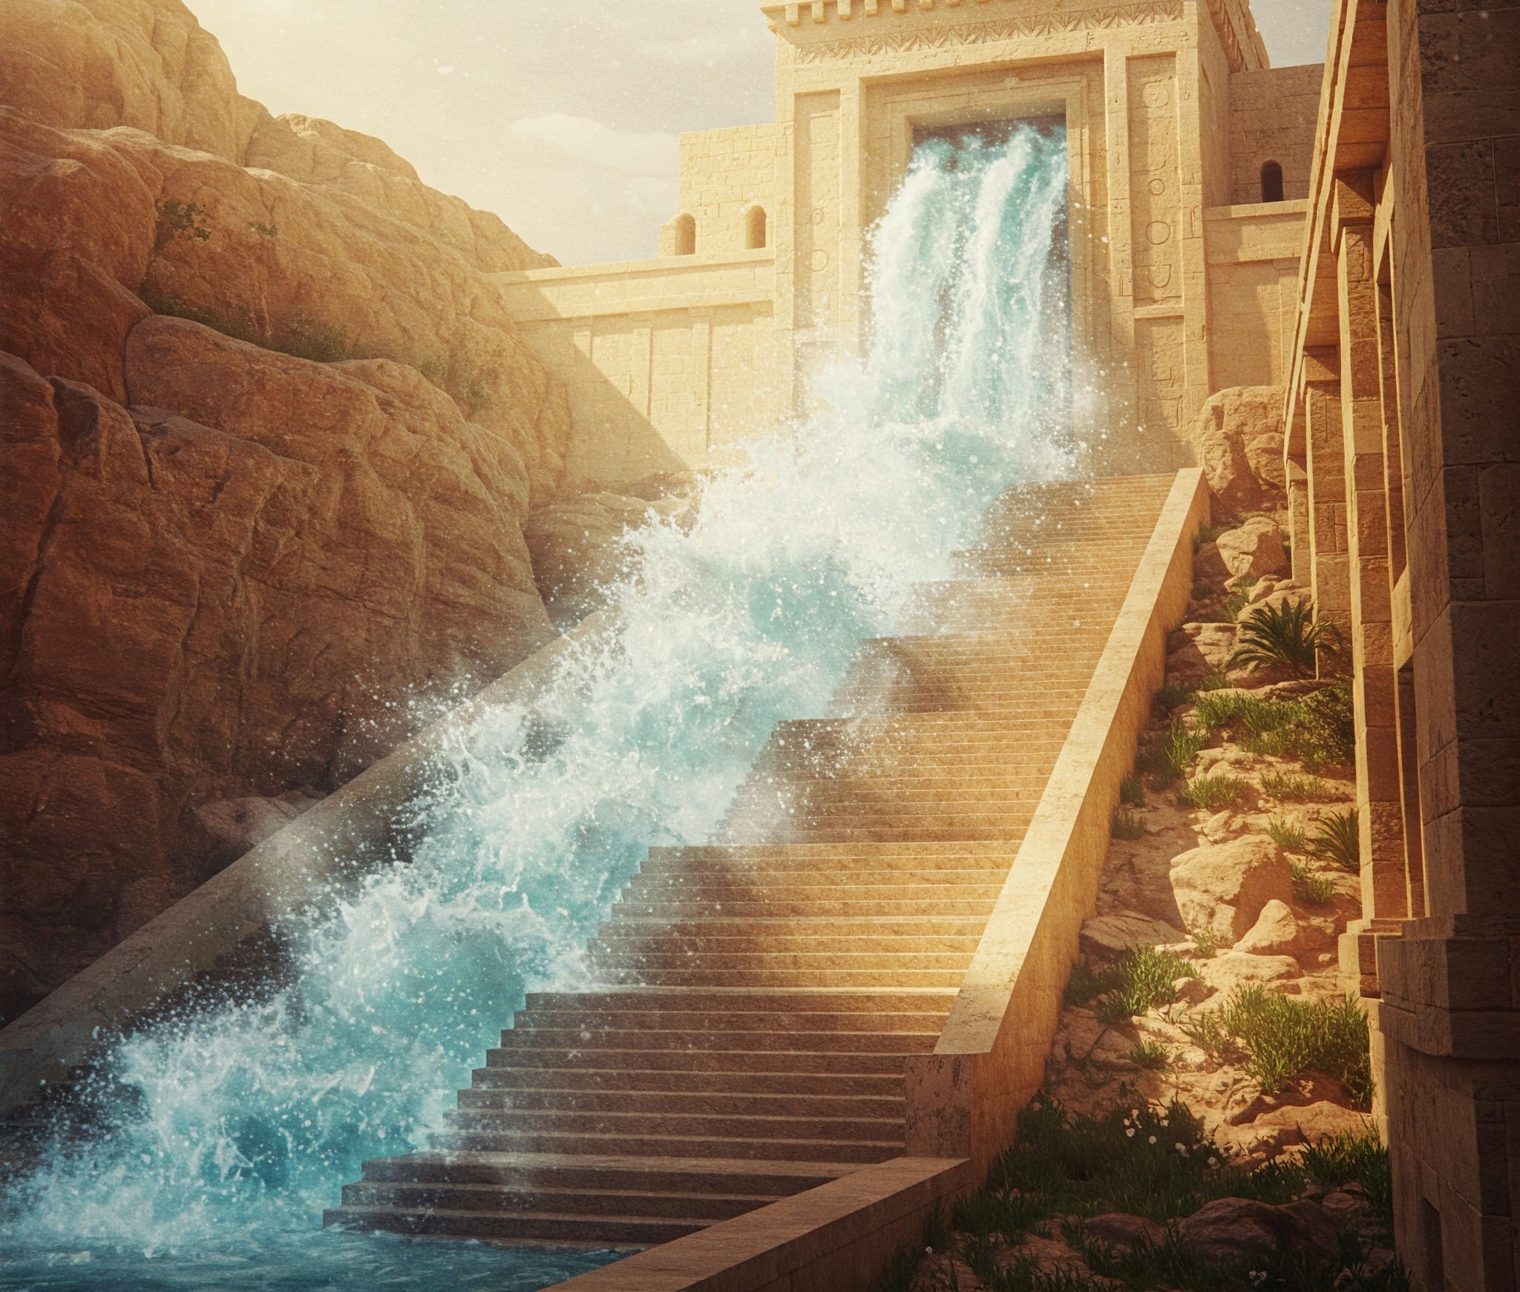
John 7:37-39(The Water Of Life
“If Anyone Is Thirsty, Let HIm Come To Me And Drink.”
Jesus Is The Source
Living Water = The Spirit
Out Of You Will Flow Rivers
Q: Feeling Spiritually Dry?
Come to Jesus!

Slide 8
Ezekiel 47: 1-12
A Connection To Ezekiel!
Verse 9: Where The River Flows Everything Will Live!
We Are The New Temple
Bringing Life To The Dry Areas Around Us

Slide 9
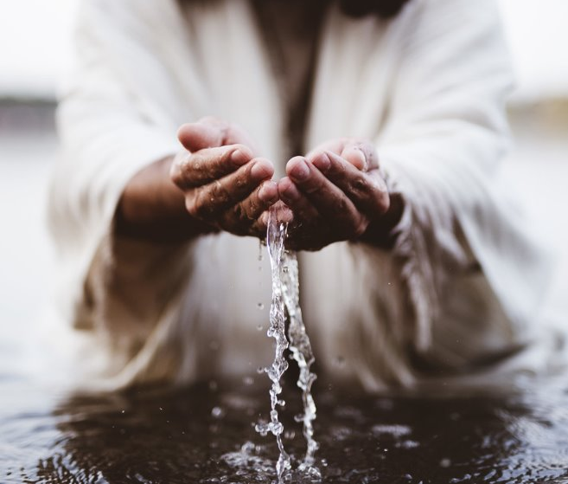
3 Invitations
To The Thirsty : Come And Drink
To The Waiting: Trust His timing
To The Church: Be The River

