Slide 1
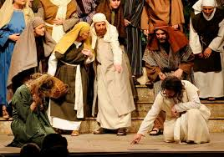
The Gospel of John VIII
The Woman Caught in Adultery

Slide 2
Book of John
Theme: Jesus is the Son of God who reveals the Father, providing life to all who believe.
Theme verse: John 1:14
Last

Slide 3
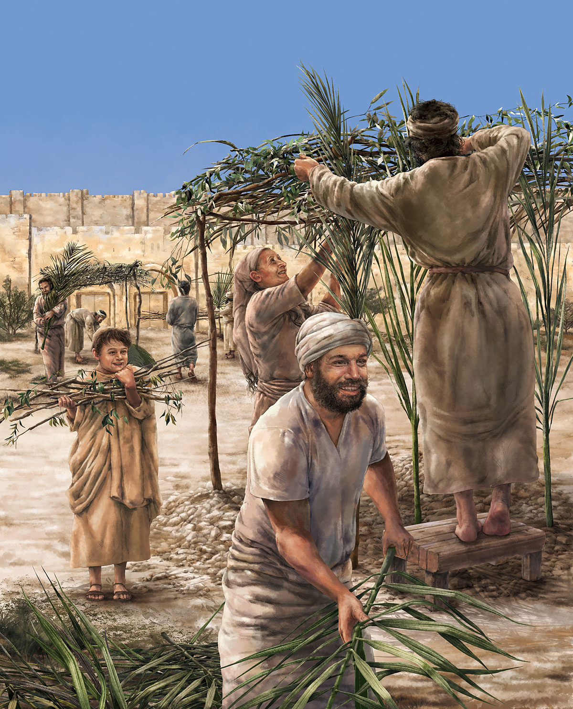
John 7 & 8 Jesus and Tabernacles
Feast of Tabernacles
Feast of Booths
Sukkot
Remembering God dwelling with his people

Slide 4
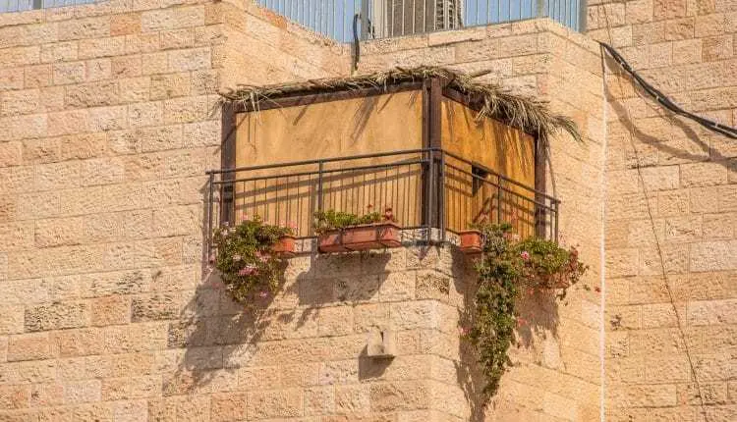
John 7:14-24
Sukkot in a city
John 7:17
If anyone chooses to do God’s will, he will find out whether my teaching comes from God or whether I speak on my own.

Slide 5
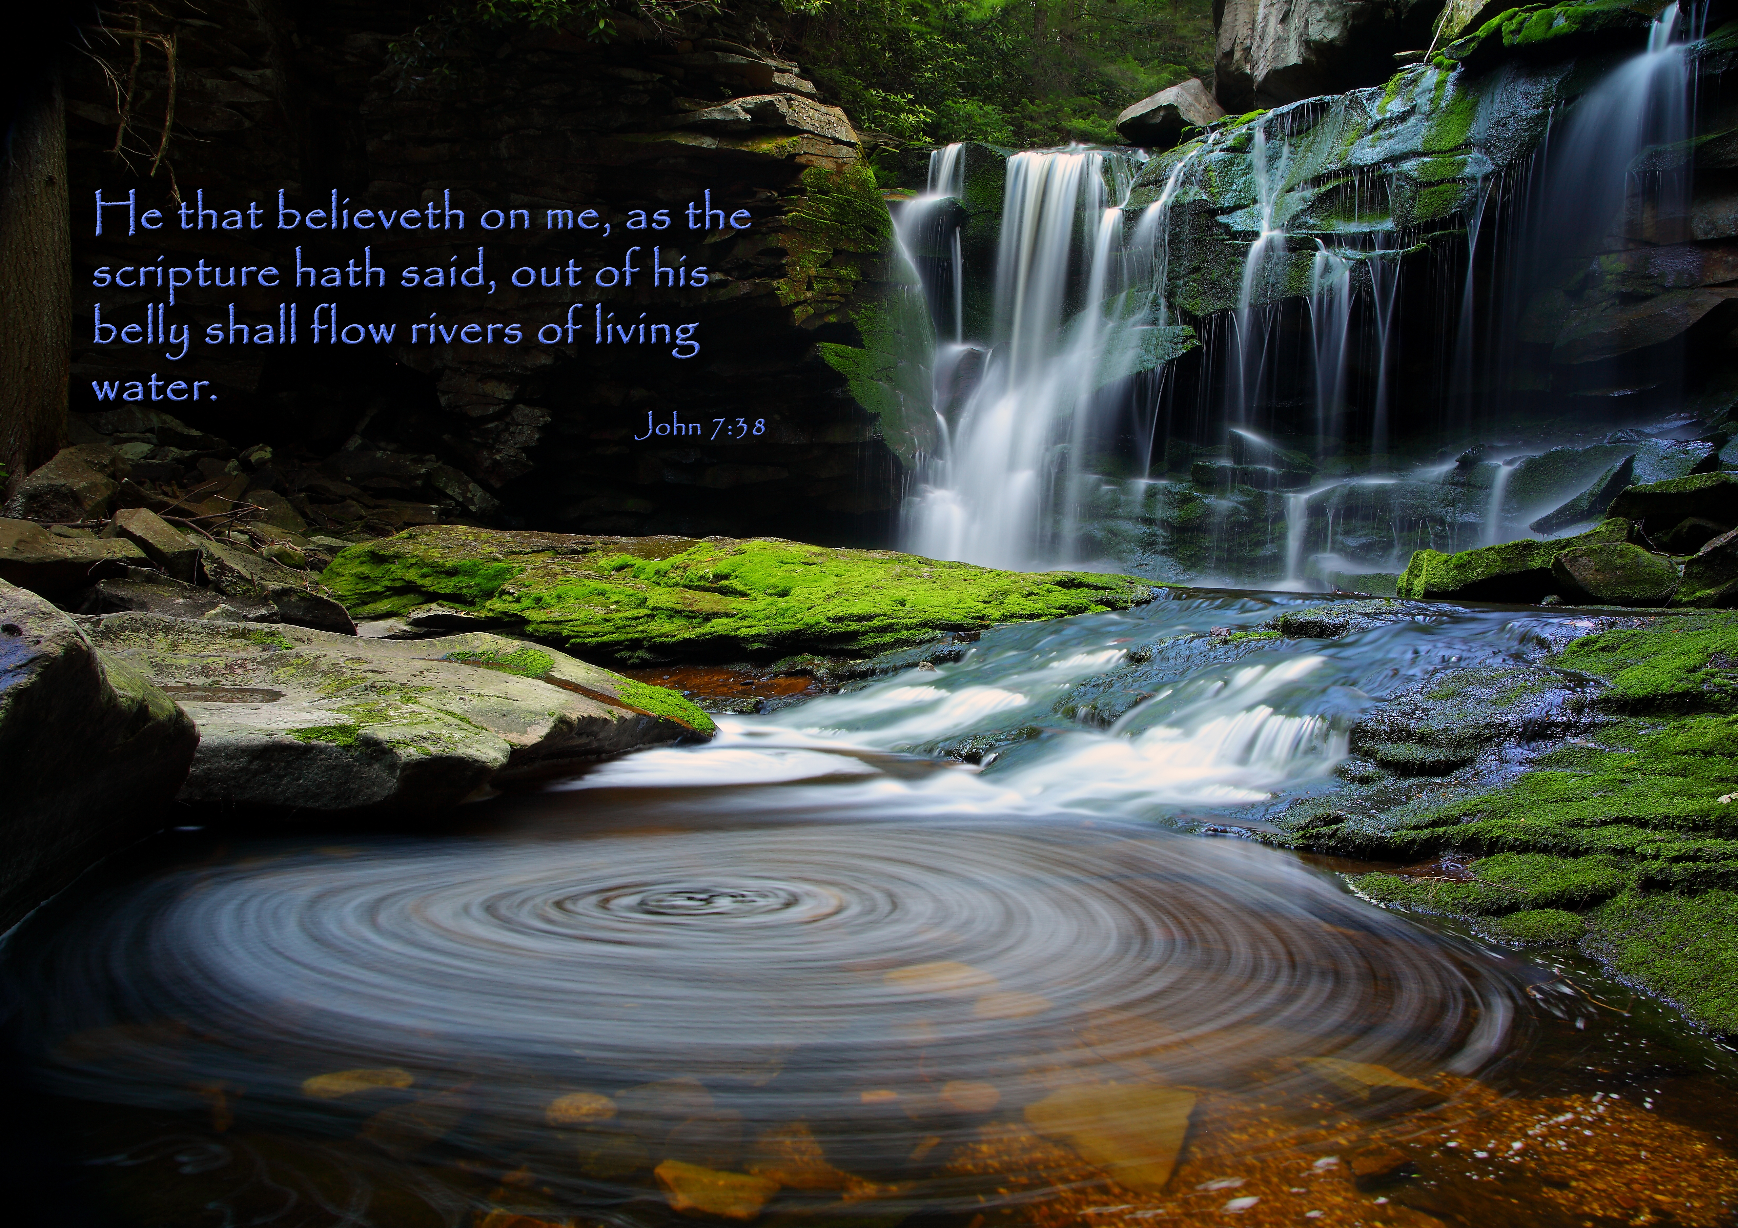
John 7:38
Whoever believes in me, as Scripture has said (Ezekiel 47), rivers of living water will flow from within them.

Slide 6
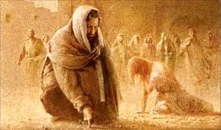
John 7:53-8:11 The Woman Caught in Adultery

Slide 7
The Woman Caught in Adultery
The Men Caught in Hypocrisy
v. 5 The Law says to stone such a woman.
What about the man?
Question: Which is important? Holding up the Law and moral purity or loving and showing compassion to the sinner?

Slide 8
God Desires Mercy, Not Sacrifice
Matthew 5:7 Blessed are the merciful…
Hosea 11:1, Matthew 9:13, Matthew 12:7
I desire mercy, not sacrifice, and acknowledgement of God rather than burnt offerings.
Hate the sin and love the sinner?

Slide 9
Sharing Time
Share with a neighbor a time when either God showed you mercy directly, or He did so through another person. What was the effect on you?

Slide 10

John 8:6 Jesus Wrote on the Ground
v. 7 They kept questioning him…

Slide 11
The First Stone
Question: Who here would be qualified to throw the first stone?
Question: Have you ever been the one to “throw the first stone” at someone?

Slide 12
I Desire Mercy, Not Sacrifice
Jesus last words to this woman:
Go and leave your life of sin.
Mercy works
Law rarely does.

Slide 13
Summary
Is anyone here without sin?
Who will throw the first stone!
God desires mercy before sacrifice.
But… Go and leave your life of sin.

