Slide 1

Welcome to the Alpha Omega Midweek

Slide 2
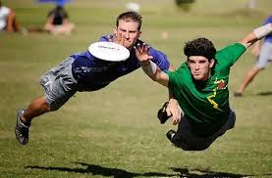
Announcements
Campus Bible Talk Mon 7:00 UCM Glacier 6th floor
Th 12:00 Bible Talk at Merced College
Fri 6:00 Ultimate Frisbee at Merino Park
Sat 9:00 AM Catholic Charities

Slide 3
Coming Up
Campus Retreat in April 11-13 The Secret Place.
https://tithe.ly/event-registration/#/9781554
ICMC and Jubilee in OC July 31-Aug 3

Slide 4

Alpha Omega Spring Retreat! https://tithe.ly/event-registration/#/9781554

Slide 5
Phil 3 The Surpassing Worth of Knowing Christ
Phil 1:1-30 To Live is Christ
Phil 2:1-18 Living Like Christ
Phil 3:1-21 Put Your Confidence in Christ
Phil 4:1-23 Practical Living in Christ

Slide 6
Phil 3:1 Rejoice in the Lord
…as opposed to rejoicing in the things of the flesh.
What will steal our joy? Relying on the things of this world.

Slide 7
Phil 3:2 Watch out!
“mutilators of the flesh” = those who are demanding men be circumcised to be Christians. These are Judaizers—legalists.
Dogs! Paul is angry. (Gal 1:8-9. 5:12. Whew!)
Q: What got Jesus angry? Matthew 18:32-35 lack of forgiveness
Q: What gets you (righteously) angry?

Slide 8
Phil 3:3 We are the Circumcision.
Romans 2:28-29
Colossians 2:11-12
Phil 3:3b. We put no confidence in the flesh.
We are the opposite of those dogs!
Q: Can you say that about yourself?

Slide 9
Phil 3:4-6 Paul’s Resume
Like Solomon, Paul had great reason to put confidence in the flesh.
Hebrew of Hebrews
A student of Gamaliel
As to legal righteousness, faultless

Slide 10
Worldly Accomplishments: Garbage!!!!
Phil 3:7-8 All the things of the flesh is loss compared to knowing Christ.
Which is of more value, the flesh or being in Christ?
No comparison!
By comparison, the things of the flesh/of the world are garbage.
Q: Do you feel this way about the things of the world?

Slide 11
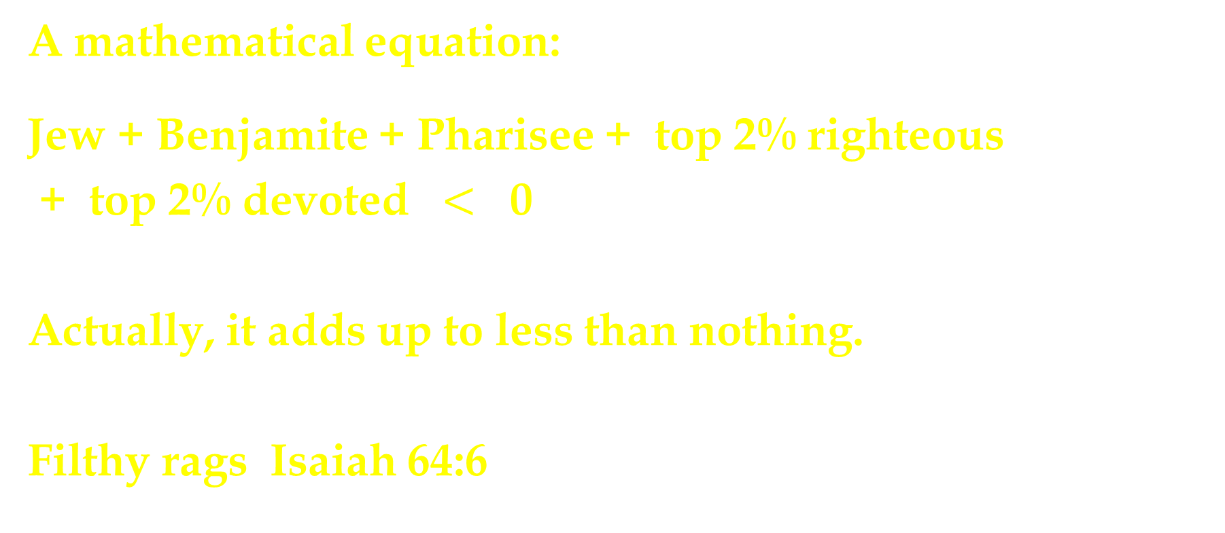
Refuse! Dung!
A mathematical equation:
Jew + Benjamite + Pharisee + top 2% righteous
+ top 2% devoted $<$ 0
Actually, it adds up to less than nothing.
Filthy rags Isaiah 64:6

Slide 12
All is loss compared to what?
Phil 3:8 to knowing Christ.
Phil 3:9 to being found in Him.
Phil 3:10 I want to know Christ.
Our goal: TO KNOW HIM
know = ginosko (Greek) = yada (Hebrew)
947 times in OT experiential knowledge

Slide 13

Knowing Christ
Q: How badly do you want to know Christ?
v. 8 Surpassing worth. Infinite value.
All things
Knowing Christ

Slide 14
Coming to know Christ
By faith, not by works Romans 4:1-3
v. 9 Where do we find righteousness?
In Christ
The result of knowing Christ:
Power
Suffering
Christlikeness (the cross)
Resurrection

Slide 15
Phil 3:11 Resurrection Power
Somehow…..
This is not uncertainty of the result, but uncertainty about the path to the end.
“I want to know Christ by whatever route God chooses in order to attain to the resurrection.”

Slide 16
Phil 3:12-14 But in the meantime…
I press on (pursue) to the goal.
Q: What is this goal? What is at the finish line?
Luke 19:17
2 Tim 4:8
1 Cor 2:9
Are you pressing on?

Slide 17
Discussion Questions
1. What produces “righteous anger” in you?
2. What do you put your confidence in? Why?
3. Fill in the blank: For me to live is ___________________

