Slide 1


Slide 2


Slide 3
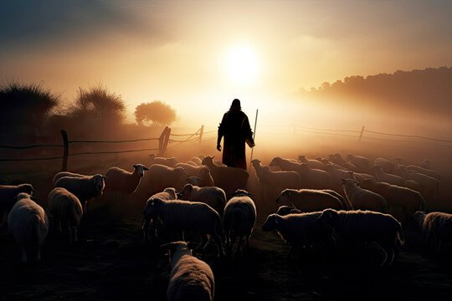
John XIII: Listening To The Good Shepard

Slide 4
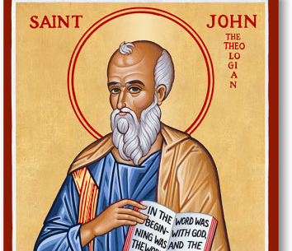
Recap
John Explores Jesus As The Son Of God Who Reveals The Father
Theme Verse: John 1:14
John's Purpose: John 20:31

Slide 5
John 8
We Saw Jesus Declare, 'I Am The Light of The World
This Week, He Gives Us Another Image: The Good Shepard
He Calls You By Name (vv. 1–6)
He Leads You To Life (vv. 7-10)
He Lays His Life Down (vv. 11-21)

Slide 6
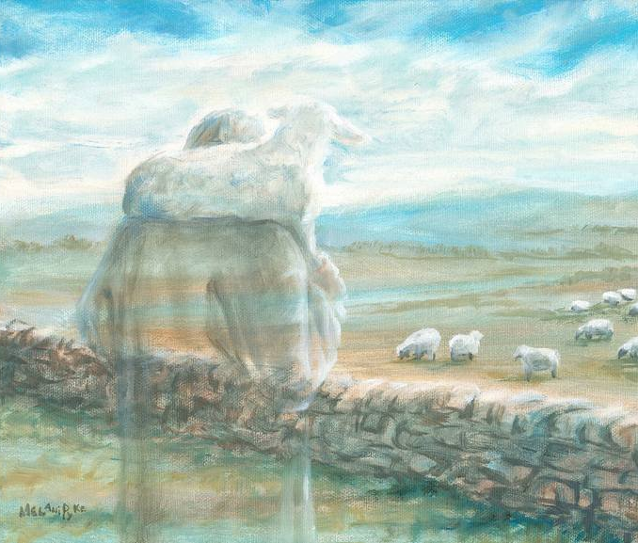
He Calls You By Name (John 10:1-6)
Jesus Condemns False Shepherds
Ezekiel 34:1-10
We Know The Good Shepherd By His Voice
Q: Are We Close Enough To Recognize His Voice

Slide 7
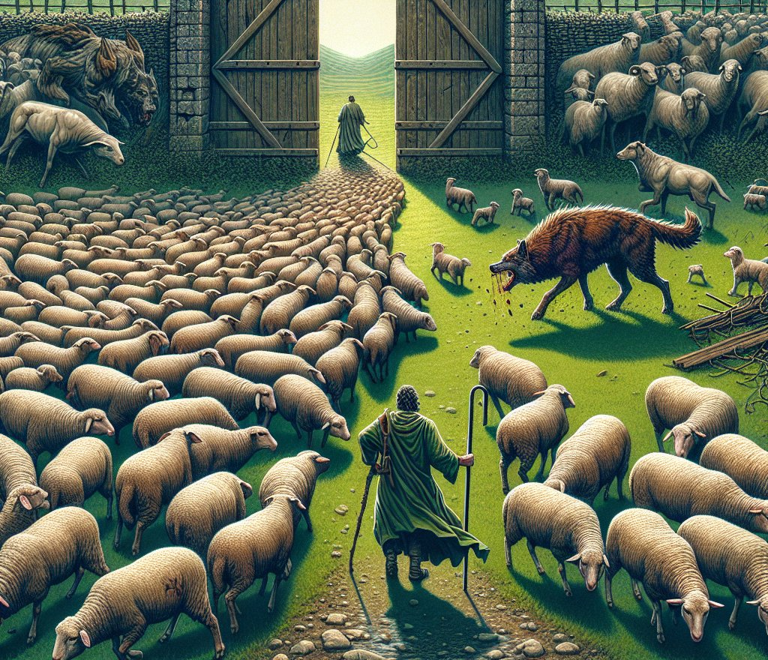
He Leads You To Life
The Word Life Has 3 Meanings In Greek
Bio= Bodily Life, Pysche= Soul, Zoe= Fulfilling Divine Life That Comes From God
Colossians 3:3-4
Q: Are You Chasing Jesus's Real Life Or A Counterfeight?

Slide 8
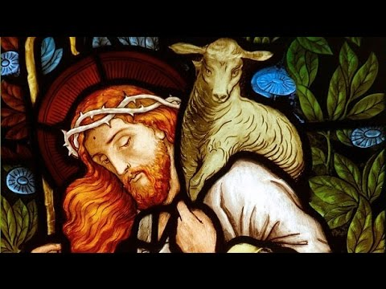
He Lays His Life Down
Jesus Claims To Be God
Ezekiel 34: 11-16, 23-24
Jesus Lays His Life Down To Unite Lost Sheep & Bring Together What's Broken
Q: Who In Your Life Needs To Meet The Good Shepherd

Slide 9
Conclusion: Psalm 23
Jesus Is Inviting You Into A Relationship Where You Are Led, Refreshed, And Comforted Regardless Of Circumstances
Q: Will You Choose To Listen To The Good Shepherd

Slide 10


Slide 11
Announcements
05/20 Tuesday Bible Study 6:30 Dinner 7:30 Bible Study
05/21 Midweek – UCM 7:30pm
05/23 Sports Night
05/25 Yosemite Park Service

Slide 12


Slide 13


