Slide 1
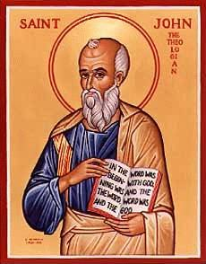
The Gospel of John XIV
The Glorification
of King Jesus

Slide 2
The Gospel of John
In John, Jesus is revealed through his miracles and through his statements about himself.
Theme verse: John 1:14 The Word of God…

Slide 3
John 11 Jesus Raises Lazarus
John 6 Jesus makes bread then Jesus says “I AM the Bread of Life.”
John 8:12, 9:5 Jesus says “I AM the light of the world, then he heals the man born blind.
John 11 Jesus says “I AM the resurrection and the life.” Then Jesus resurrects Lazarus.

Slide 4
John 11:26-27
Jesus: I AM the resurrection and the life. He who believes in me will live, even though he dies; and whoever lives and believes in me will never die.
Do you believe this? Then you will never die!
Martha: Yes, Lord, I believe that you are the Christ, the Son of God, who was to come into the world.

Slide 5
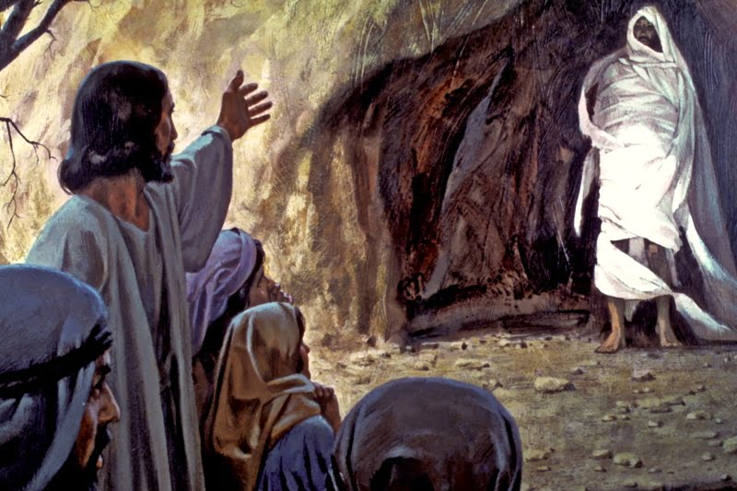
Lazarus, Come Out!

Slide 6
John Chapter 12
Theme: The Glorification of the King
A transition… Jesus enters Jerusalem
A transition… Jesus’ public ministry ends
A transition… The Book of Signs ends and the Book of the Passion begins

Slide 7
An Outline of John
John 1:1-18 Prologue
John Ch 1:19-11 The Book of Signs
John Ch 12-20 The Book of the Passion
John 21 Epilogue

Slide 8
The Glorification of the Messiah/King
John 12:1-8 Anointing of a Messiah/King.
John 12:12-16 Triumphal entry of the King.
John 12:28 God: I will glorify your name.
John 12:32 Jesus will be lifted up (glorified)

Slide 9
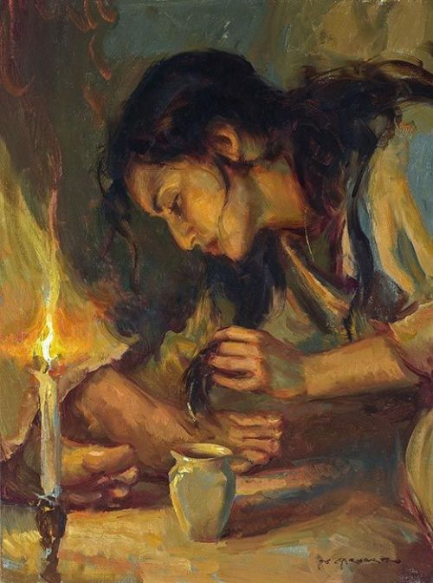
John 12:1-8
Jesus Anointed as King and For His Burial
Judas: What a waste of money!

Slide 10
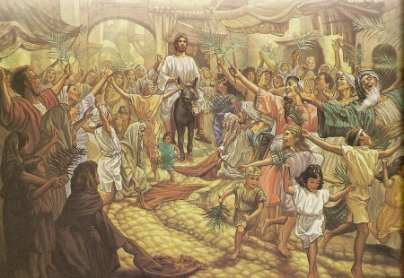
John 12:12-19 The Passion Story Begins
I Maccabees 13:21
(Simon Maccabeus)
Hosannah! Ps 118:25-26
Jesus hailed as King and Messiah.
King of Peace (on a donkey)
Zechariah 9:9

Slide 11
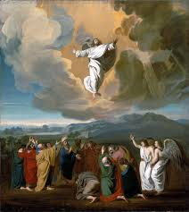
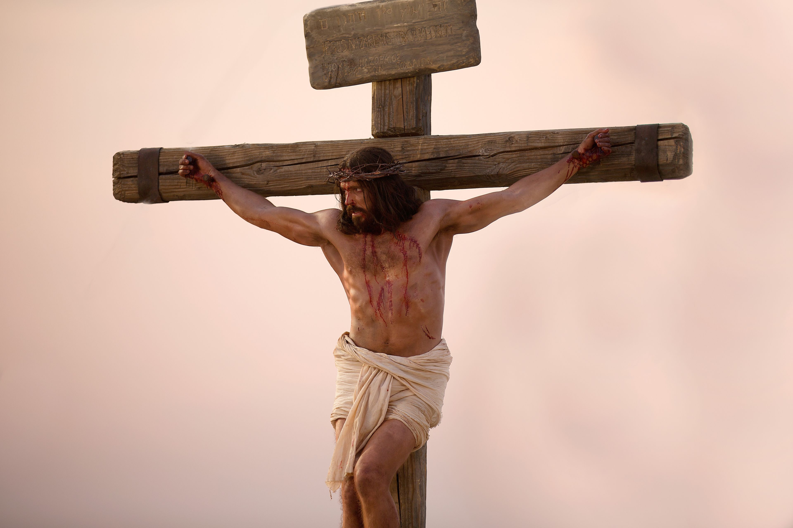
John 12:16
Only after Jesus was glorified…
How was Jesus glorified?

Slide 12
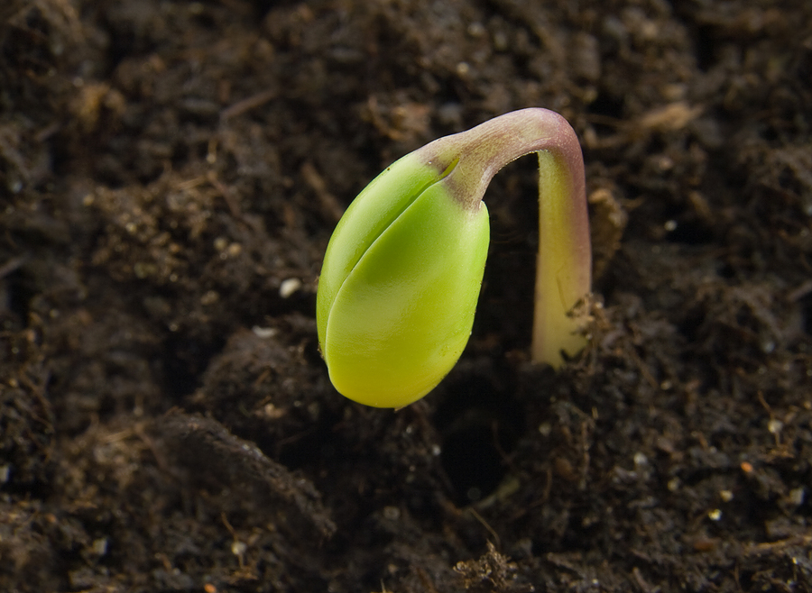
John 12:23-29 The Hour Has Come to Glorify the King!
Truly, truly I tell you, unless a kernel of wheat falls to the ground and dies, it remains only a single seed. But if it dies, it produces many seeds. John 12:24
John 12:32 I will draw all men to myself. How??? By dying!

Slide 13
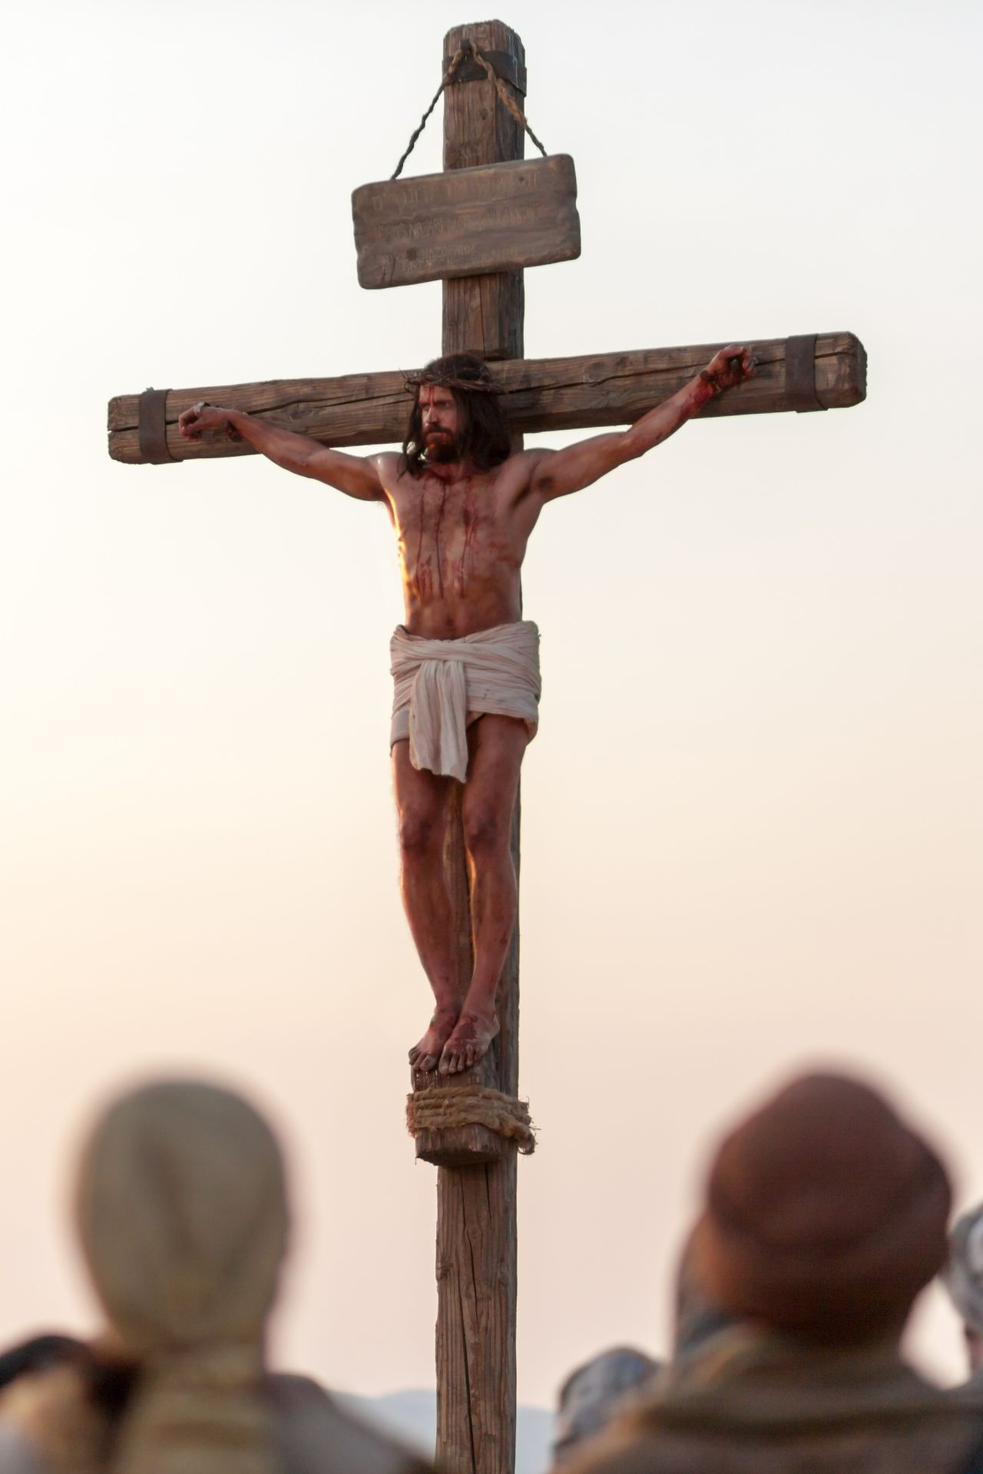
John 12:30-36 Jesus Glorified
How is Jesus glorified?
How does Jesus glorify God?
Answer: By dying!
Lifted up:
-on a cross
-resurrection
-ascencsion to heaven
-when we lift up Jesus

Slide 14

John 12:37-43
The people are talking…

Slide 15
John 12:44-50
Summary of the Book of Signs
Jesus did not come to judge—that was not his purpose in coming.
But…
Jesus’ words (and his miracles) will judge us at the last days.
Are you ready for judgment?

Slide 16
Summary
It is not possible to be too extravagant toward king Jesus.
King Jesus has come to Jerusalem. He will be glorified on the cross, by his resurrection and by his ascension. Will you glorify him? Will you lift him up?
A grain of wheat must die to bear fruit. Glorification through dying. How much do you love your life?
Jesus’ Word will judge us at the last day. Will you hold to his teaching?

