Slide 1
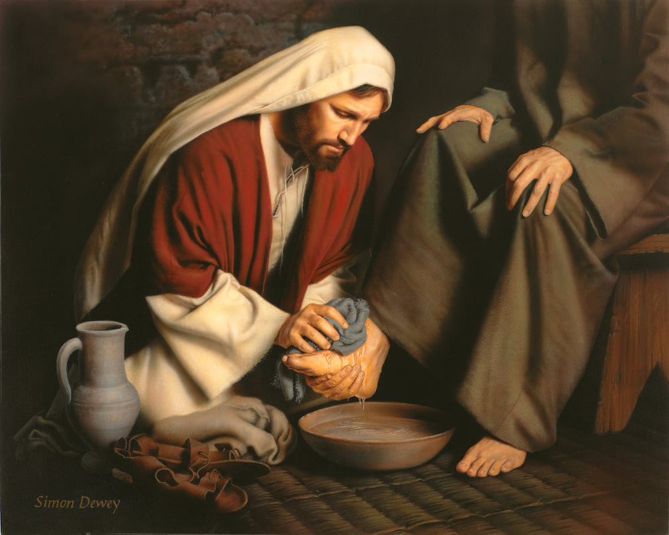
The Gospel of John XV
Jesus Shows His Love

Slide 2
Last Week: John Chapter 12
A transitional Chapter
Jesus enters Jerusalem
Jesus’ public ministry ends
The Book of Signs ends and the Book of the Passion begins

Slide 3
John 12 Glorification of the King
Jesus glorified through
His anointing as Messiah
His triumphal entry into Jerusalem as a king
God to Jesus: I will glorify your name
Jesus: “I will be lifted up”

Slide 4
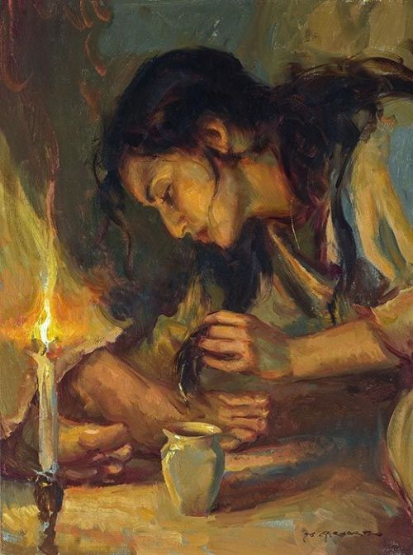
John 12:1-8
Glorification of the King.
Jesus Anointed as King and For His Burial

Slide 5
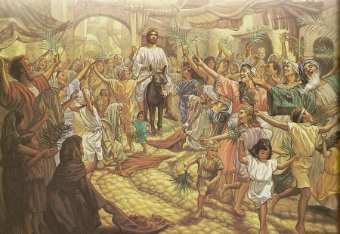
John 12:12-16 The Passion Story Begins
Jesus hailed as King and Messiah.
A king who will be glorified by dying.

Slide 6
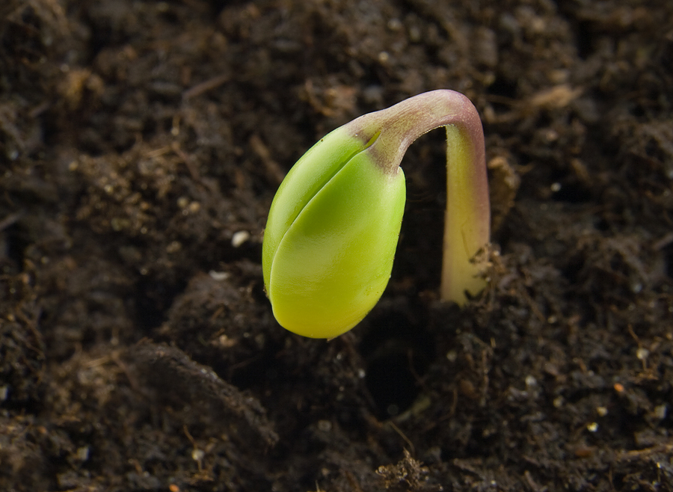
Truly, truly I tell you, unless a kernel of wheat falls to the ground and dies, it remains only a single seed. But if it dies, it produces many seeds. John 12:24

Slide 7
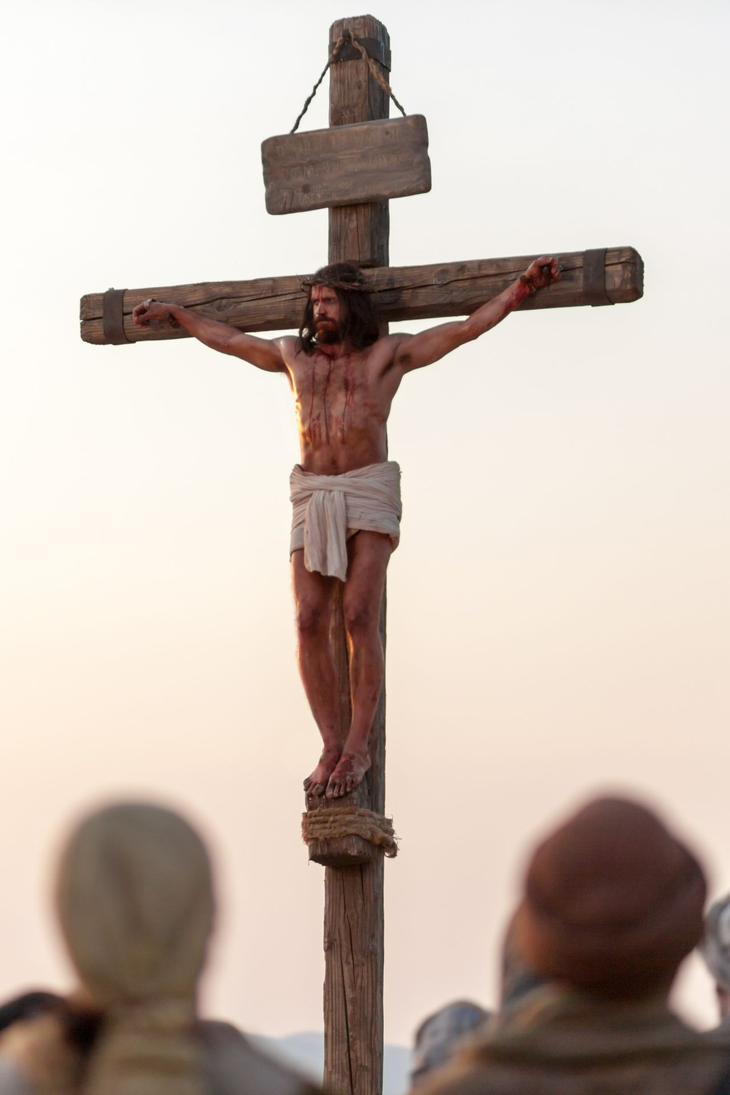
John 12:30-36 Jesus Glorified
How is Jesus glorified?
Answer: By dying!
Lifted up:
-on a cross
-resurrection
-ascension to heaven
-when we lift up Jesus

Slide 8
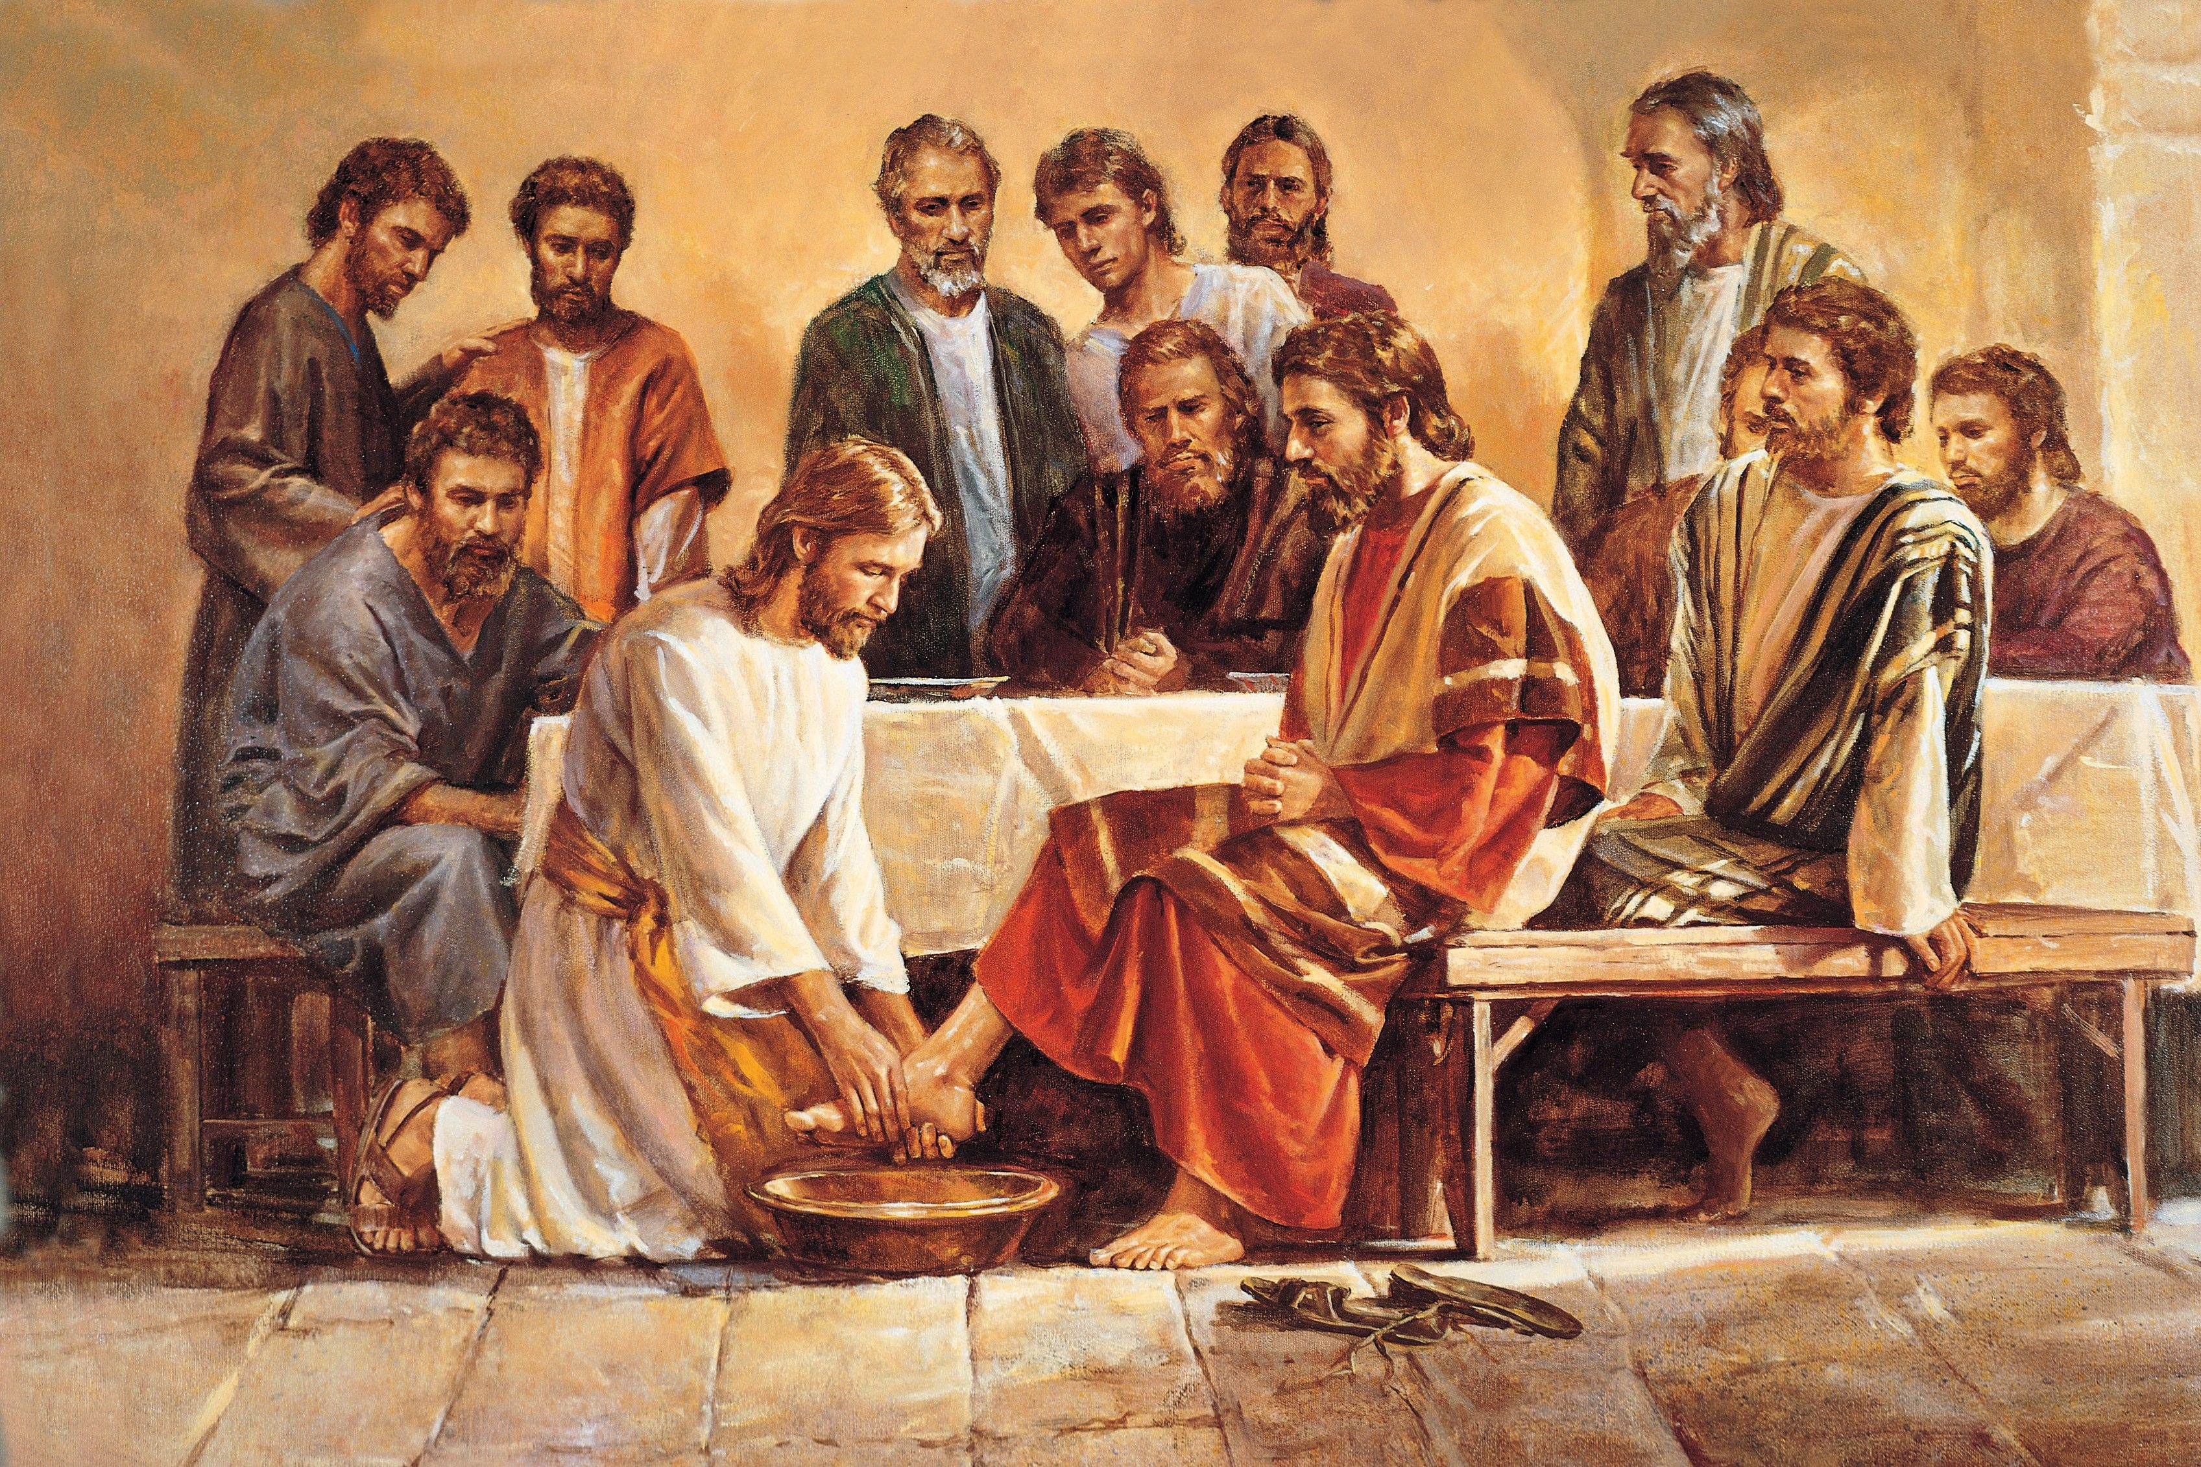
John 13:1-17 Jesus Shows His Love
John 13:1 Jesus loved them “to the end.”
A double meaning

Slide 9
Peter: No Way, Lord!
Was it:
1. He was too prideful for anyone to wash his feet.
2. He was so unselfish, he did not expect anyone to have to wash his feet.
3. He had a worldly idea of what it means to be a leader—that they should be served, not vice-versa.
Acts 20:35 More blessed to give than to receive

Slide 10
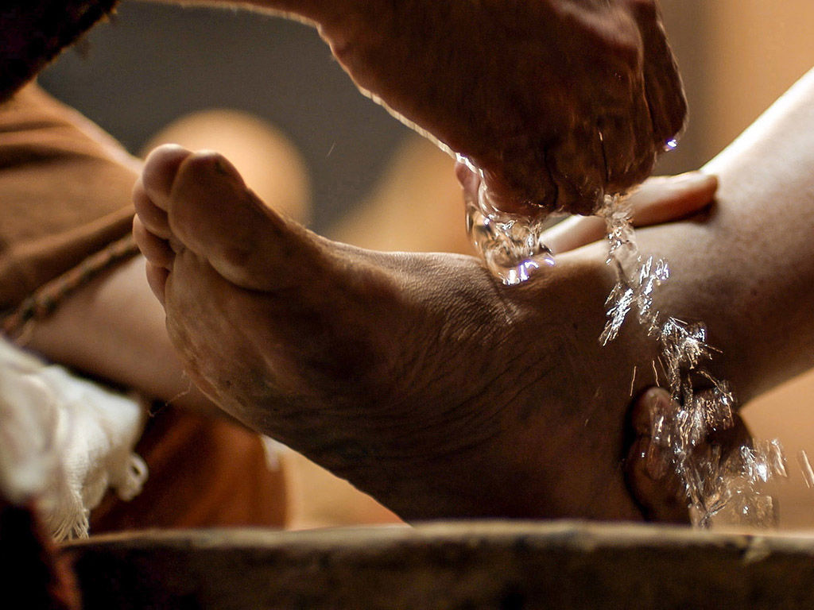
John 13:15
Jesus:
Now that I, your Lord and Teacher have washed your feet, you also should wash one another’s feet.

Slide 11
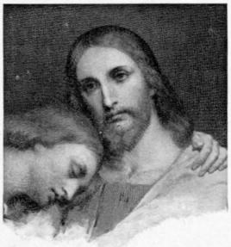
John 13:18-30 Betrayal! Glorification!
The disciple whom Jesus loved. John!

Slide 12
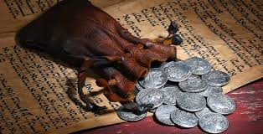
Betrayal!
How did Judas end up here?
1. Borrowed without asking.
2. Borrowed again, but kept some for himself.
3. Flat-out took money for himself.
4. Betrayed Jesus
The solution: Be open at the temptation stage.

Slide 13
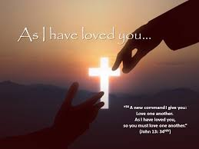
John 13:31-35 As I Have Loved You
v. 31 Now the Son of Man is glorified…
I will glorify him at once.
How? By dying on a cross.

Slide 14
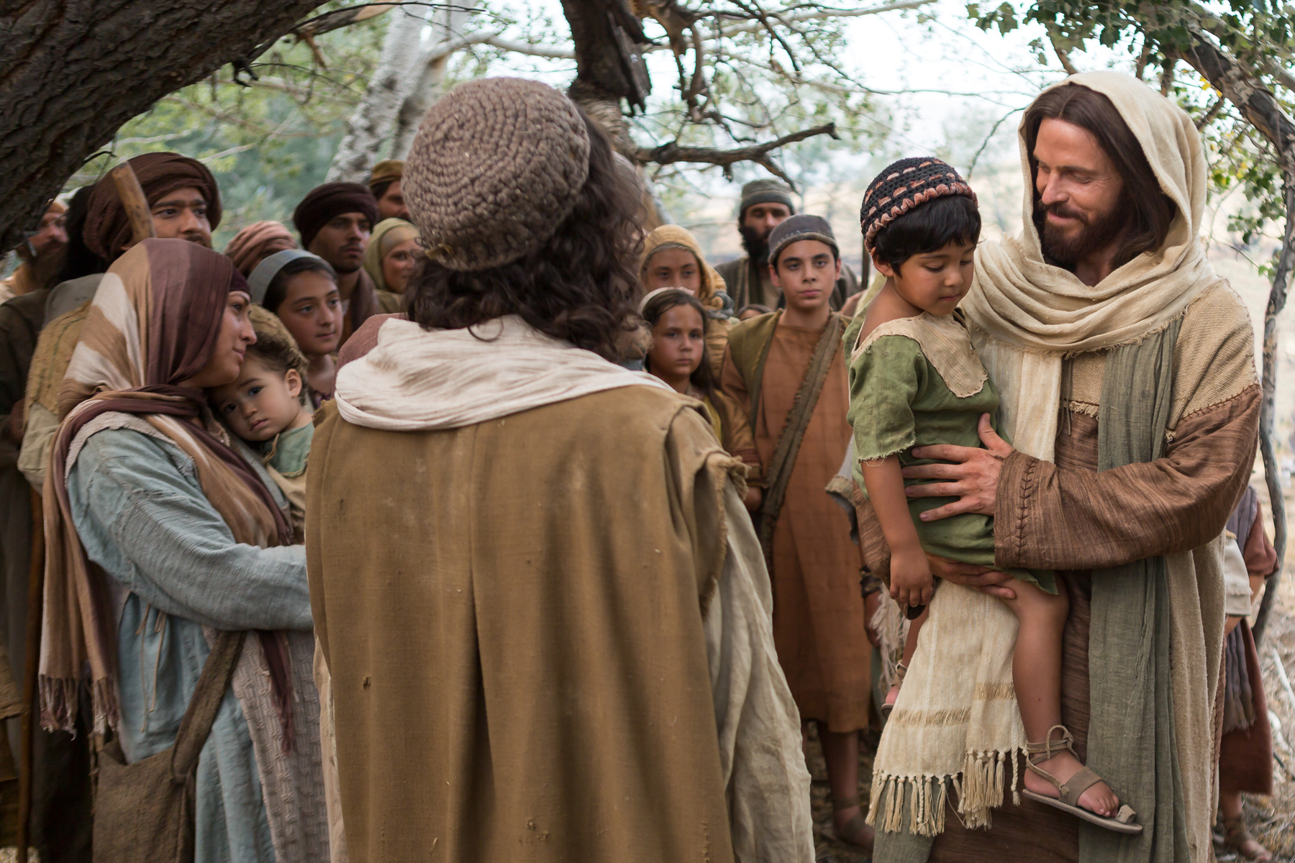
John 13:31-35 As I Have Loved You
Little children…
Love one another as I have loved you.
By this all people will know that you are my disciples.

Slide 15
John 13:36-39
Jesus: You cannot go where I am going
But you will later…
Peter will deny Jesus three times.

Slide 16
Summary
Let us wash one another’s feet
Jesus is glorified through the most inglorious means imaginable. What about you?
Let us love one another as Jesus has loved us.

