Slide 1
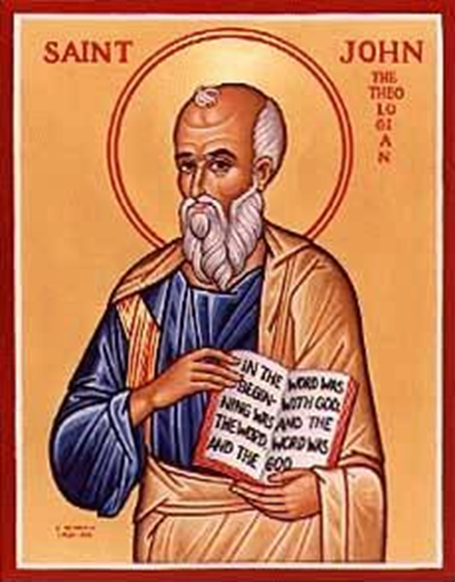
John XVI
Jesus Comforts His Disciples
I will be with you.
You will be with me.
I will send the Holy Spirit as a Comforter.

Slide 2
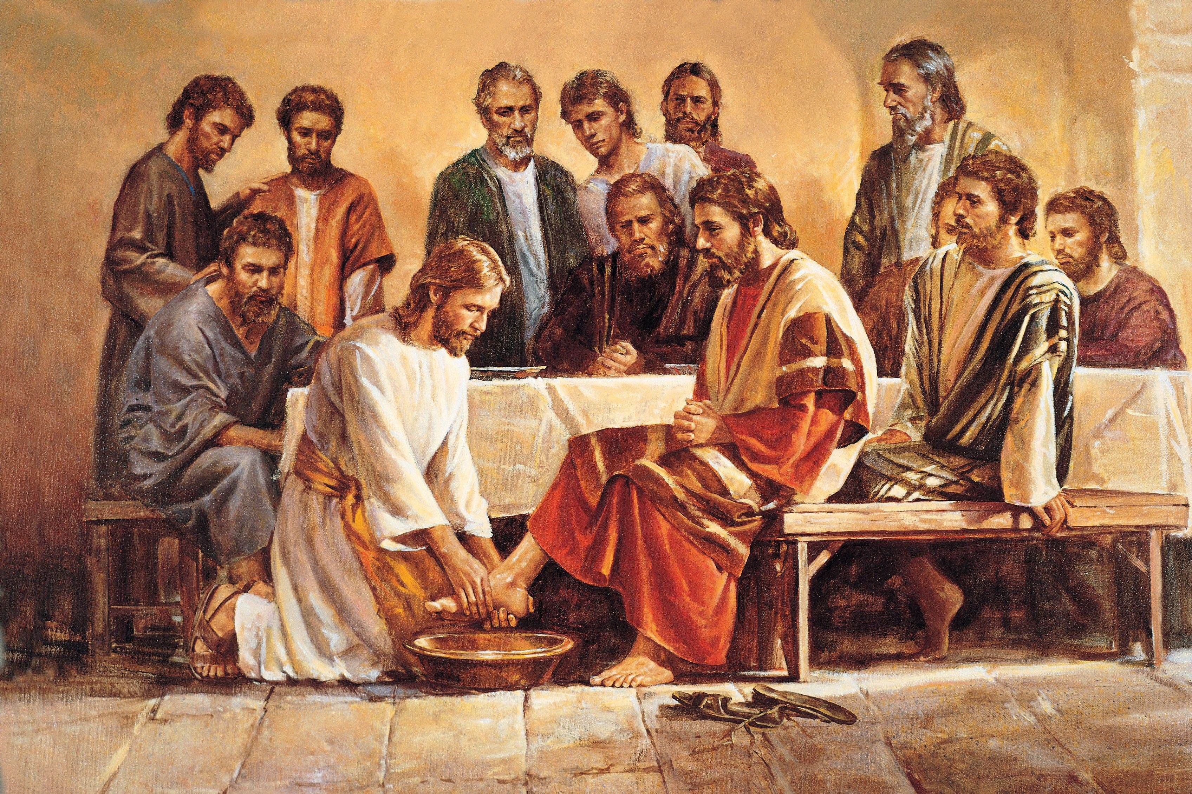
John 13:1-17 Jesus Shows His Love
John 13:1 Jesus loved them “to the end.”
How? By washing their feet.

Slide 3
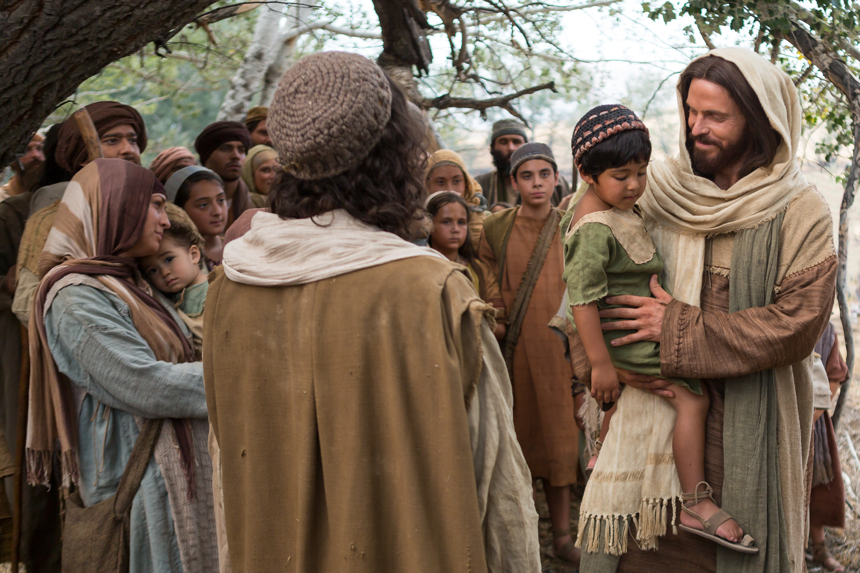
John 13:31-35 As I Have Loved You
Love one another as I have loved you.
By this all people will know that you are my disciples.

Slide 4
John 14:1-4 Jesus: Trust in me
Trust in God, trust also in me.
  Do you trust God?
Wedding metaphor
  Jewish betrothal: Groom promises to “build a room” for the bride.
  Then he brings her there to live with him.

Slide 5

In My Father’s There are Many Rooms
1 Corinthians 2:9
No eye has seen, not ear has heard not mind conceived…

Slide 6

John 14:5-14
I AM the Way the Truth and the Life
I AM the way
“The Way” Acts 22:14, Acts 9:2, 19:9, 22:4
I AM the truth
I Am the life
Which is most comforting to you?

Slide 7
Comfort From Jesus
John 14:12 They will do greater works than these:
What things?
Bringing salvation to the lost and offering the Holy Spirit
v. 14 Ask Me anything in my name.
We can pray through Jesus or
We can pray to Jesus.

Slide 8
Jesus Comforts the Disciples
John 14:15-31
v. 16 I will not leave you alone.
I will send the Advocate/Comforter/Counselor.
v. 18 You are not an orphan.
v. 23 “We will come to him and make our home with him.”
v. 26 An advocate
v. 27 My peace (shalom) I leave you.

Slide 9

Verse for the Week
John 14:27 Do not let your heart be troubled, and do not be afraid.

Slide 10
Jesus Comforts His Disciples
I Am preparing a place.
I AM the way to that place.
I AM truth and life.
You will do greater things than me.
Ask anything in my name
I am sending the Counselor/Comforter to you
I will make my home with you

