Slide 1
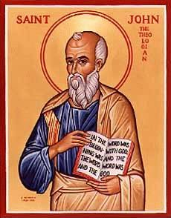
The Gospel of John XVIII
John Ch 16
I Have Overcome the World

Slide 2

In My Father’s There are Many Rooms
Trust in God.
Trust also in me.

Slide 3

John 14:5-14
I AM the Way the Truth and the Life
I AM the way
“The Way” Acts 22:14, Acts 9:2, 19:9, 22:4
I AM the truth
I Am the life
Which is most comforting to you?

Slide 4

Verse for the Week
John 14:27 Do not let your heart be troubled, and do not be afraid.

Slide 5
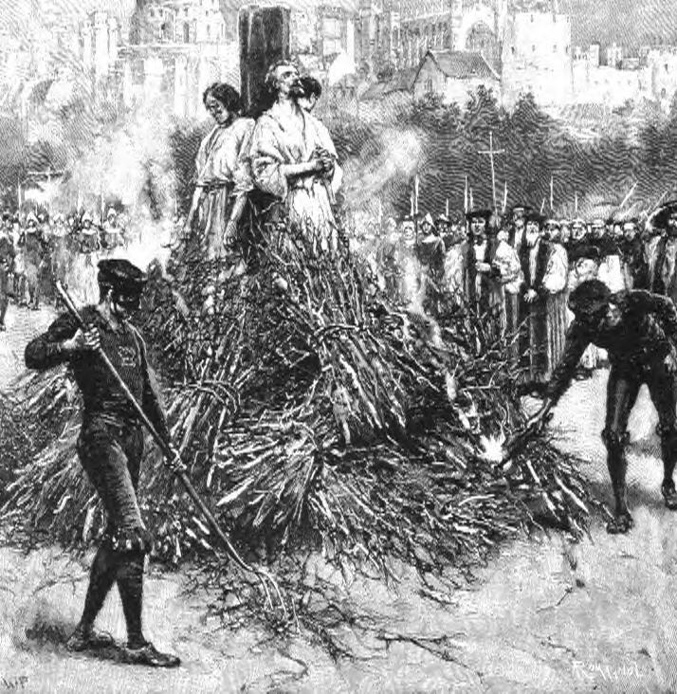
John 15:18-25 The reason we need so much comfort: Persecution
Jesus “assures” them with six if… then.. statements. 15:18, 19, 20 (2x), 22, 24.
They do not hate you. They hate me and they hate my Father.
Their hatred is not reasonable

Slide 6
Why do they persecute us?
Because we are Christ-like.
Because we call them to change.
Because our righteous lives make them look bad.
Because we call them to love God more than self.
Because we call them to love those they hate.
None of this is rational

Slide 7
Our emotions: They hate me. What did I do wrong?
Reality: It is because you are being Christ-like and loving them (ideally!).
Jesus: Let us hold on to the reality here.

Slide 8
John 15:26-6:4 Comfort
John 15:26 The Holy Spirit is your Advocate.
He will put words into your mouth. Luke 12:11-12
Remember, I told you ahead of time.

Slide 9
John 16:5-15 Comfort
John 16:6-7 It is good for you that I am going away. What????!!!!
I got you!
The Holy Spirit will put words in your mouth.
He will convict the world about sin, righteousness and judgment.
You will have miraculous understanding of Scripture.

Slide 10
John 16:16-24 Comfort
Your grief and mourning will turn to joy.
It will get rough, but I have you covered.

Slide 11
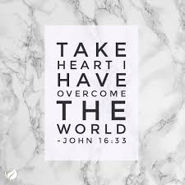
John 16:29-33
Here is our take-home lesson:
Take heart, I have overcome the world!

Slide 12
Summary
To the extent we reflect Christ, we will be persecuted.
But, we have the Holy Spirit/Counselor who will put words in our mouth and, through us, convict the world of sin, righteousness and judgment.
Bottom line: Take heart, I have overcome the world. And so will you!

