Slide 1
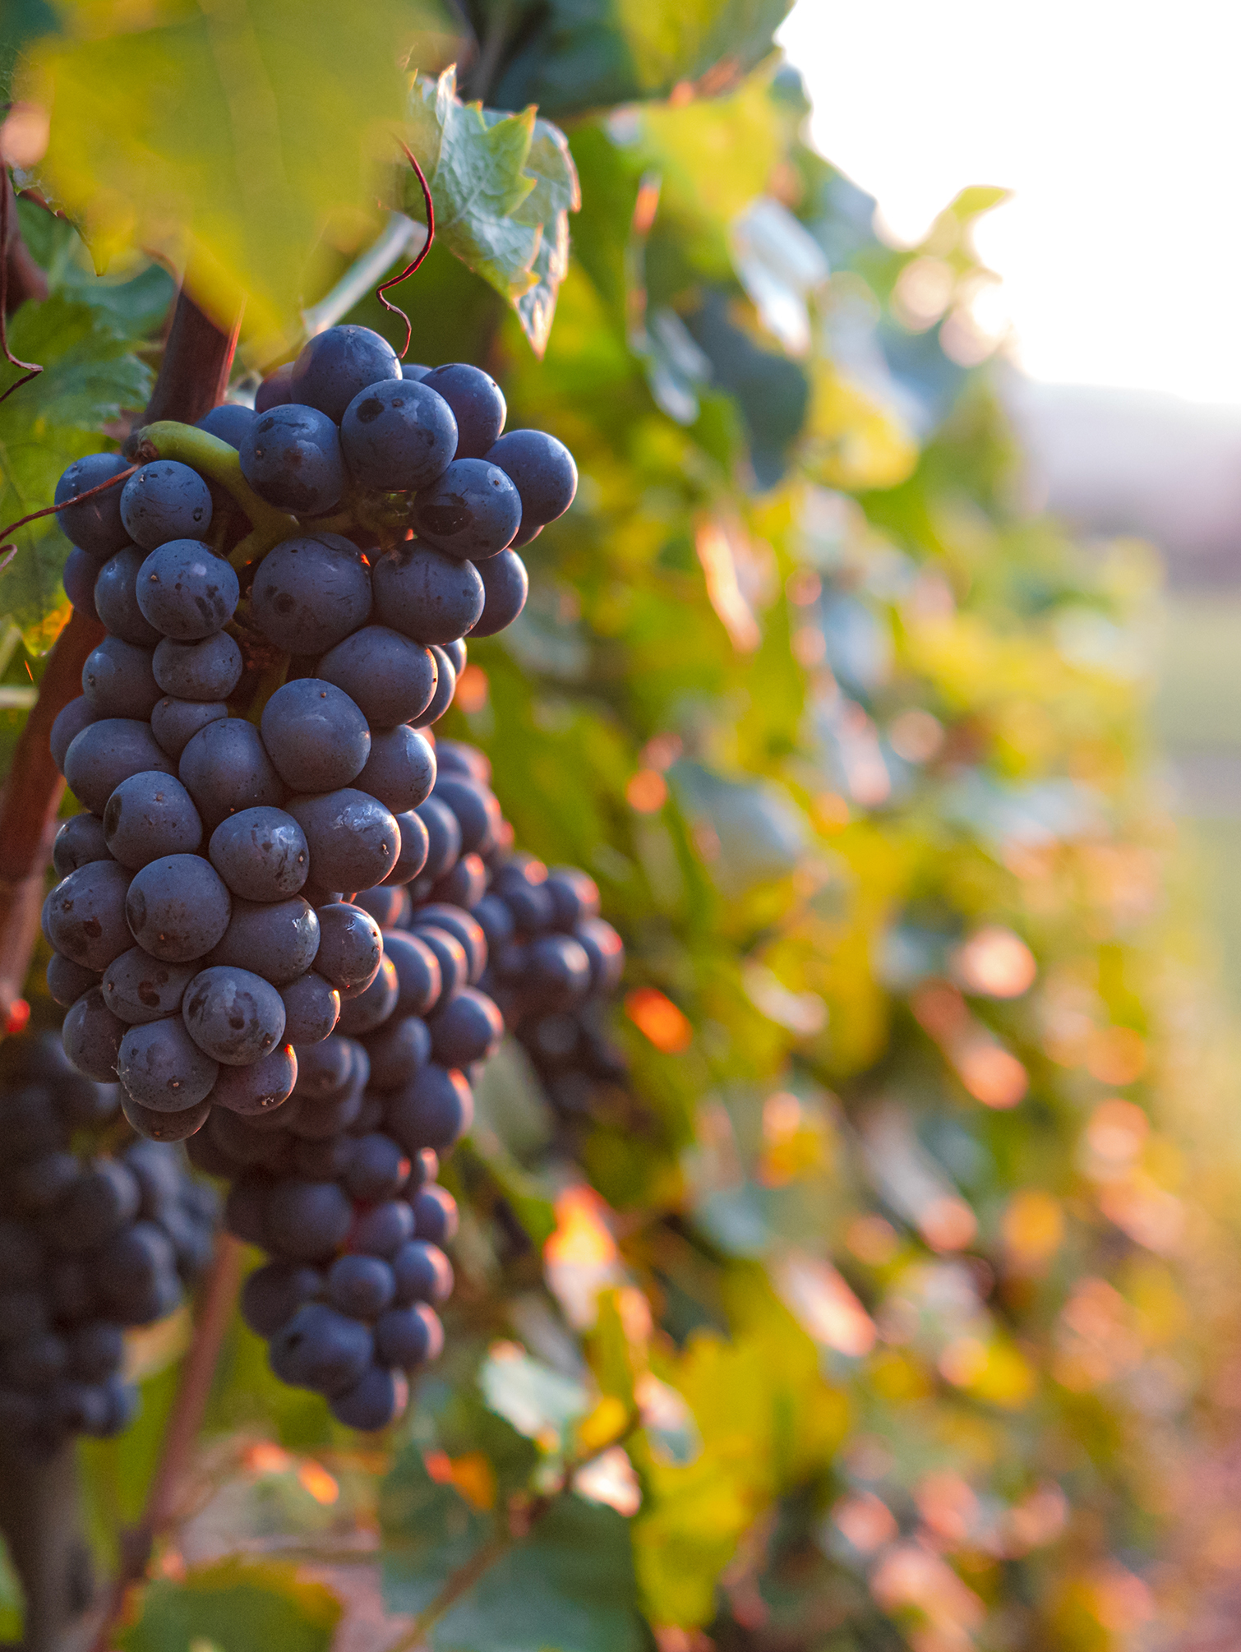
John XVII: The True Vine

Slide 2
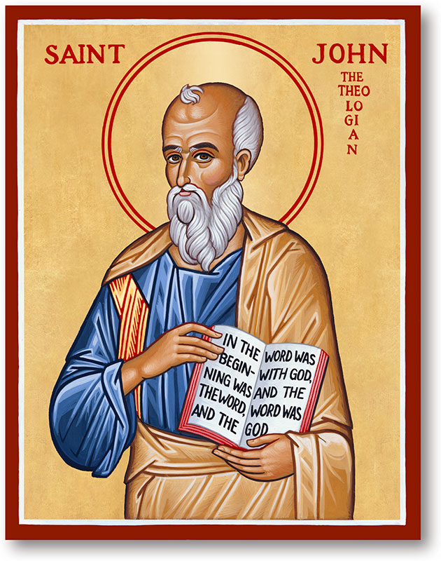
Recap
Expect persecution because of Christ
Rely on the Holy Spirit
Take heart Jesus has overcome the world

Slide 3
God’s Vineyard Vision (Isaiah 5:1–7)
God’s intent: Fruit of justice and righteousness
God’s effort: Dug, cleared, planted, watched
Outcome: Only wild grapes (sin, injustice)
Result: Judgment and devastation
Isaiah 27: Promise of Restoration
“Now Jesus says, ‘I am the true vine.’

Slide 4
The True Vine & The Gardener (John 15:1–2)
Jesus = True Vine (faithful Israel)
The Father = Gardener
Dead branches cut; fruitful branches pruned
Pruning is not punishment, it brings a harvest (Hebrews 12:11)
Q: Are you resisting God’s pruning?

Slide 5
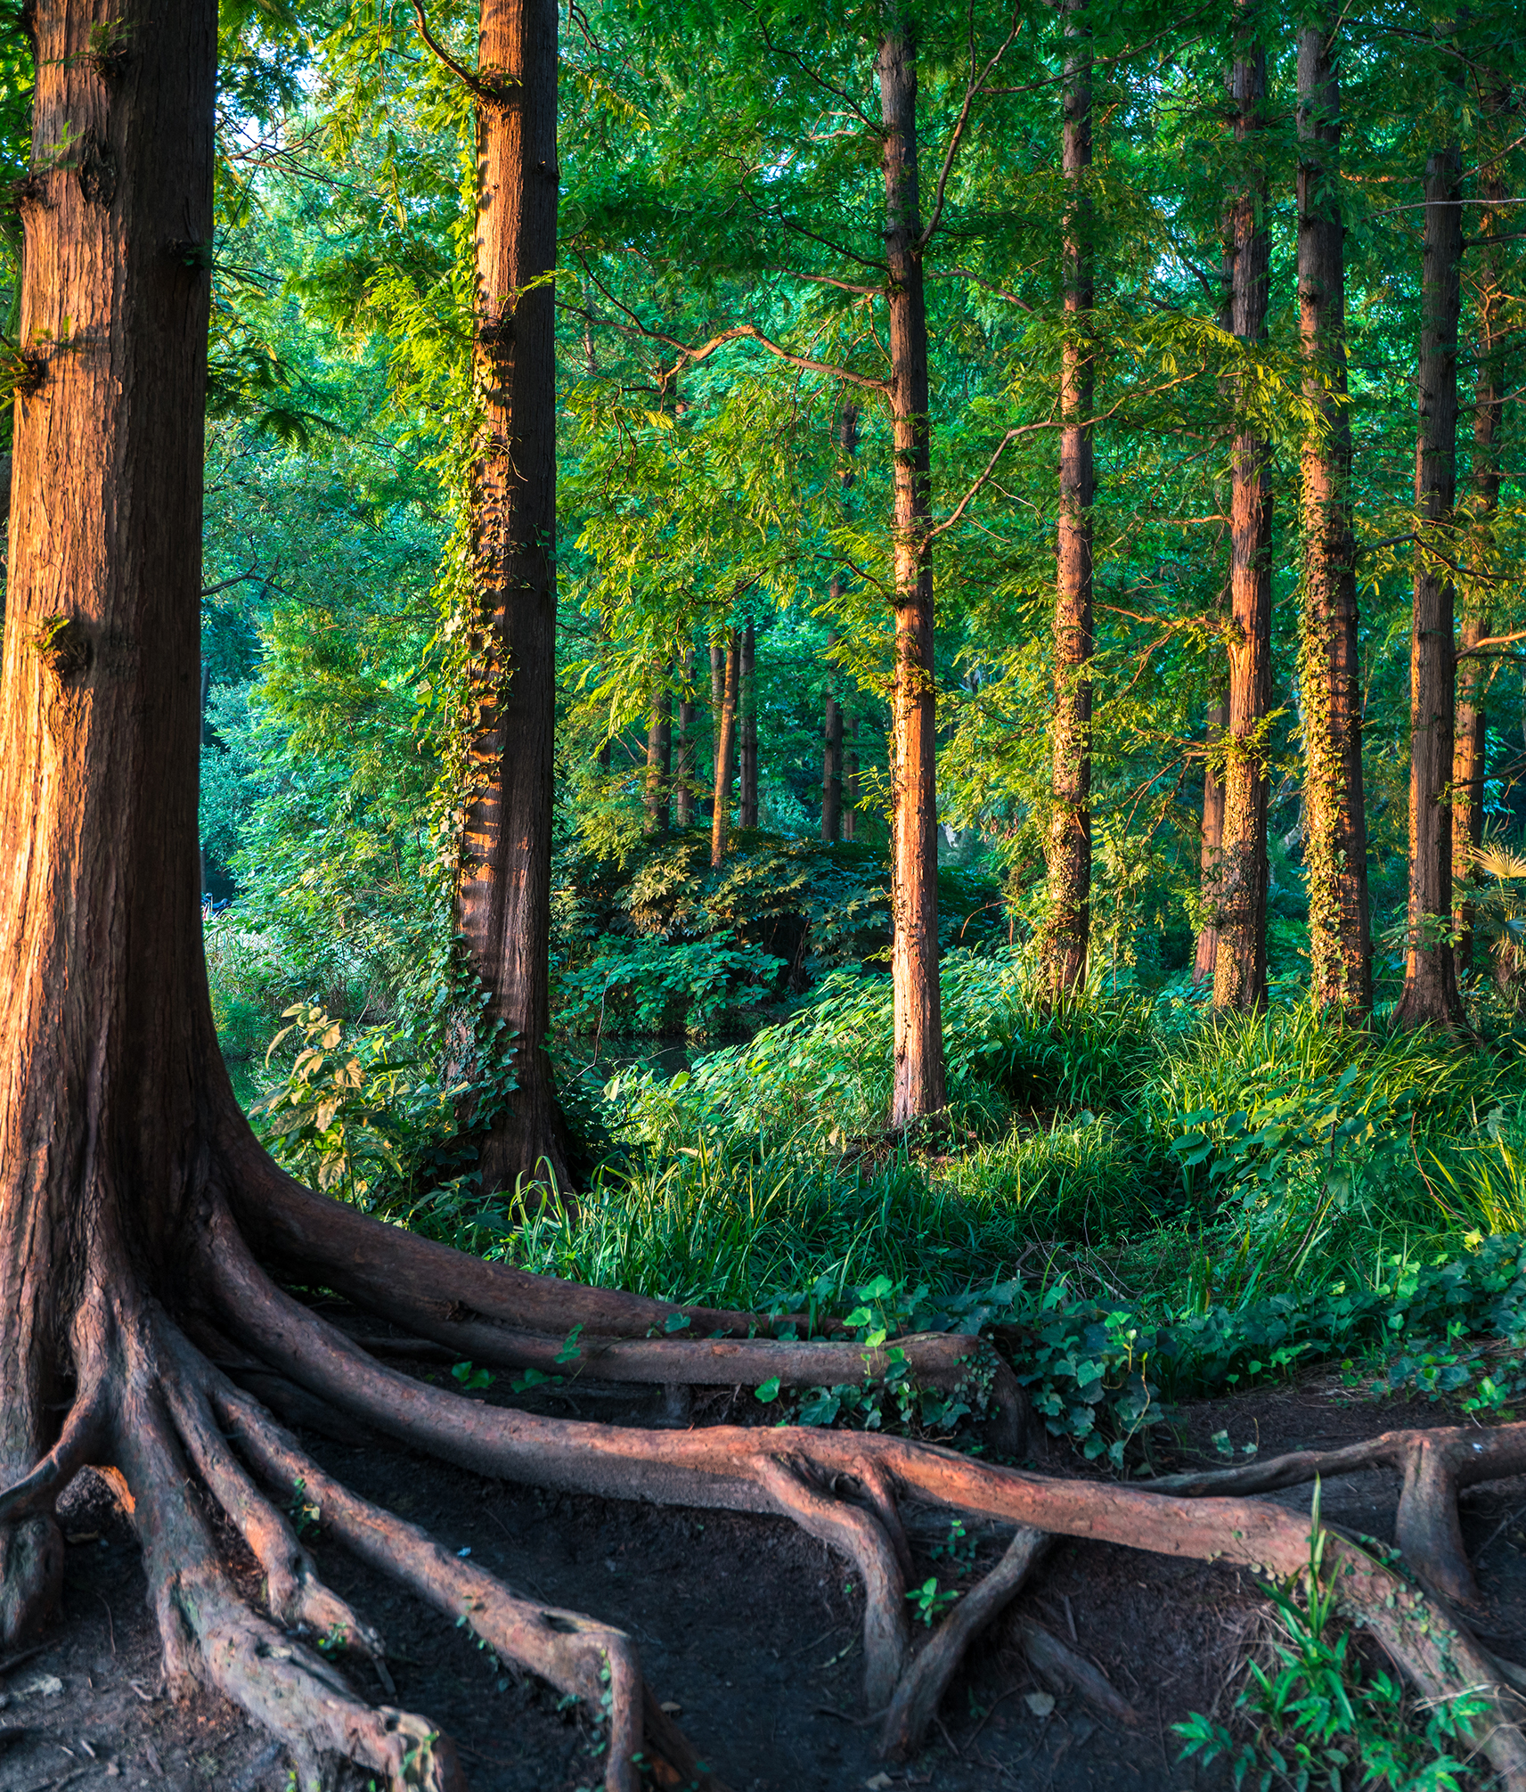
The Call to Abide (John 15:3–6)
Abide = Remain, stay connected (Greek: meno)
Disconnection = death, fruitlessness
“Apart from Me you can do nothing.”
Q: Where are you rooted?

Slide 6
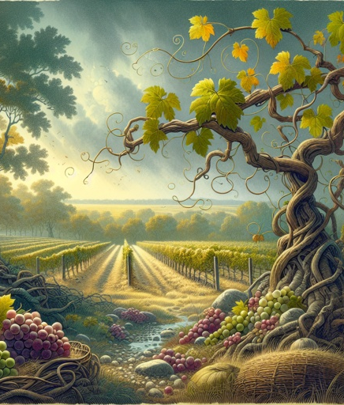
The Fruit of Abiding (John 15:7–8)
Prayer becomes powerful when rooted in Christ
True disciples bear visible fruit
“This is to my Father’s glory…”
Isaiah 27:6: “Israel will bud and blossom and fill the world with fruit.”

Slide 7
Love, Obedience, and Joy (John 15:9–11)
Love is the atmosphere of abiding
Obedience flows from relationship, not law
“I have told you this so that My joy may be in you…”
Q:Is your Christianity a joy or a burden?
Acts 2:42

Slide 8
Friendship and Fruit that Lasts (John 15:12–17)
Not servants, but friends
Love each other as Christ loved us
Chosen and appointed to bear lasting fruit
Q: Are you loving radically or just comfortably?
Q: Do you relate to Jesus as a friend or still as a distant master?

Slide 9
What we learned
God’s vineyard (Israel) failed...but Jesus is the True Vine.
The Father prunes not to punish, but for a harvest
Abiding in Jesus is the only way to bear lasting fruit.
Love and joy are the environment and result of true discipleship.
We are called friends, not just servants, and appointed to bear fruit that lasts.

