Slide 1
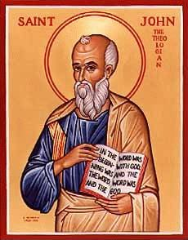
The Gospel of John XIX
John Ch 17
The Hour Has Come
Prayer for Unity

Slide 2
Jesus’ Last Discourse
Jesus showed them his love “to the bitter end.”
Jesus washed their feet.
Jesus comforted his disciples
In my Father’s house there are many rooms…
I am going to the Father, but I am sending the Comforter
You will be persecuted, but the Holy Spirit will help you.
Abide in me!

Slide 3
John 17 :1 The Hour Has Come
What hour is this?
The hour of Jesus’ death
The hour of the redemption of humanity
The greatest hour in human history
The hour God’s plan is consummated
The hour Old Testament prophecy is fulfilled
The Old Covenant will be fulfilled
The hour the world will take its best shot at Jesus
The New Covenant will be sealed with blood
The Lamb from the foundation of the world will be slain

Slide 4
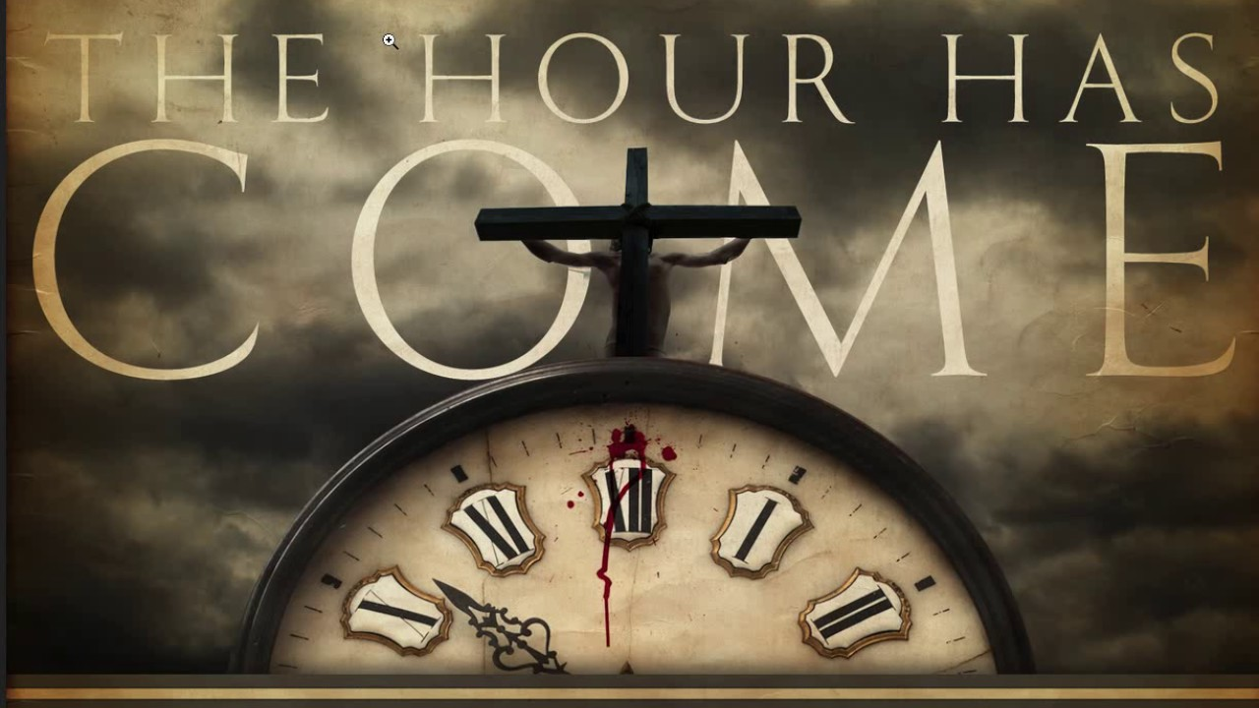

Slide 5
John 17:1 The Hour for What?
The hour for Jesus to be glorified
Glory/glorify 9 times in John 17 (36 times in John)
Glorify:
John 3:14
John 8:28
John 12:32

Slide 6
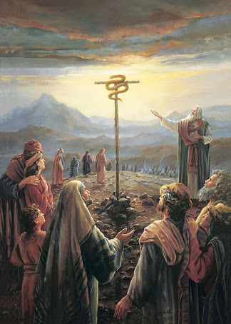
John 3:14
Numbers 21:7-9
Just as Moses lifted up the snake in the wilderness, so the Son of Man must be lifted up.

Slide 7
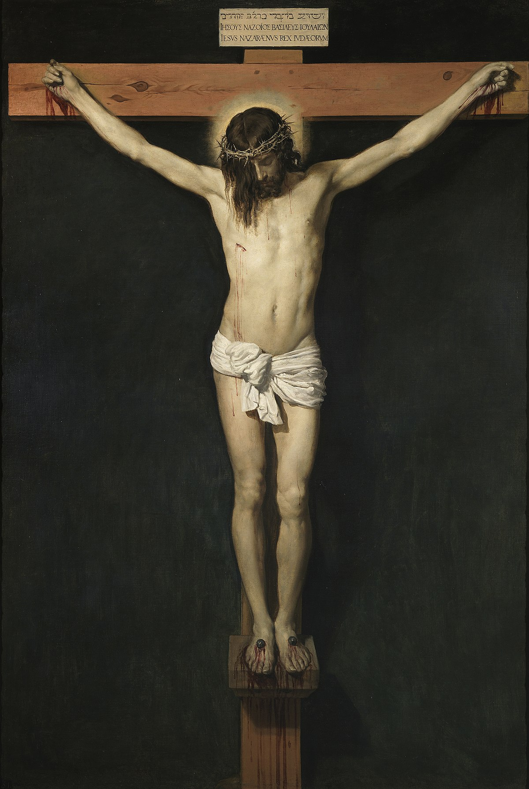
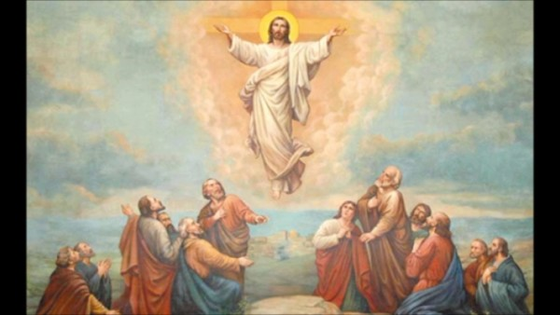
John 8:28 I AM He ego eimi
When you have lifted up the Son of Man, then you will know that I AM He
Have you been lifting Jesus up?

Slide 8
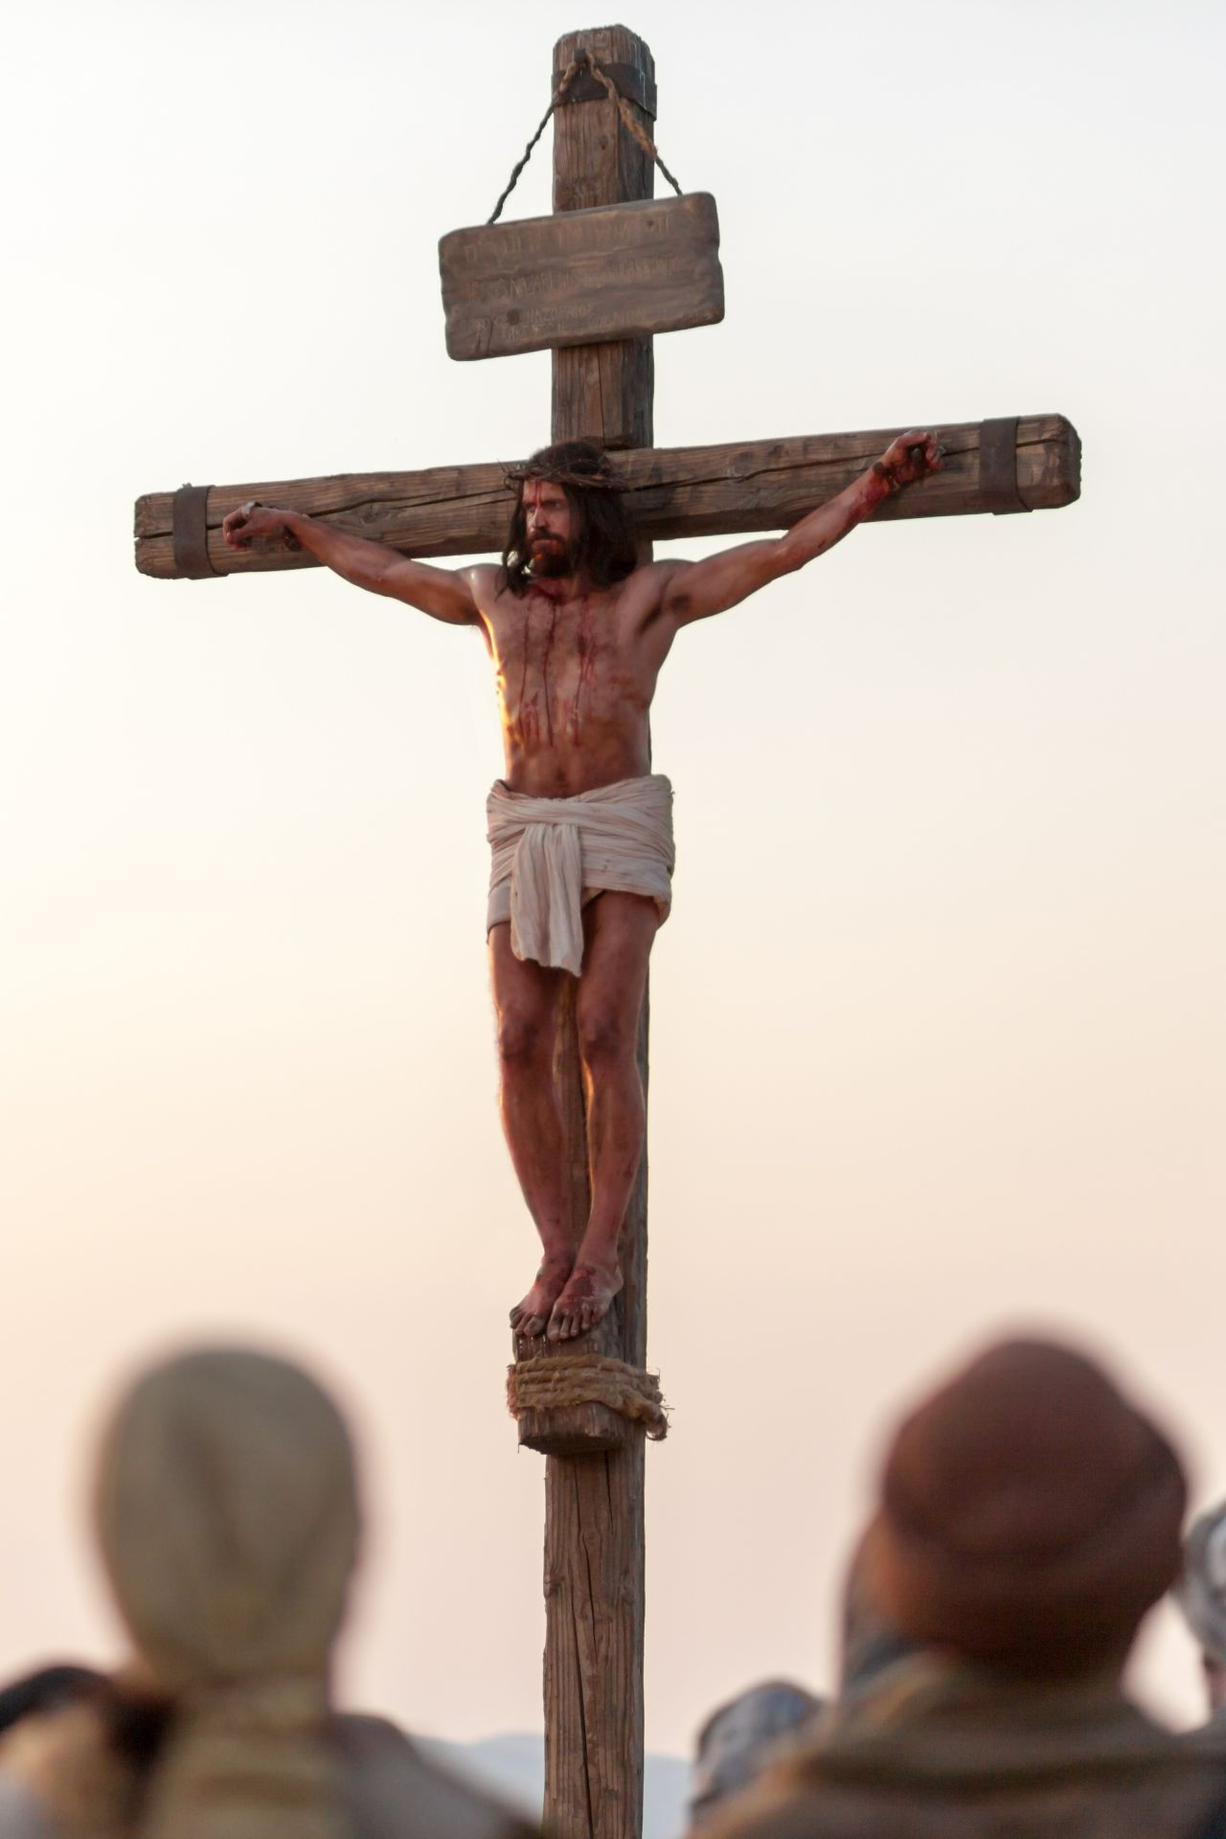
John 12:32 Jesus Glorified
How is Jesus glorified?
How does Jesus glorify God?
Answer: By dying!
Lifted up:
-on a cross
-resurrection
-ascencsion to heaven
-when we lift up Jesus

Slide 9
John 17:3
This is eternal life: That they may know you, the only true God and Jesus Christ, whom you have sent.
Ginosko: To know intimately, to experience
Do you know Jesus?
John 17:25-26 I have made you known to them.

Slide 10
John 17:4
God glorified Jesus, but Jesus also glorified God!
How? By completing the work given to him.
2 Tim 4:6-8
What is the work God has given you?
Are you completing this work?

Slide 11
John 17:6-19
Jesus Prays for the Apostles
v. 10 All I have is yours and all you have is mine.
v. 17 Sanctified (set apart) by the truth for the work you gave them.
v. 11,12,15 Protected
v. 13 the full measure of my joy

Slide 12
John 17:20-26
Jesus Prays for Us
God: Please see that they love one another!!!!!
v. 22 May they be one as we are one. What does that look like?
v. 23 Then the world will know…. (John 13:334-35)

Slide 13

John 17:23
Complete Unity

Slide 14
Jesus’ Last and Greatest Prayer
The hour has come!!!
Jesus is being lifted up and glorified!
The key to eternal life: Knowing Jesus!!!
Jesus (and we) can glorify God by completing his work.
Jesus prays for our protection and our sanctification.
Jesus parting thought for us: Be one as the Son and the Father are one!!!

Slide 15
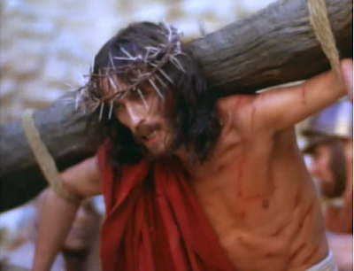
John 18 & 19 The Passion of Christ
Jesus is completely in control.
Jesus has predicted what is happening.
Jesus is fulfilling prophecy.
Jesus is being bold.

Slide 16
Summary: John 20:21-31
My Lord and my God!
These things were written that you may believe that Jesus is indeed the Christ, the Son of God, and that, by believing, you will have life in his name.
Do you believe? Will you lift up Jesus?
And to God be the glory!

