Slide 1
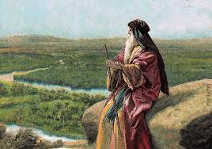
Deuteronomy VIII
Moses’ Final Words

Slide 2
Deuteronomy
Theme: hesed. Covenant loyalty. God wants from us, what he has already given us.
Theme passage: Deuteronomy 6:4-5 The shema
Hear, O Israel: The Lord your God, the Lord is one. Love the Lord your God with all your heart, and with all your soul, and with all your strength.

Slide 3
Last Week Deuteronomy 30 Decisions, Decisions
God is calling you to do two things:
Love God with ALL your heart.
Fully obey all he has commanded you.
And he says it is not too hard. It is right near you.
v. 14 God: the Word is near you, in your mouth, you can obey it. You can do it. Si! Se puede!
How can I both love completely and obey fully?

Slide 4
Two Possible Ways To Do This
1. Act my way to a better way of feeling. (obedience first)
2. Feel my way to a better way of acting (heart first)

Slide 5
How Can I Do This, Moses?
Deuteronomy 30:19-20
Choose Life!!! Choose today!!!
Luke 9:62 Put your hand to the plow and do not look back.
Then… You will be able to love God with all your heart, and to listen to His voice and hold fast to him.

Slide 6
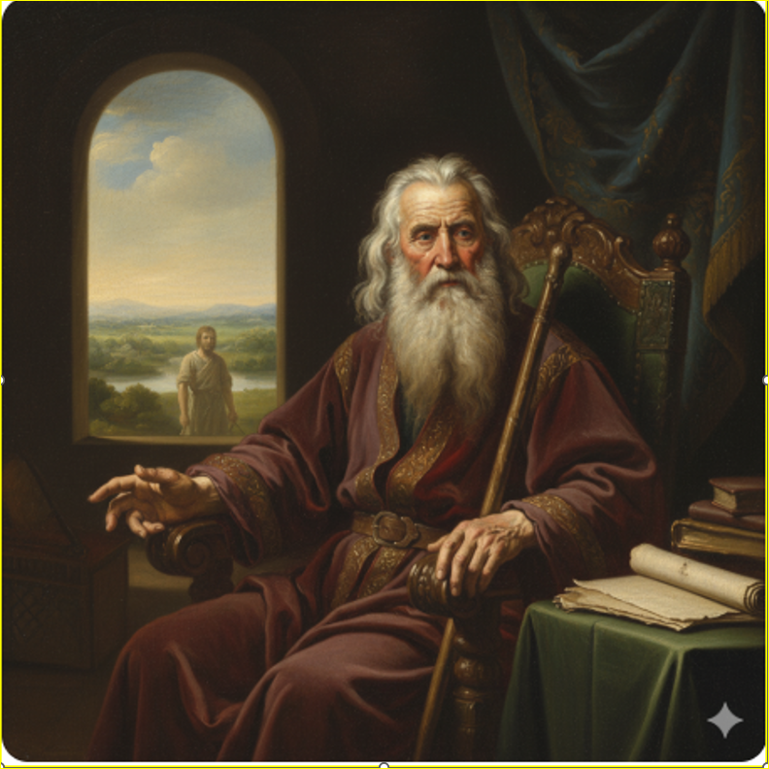
Deuteronomy 31:1-8 Be Strong And Courageous!
Moses: Sorry, I am not going with you. I’m too old.
But… God will go before you, which is far better!
Heb 13:5 Never will I leave you, never will I forsake you.

Slide 7
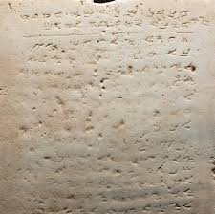
Deuteronomy 31:9-13
Point #1 Be strong and courageous. God is going before you.
Point #2 Listen and Learn from the Law/the Bible.

Slide 8
Deuteronomy 31:14-18
Point #1 Be strong and courageous. God is going before you.
Point #2 Listen and Learn from the Law/Bible.
Point #3 Do not forsake your covenant love, or I will forsake you.
2 Timothy 2:11-13 If we disown, God will disown us, but he will always be faithful!

Slide 9
Deuteronomy 32 The Song of Moses
v. 1-4 God is the Rock!
v. 5-14 God found us, and led us, and brought us to the heights.
But we are of the flesh and likely to corruption.
v. 15-16 We abandoned Him, so he will abandon us.
v. 17-21 We went for idols and made God jealous. God gave us over to the idols. Romans 1:24

Slide 10
Deuteronomy 32:28-33
How foolish!
We forget that God worked great miracles.
A great memory verse:
Deuteronomy 32:31 “For their rock is not like our Rock, as even our enemies concede.”

Slide 11
Deuteronomy 32:36-40 Hope!
I will vindicate those who are faithful to the covenant.
I, I Am He!
I bring life, I heal, I deliver.
v. 40 I swear!

Slide 12
Deuteronomy 32:45-47 Moses’ Last Words
A great memory verse:
“These are not idle words for you—they are your life! By them you will live long in the Promised Land.”

Slide 13
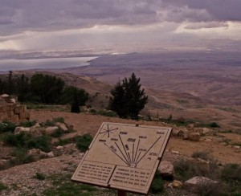
Deuteronomy 34:1-5 Moses on Mt. Nebo
Remember Deut 18:15 “God will raise up a prophet like you from among the Israelites.”
Moses willingly went up on Mt. Nebo to lay down his life so that we could enter the Promised Land.

Slide 14
Deuteronomy 34:10-12 Post Script
Since then, no prophet has risen in Israel like Moses, whom the Lord knew face to face.
True, but then, in Nazareth in Galilee, a new prophet like Moses rose. Listen to him.

Slide 15
Summary
God wants us to take the Promised Land
He tells us to be strong and courageous, because he is going before us.
But, do not become spiritually fat and go back to your idols, or, when we forsake him, he will forsake us.
God will go before us. He is our Rock! He gives life, He heals, He delivers. He swears he will make atonement for his people.
Do not forget his Word. These are not idle words, they are your life!

