Slide 1

1 Peter
God’s Elected Exiles

Slide 2
1 Peter
Author: The apostle Peter
A “General Epistle” to Christians generally

Slide 3
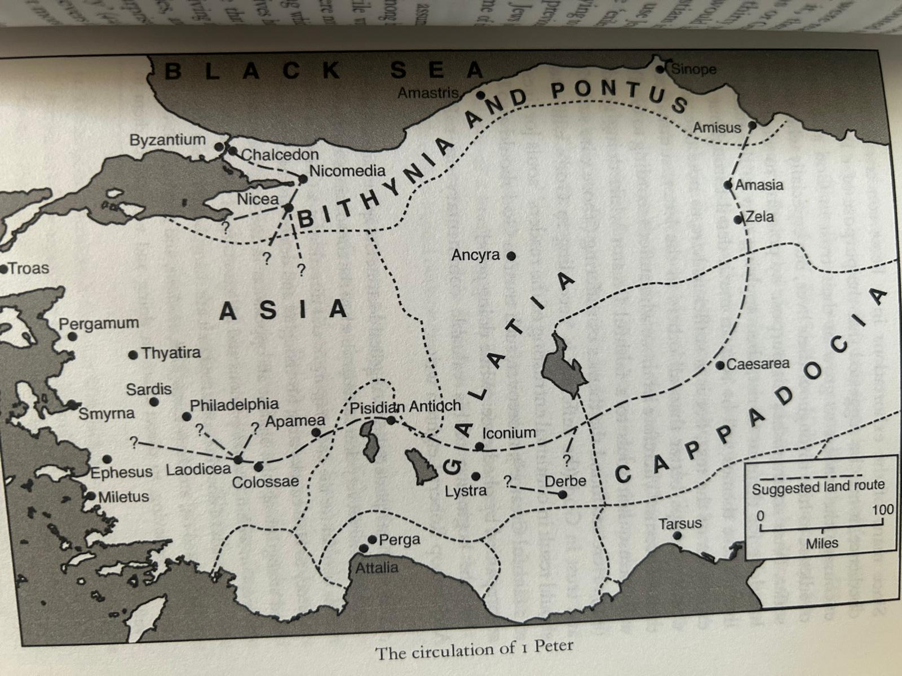
Audience of 1 Peter
The Dispersion in
Pontus, Galatia, Cappadocia, Asia and Bithynia

Slide 4
1 Peter
Date of writing: 62-63 AD
A “pastoral letter.” 1 Peter 5:1-4

Slide 5
1 Peter Principal Themes
A call to holy living in Christ.
“holy” 8 times
“righteous” 8 times
The Christian response to suffering and persecution.
Theme Passage: 1 Peter 4:19 “So, then, those who suffer according to God’s will should commit themselves to their faithful Creator to do good.”

Slide 6
Things To Look For in 1 Peter
The glory of God.
2. The sovereignty of God.
The suffering of Christ.
Our suffering.
The call to holy living.
This is our outline!

Slide 7
So…
If you have either had to deal with significant persecution, or another form of suffering and challenge to your faith.
Or
If you have had a struggle with sin and with the continued call to holiness in your Christian life.
Then, 1 Peter is the book for you.

Slide 8
1 Peter 1:1-2
Who am I?
I am an elect exile. A scattered, elect, exile.
Scattered. “of the dispersion”… A reference to the Jews, but applied to all the Children of Abraham.

Slide 9
Exiles…
parapidemos other-walkers exiles, sojourners, temporary residents.
1 Peter 1:17 paroikious (other-homed, exiles)
1 Peter 2:11 paraoikos and parapidemous
Hebrews 11:13 foreigners (xenoi) and sojourners (parapideimous)

Slide 10
Exiles, Sojourners
We are different. We do not fit in.
Phil 3:20 Our citizenship is in heaven.
Our constitution? Matthew 5-7
Our bill of rights? 1 Cor 9
Jesus: “My kingdom is not of this world.” John 18:36

Slide 11
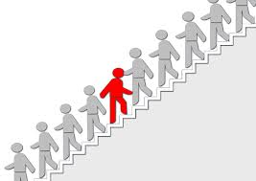
Elect Exiles
elektos
Chosen by God’s foreknowledge
By His Holy Spirit

Slide 12

Chosen! Elect!
Chosen for what?
Chosen for sanctification—to be made holy
and for obedience.
Deification, transformation,

Slide 13
Elected For What?
Grudem: For “a life lived in daily obedience and forgiveness.”
For “a life lived in accordance with God’s will and continually cleanse from sin by the blood of Jesus.”
How does it feel to be chosen by God?

Slide 14
Summary
We are elect exiles
Exiles, sojourners, aliens, parapideimous. Our kingdom is not of this world. Do you live that way?
Elect, chosen by God’s foreknowledge for sanctification and obedience to Him.

