Slide 1

Welcome to the Merced Christian Church

Slide 2
I Feel Good
(714)

Slide 3
I feel good, good good
I feel good, oh yes my Lord!
Because there’s somethin’ ‘bout the Spirit of Jesus,
That makes me feel good,
Good, good, good.

Slide 4
I feel love, love love
I feel love, oh yes my Lord!
Because there’s somethin’ ‘bout the Spirit of Jesus,
That makes me feel love,
Love, love, love.

Slide 5
I feel joy, joy joy
I feel joy, oh yes my Lord!
Because there’s somethin’ ‘bout the Spirit of Jesus,
That makes me feel joy,
joy, joy, joy.

Slide 6
I feel peace, peace, peace
I feel peace, oh yes my Lord!
Because there’s somethin’ ‘bout the Spirit of Jesus,
That makes me feel peace,
Peace, peace, peace.

Slide 7
So – I feel good, good good
I feel good, oh yes my Lord!
Because there’s somethin’ ‘bout the Spirit of Jesus,
That makes me feel good,
Good, good, good.
[End]

Slide 8


Slide 9
Sing Hallelujah To The Lord
(218)

Slide 10
(Women echo after men.)
Sing hallelujah to the Lord,
Sing hallelujah to the Lord,
Sing hallelujah, sing hallelujah,
Sing hallelujah to the Lord.

Slide 11
(Women echo after men.)
Jesus is risen from the dead,
Jesus is risen from the dead,
Jesus is risen, Jesus is risen
Jesus is risen from the dead.

Slide 12
(Women echo after men.)
Jesus is living in His church,
Jesus is living in His church,
Jesus is living, Jesus is living
Jesus is living in His church.

Slide 13
(Women echo after men.)
Jesus is Lord of Heaven and Earth,
Jesus is Lord of Heaven and Earth,
Jesus is Lord, Jesus is Lord,
Jesus is Lord of Heaven and Earth.

Slide 14
(Women echo after men.)
He’s coming back to claim his own,
He’s coming back to claim his own,
He’s coming back, He’s coming back,
He’s coming back to claim his own.

Slide 15
(Women echo after men.)
Sing hallelujah to the Lord,
Sing hallelujah to the Lord,
Sing hallelujah, sing hallelujah,
Sing hallelujah to the Lord.
[End]

Slide 16
I Need Your Love
(218)

Slide 17
Oh I need your love in this shadowed place;
I can’t get enough of your sunlight on my face
When it’s cold and dark, or I’m far from home, you are in my heart and I never walk alone.

Slide 18
And just like a tree planted by a stream, thirsty for a drink of your love, I can’t face a day without some time to pray;
I sing this song to say I need your love

Slide 19
I’m a tiny child, but when I’m with you
I will not grow tired ‘cause there’s nothing you can’t do.
Your love makes me strong though I’m small and weak,
And the whole day long you’ll speak through me when I speak.

Slide 20
And just like a tree planted by a stream, thirsty for a drink of your love, I can’t face a day without some time to pray;
I sing this song to say I need your love

Slide 21
You gave all for me though I’d cursed your name;
On that bitter tree, Lord, you suffered for my shame.
How can I thank you? Your love paid my way.
All that I can do is live for you every day.

Slide 22
And just like a tree planted by a stream, thirsty for a drink of your love, I can’t face a day without some time to pray;
I sing this song to say I need your love
[End]

Slide 23
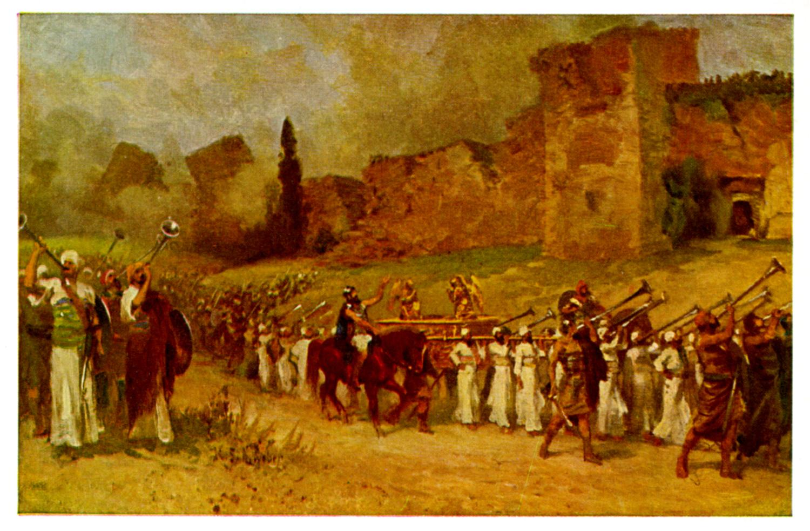
Joshua II Preparing to Enter

Slide 24
Background to Joshua
Three ways of thinking about Joshua:
1. A Historical Book (Joshua, Judges, 1,2 Sam, 1,2 Kings)
2. The completion of Deuteronomy (Hexateuch)
3. A book about godly leadership

Slide 25
Theme Passage
Joshua 1:6 Be strong and courageous, because you will lead these people to inherit the land I swore to their ancestors to give them.
The land is yours, now go and take it.
Receiving the Promised Land is an event.
Taking it is a process. Already but not yet.

Slide 26
Joshua as History
Joshua 15:14 Sheshai, Ahiman and Talmai
Joshua Ch 1-3
29 cities
10 persons
17 “peoples”
Ex: The Hittites

Slide 27
Are the Hittites a real people?
Mentioned 47 times in the Old Testament.
In Joshua and Judges the Hittites appear to be the other dominant power in Canaan other than Egypt.
19th century: Historians claim the Hittites (and Hivites, Jebusites, Girgashites, Gibeonites…) were an invention of 5th century BC Jewish writers.

Slide 28
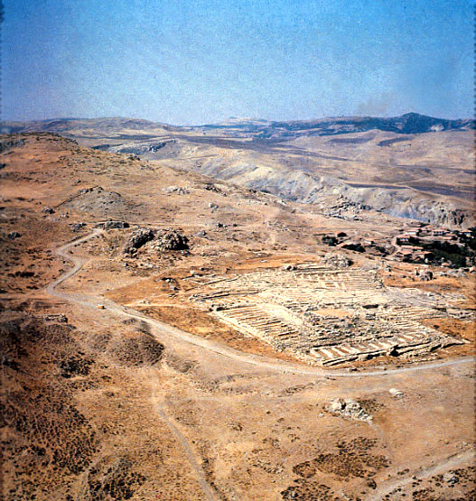
1906
Hugo Winkler
Ruins of Hattusha, capital of the Hittites

Slide 29
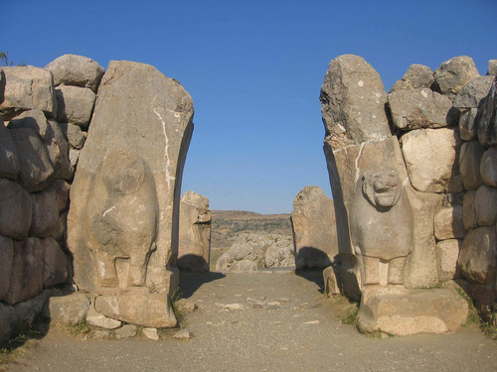
The Lion Gate in Hattusha

Slide 30
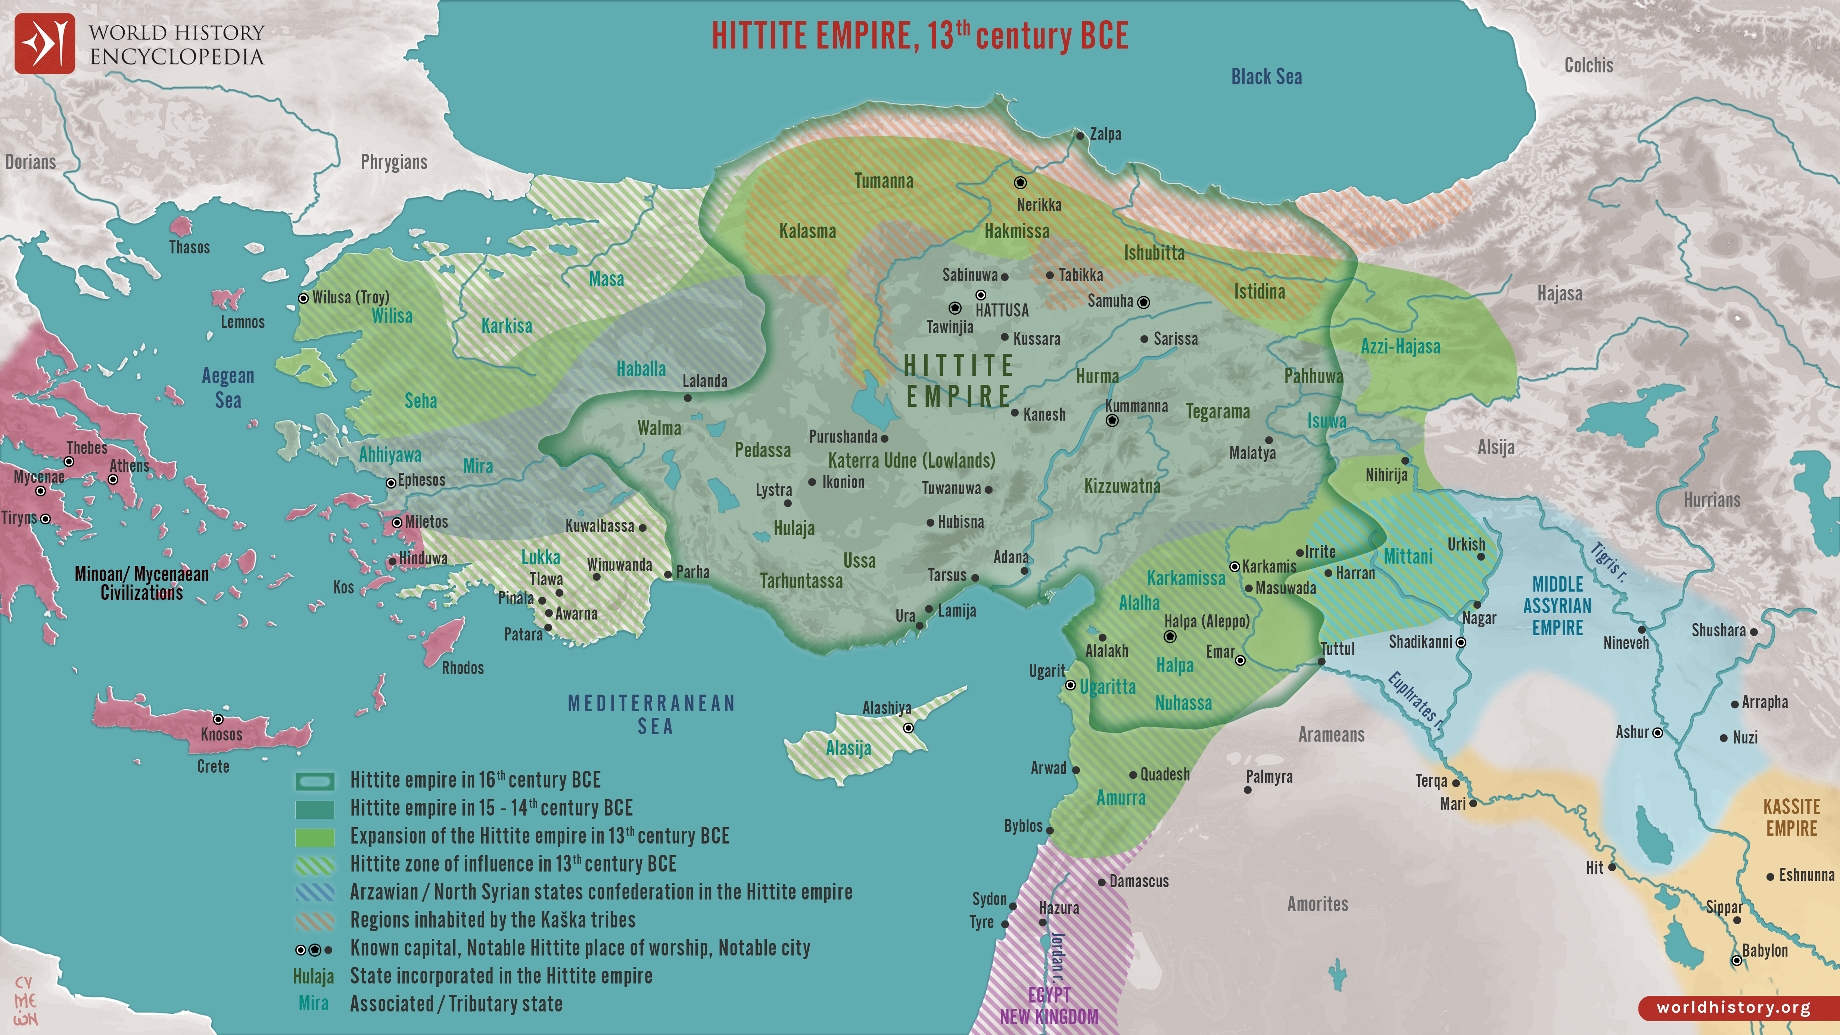

Slide 31
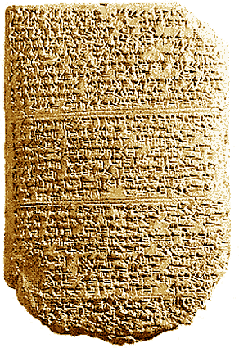
‘The Habiru plunder all lands of the king. If archers
are here this year, then the lands of the king, the
lord, will remain; but if the archers are not here,
then the lands of the king, my lord, are lost.’
Tel El Amarna Letters c. 1400 BC

Slide 32
Joshua as History
Conclusion: “The Book of Joshua is a contemporary historical account of actual events, which lends strong credence, both to the historical reliability of the Bible, and to the miraculous events recorded in the book.”
John Oakes
☺

Slide 33
Prefigures and Foreshadows in Joshua
Joshua is the New Moses.
Joshua is a prefigure of Christ.
Jeshua/Jesus The Lord Saves
The Jordan River is the new Red Sea

Slide 34
Foreshadows
Exodus – Deuteronomy:
Egypt = Slavery, lost
Wilderness = Disciple, saved
Promised Land = Heaven
Red Sea = baptism, when you were saved
Moses as messianic prefigure
Joshua-2 Kings
Egypt = Slavery, lost
Canaan = Disciple, saved
Heaven = Heaven
Jordan River = baptism, when you were saved
Joshua as messianic prefigure

Slide 35
Joshua I Be Strong and Courageous
Joshua 1:1-5
“After the death of Moses. Connects with Deuteronomy
Luke: Coming to Jerusalem.
Acts: Leaving Jerusalem.
Deuteronomy: Coming to the Jordan
Joshua: Crossing the Jordan, taking the land

Slide 36
Outline of the Book of Joshua
v. 2 Crossing the Jordan Ch 1-5
v. 3 Conquering the land Ch 6-12
v. 4 Dividing the land Ch 13-22

Slide 37
Joshua 1:5-9
Be strong and VERY courageous v. 6, 7, 9
Joshua: Why?
v. 6 Because I chose you to lead
v. 7 Because you have obeyed the Law of Moses
v. 9 Because the Lord your God will be with you wherever you go.
Deuteronomy 31:6 Matthew 28:20

Slide 38
Have you ever felt inadequate and discouraged?
God to Joshua: Do not be afraid. Do not be discouraged.
God says to Joshua and to you (Joshua 1:5)
“I will be with you. I will never leave you nor forsake you.”

Slide 39
Summary
God has already given you the land. An event
But taking the land, our mission, is a process.
Be strong and very courageous! Cross that river and take that land!

