Slide 1
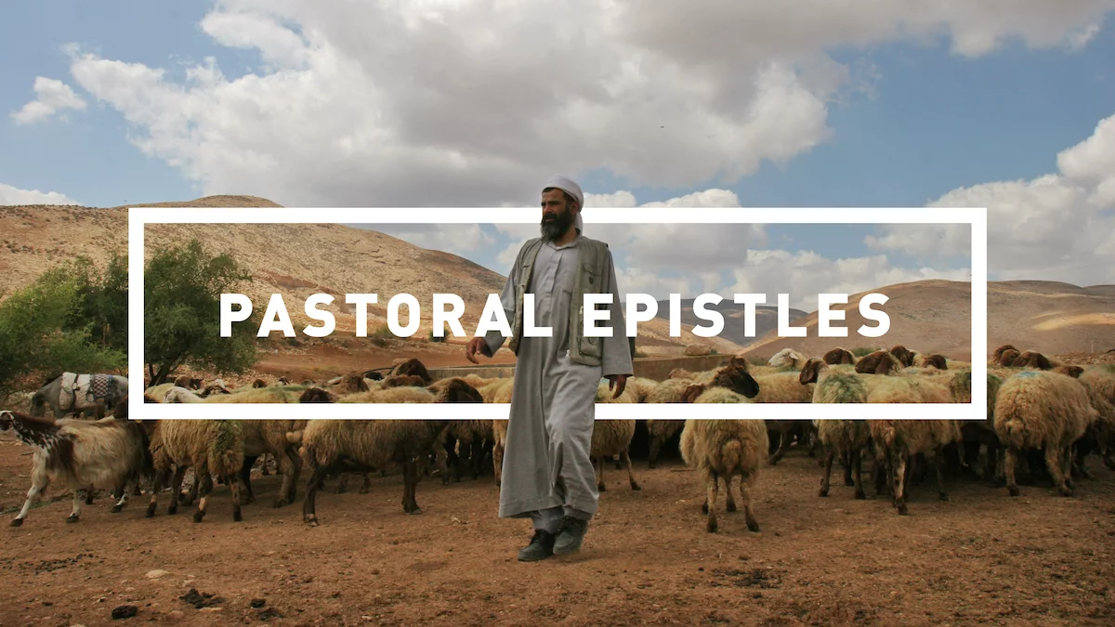
Midweek

Slide 2
Purpose & Themes of Pastoral Epistles
The purpose is pastoral—in other words it is to prepare Timothy to care for the churches Paul has planted and/or led.
Themes:
The life of the evangelist/minister. Holy living
The work of the evangelist.
Opposing false teaching, controversies and divisiveness.
The raising up of leaders in the church.

Slide 3
Theme Passage of Pastoral Epistles
1 Tim 3:15
(these instructions are so that) “you will know how people ought to conduct themselves in God’s household (family), which is the church of the living God, the pillar and the foundation of the truth.”

Slide 4
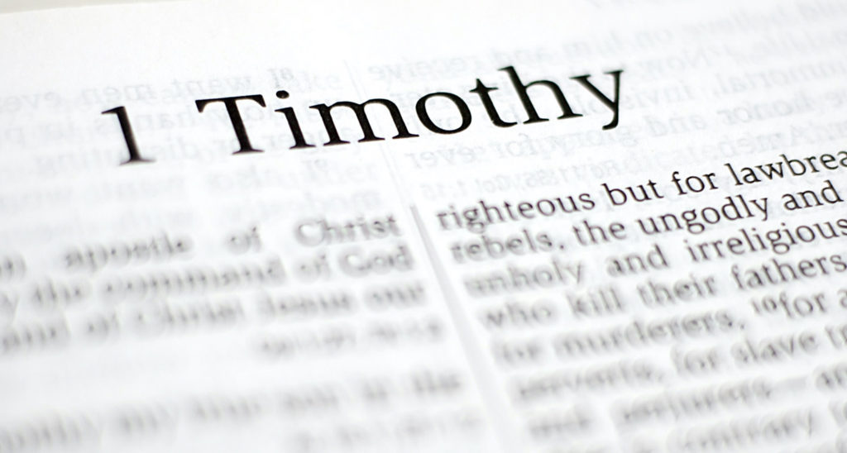
OUR FOCUS

Slide 5
FOUR MAIN THEMES OF 1 TIM
Sound Doctrine
Sound Worship
Sound Leadership
Sound Living

Slide 6
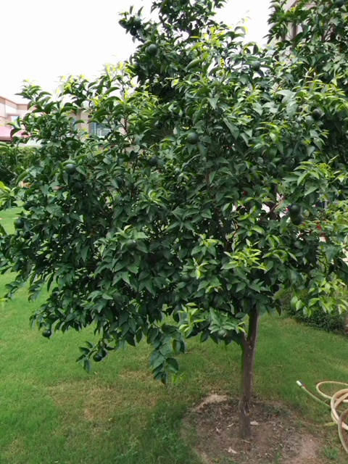
What type of fruit tree do you think this is?

Slide 7
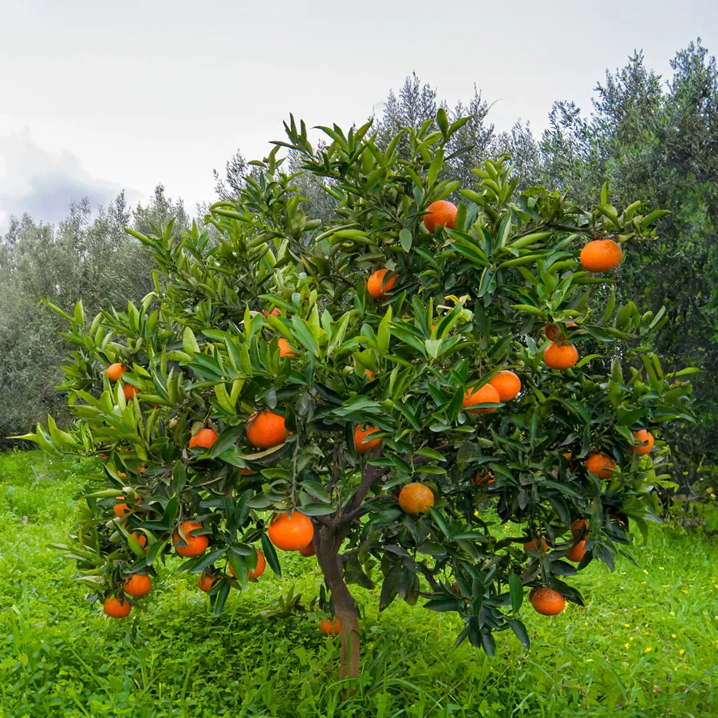
ORANGE TREE

Slide 8
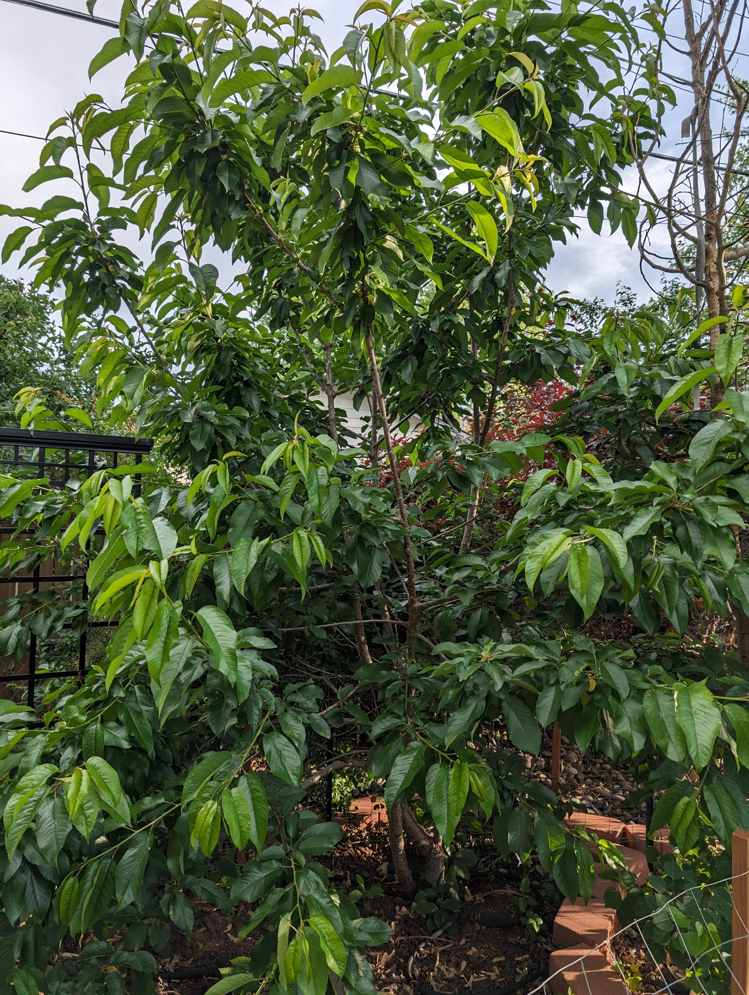
What type of fruit tree do you think this is?

Slide 9
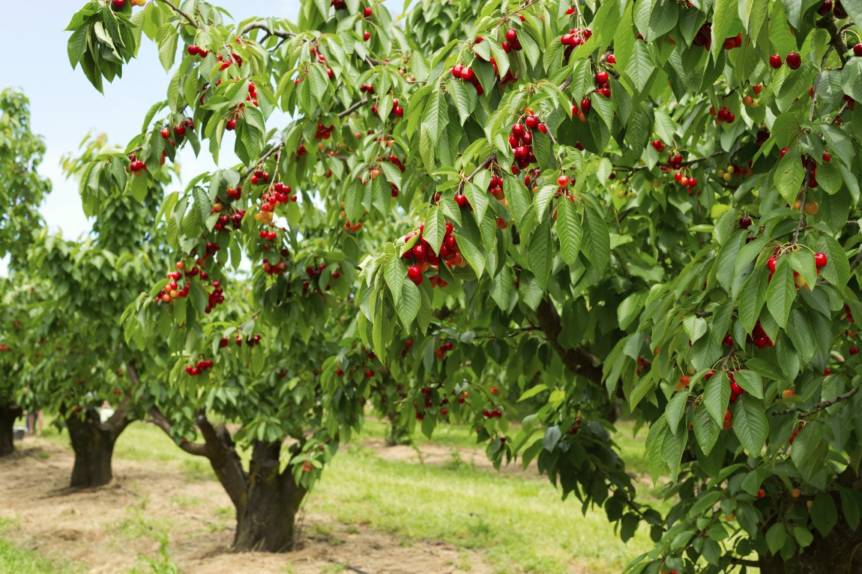
CHERRY TREE

Slide 10
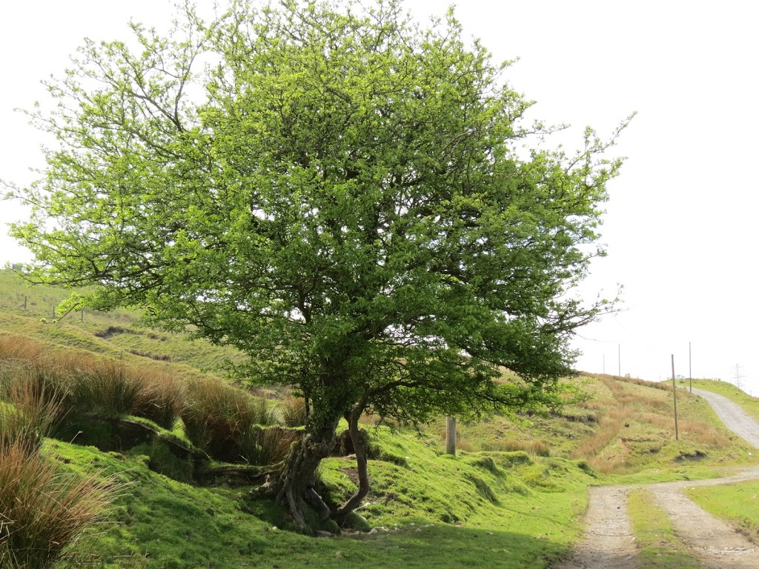
What type of fruit tree do you think this is?

Slide 11
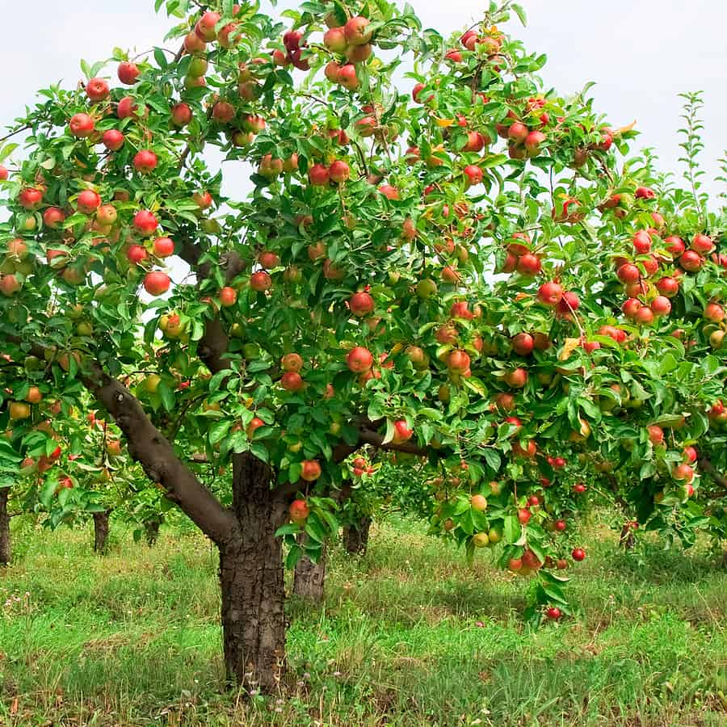
APPLE TREE

Slide 12
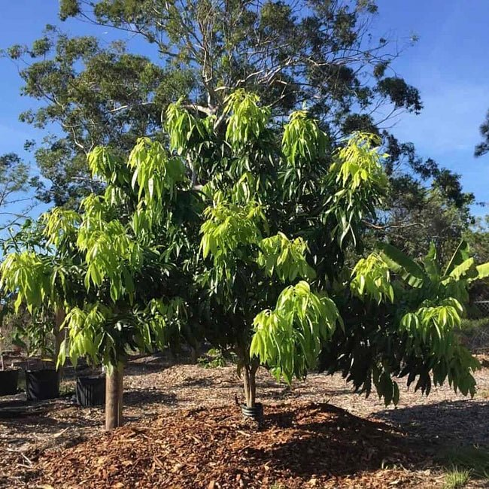
What type of fruit tree do you think this is?

Slide 13
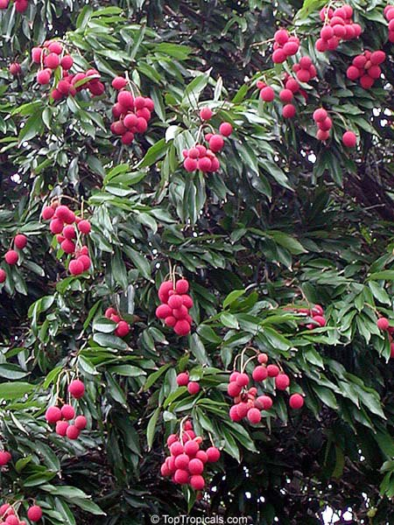
LYCHEE TREE

Slide 14
Matthew 7:15-20
Recognize a tree by its fruit.
Recognize False Teaching by its fruit.

Slide 15

FALSE TEACHING
SOUND DOCTRINE

Slide 16
Doctrine:
Beliefs that govern your life.

Slide 17
1 Timothy 1:1-2

Slide 18
1 Timothy 1:3-7

Slide 19
Some Examples
Prosperity Gospel
Legalism
Progressive Moralism
Self-Help Christianity

Slide 20
1 Timothy 1:8-11

Slide 21
1 Timothy 1:12-17

Slide 22
Discussion Question:
What unhealthy or bad fruit are you noticing in your life right now, and what beliefs might be contributing to that fruit?

Slide 23
Discussion Question:
What one main scripture that you hold onto that governs your life today and what fruit does it produce?

Slide 24
ANNOUNCEMENTS

Slide 25


Slide 26


Slide 27


