Slide 1
WORTHY OF IT ALL
LINK

Slide 2
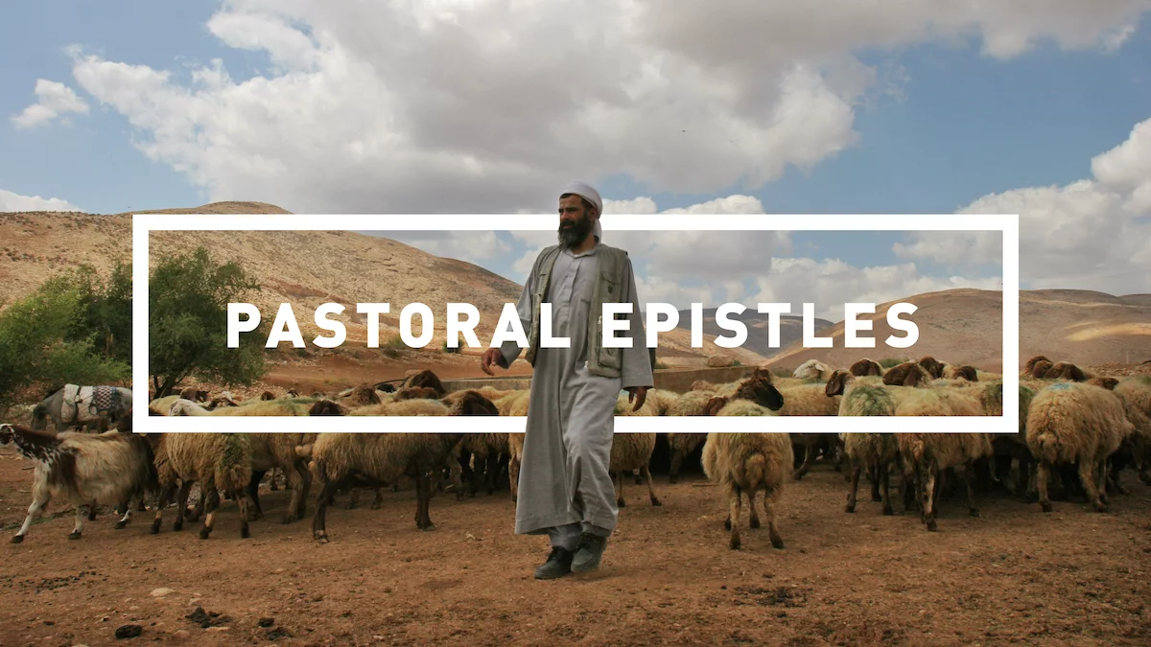
Midweek

Slide 3
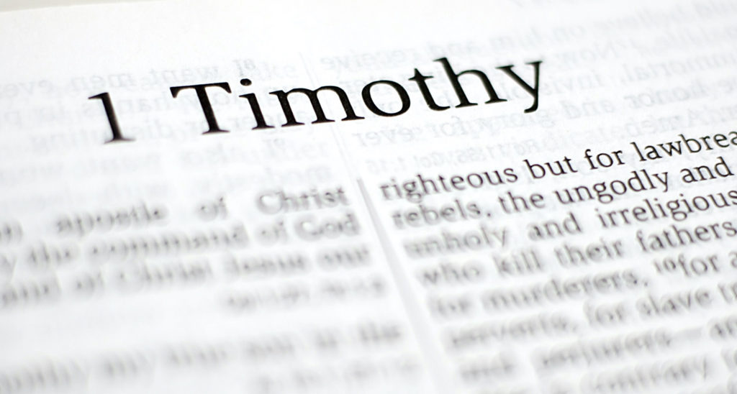
OUR FOCUS

Slide 4
FOUR MAIN THEMES OF 1 TIM
Sound Doctrine
Sound Worship
Sound Leadership
Sound Living

Slide 5
Matthew 7:15-20
Verse 20: “Therefore by their fruits you will know them.”
Recognize a tree by its fruit.
Recognize False Teaching by its fruit.
Recognize what is Sound/True by its fruit.

Slide 6
Sound Doctrine:
Beliefs that govern your life and produces good spiritual fruit!
Goal: Love coming from a pure heart, a good conscience, and a sincere faith.
Conforms to the Gospel!

Slide 7
FRUIT OF FALSE TEACHING
FRUIT OF SOUND DOCTRINE
Speculation
Pride
Confusion
Controversy
Division
Spiritual Distraction
….not Love
Humility
Godliness
Self-Control
Pure Heart
Good Conscience
Sincere Faith
Truth
Love
Grace
Peace
Mercy
Patience
Notes:
The letter reference?

Slide 8
Sound Worship:
More than singing.
Responding to God with reverence, humility, and love.
Reflecting God’s character to one another and towards the lost.
Does not distracts!

Slide 9
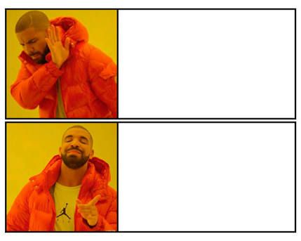
FALSE TEACHING
SOUND DOCTRINE
SOUND WORSHIP

Slide 10

SOUND LEADERSHIP

Slide 11


Slide 12
JESUS IS:
Head of the Church
Chief Shepherd
Perfect example of Sound Leadership
Question:
Since Jesus is our perfect leader, why do we need leaders at all?

Slide 13
MATTHEW 28:18-20
Question:
How do we make disciples and teach them to obey Jesus?

Slide 14
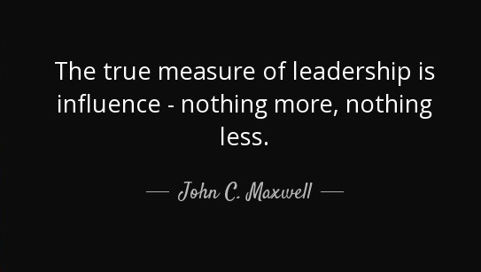
Discipleship requires Leadership!
Leadership is Influence!

Slide 15
Question:
What happens when Leadership is poor?
Confusion
Division
Broken trust
Poor direction
Discouragement
People get hurt!
BAD FRUIT

Slide 16
BOOK OF JUDGES
MAJOR THEME: Need for Godly Leadership!
Judges 5:2
When the princes in Israel take the lead, when the people willingly offer themselves—praise the Lord!
Judges 21:25
In those days Israel had no king; everyone did as they saw fit.

Slide 17
BOOK OF DANIEL
Ungodly Kings
Pagan government
Blasphemous rulers
Corrupt leadership
Poor leadership is not an excuse!
Daniel remained Faithful!

Slide 18
Sound Leadership Matters!
Helps protect Sound Doctrine
Helps preserve Sound Worship
Helps model Sound Living

Slide 19
1 Timothy 3:1-13

Slide 20
Most People Think:
Talent
Charisma
Confidence
Vision
Communication Skills
Education
Experience
Notes:
The letter reference?

Slide 21
Paul Focuses On:
Self-control
Respectability
Gentleness
Faithfulness
Integrity
Maturity
Trustworthiness
Able to Teach
CHARACTER BEFORE COMPETENCY!
BUT WHY??
Notes:
The letter reference?

Slide 22
OVERSEER - episkopē
The office in charge of overseeing the Church
DEACON - diakonos
One who executes the commands of another
Watches
Protects
Guides
Cares for God’s people
Serves
Meets Needs
Supports Ministry
DIFFERENT RESPONSIBILITIES SAME EXPECTATION…. GODLY CHARACTER
Notes:
The letter reference?

Slide 23
1 Timothy 3:4-5
Why does Paul care so much about person’s household?
Leadership begins at home, in private, in the little things.

Slide 24
Matthew 25:21
His master replied, ‘Well done, good and faithful servant! You have been faithful with a few things; I will put you in charge of many things. Come and share your master’s happiness!’
What does being faithful with a few things teach us about leadership?

Slide 25
1 Timothy 3:14-16
Why does Paul say he is writing these instructions?
THIS IS GOD’S HOUSE!

Slide 26
DISCUSSION QUESTIONS:
What leadership quality from this chapter do you most want to grow in?
Where has God given you influence right now, and how can you use it to serve others this week?
What's one practical way you can strengthen God's household this week?
Leadership qualities: Self-control, Respectability, Gentleness, Faithfulness, Integrity, Maturity, Trustworthiness, Able to Teach

Slide 27
ANNOUNCEMENTS
Friday - 7pm GAME NIGHT @ Aguilar's
Sunday Service - 11am @ 500 Buena Vista
Monday - Atwater Bible Talk
Tuesday - Merced Bible Talk - Oakes’ Home
Special Missions Giving - End of June!
ICMC Milwaukee - Sign up now!

Slide 28
SOUND LEADERSHIP
The people who should lead God's church are people whose lives can be trusted.
People of character.
People of integrity.
People who are faithful with a few things.
People who reflect Christ.
WE SHOULD ALL ASPIRE TO BE THE KIND OF PEOPLE GOD CAN TRUST WITH THE CARE OF HIS CHURCH.

Slide 29
Lord, I Need You
LINK

