Slide 1
Lord, I Lift Your Name On High
LINK

Slide 2

Midweek

Slide 3
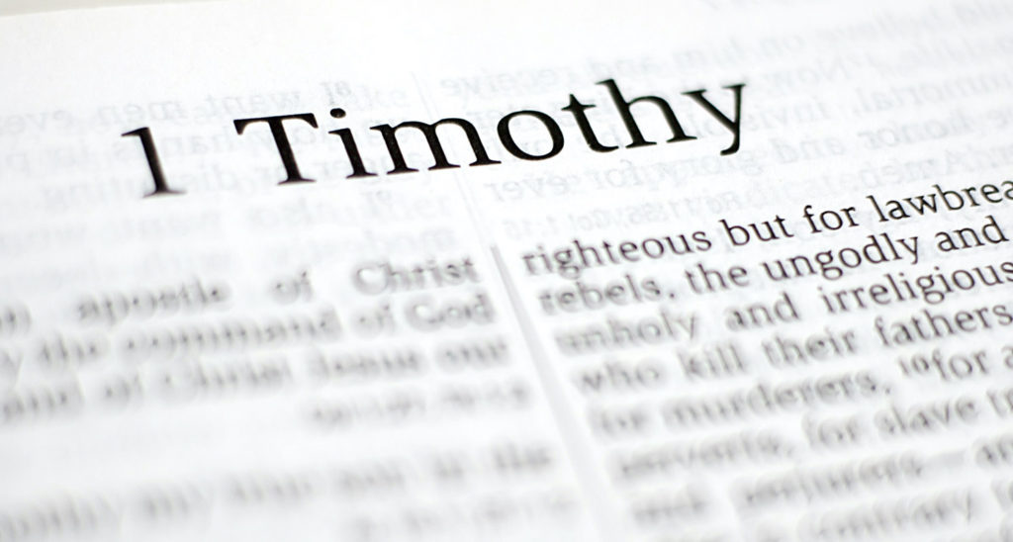
OUR FOCUS

Slide 4
FOUR MAIN THEMES OF 1 TIM
Sound Doctrine
Sound Worship
Sound Leadership
Sound Living

Slide 5
Matthew 7:15-20
Verse 20: “Therefore by their fruits you will know them.”
Recognize a tree by its fruit.
Recognize False Teaching by its fruit.
Recognize what is Sound/True by its fruit.

Slide 6
Sound Doctrine:
Beliefs that govern your life and produces good spiritual fruit!
Goal: Love coming from a pure heart, a good conscience, and a sincere faith.
Conforms to the Gospel!

Slide 7
FRUIT OF FALSE TEACHING
FRUIT OF SOUND DOCTRINE
Speculation
Pride
Confusion
Controversy
Division
Spiritual Distraction
….not Love
Humility
Godliness
Self-Control
Pure Heart
Good Conscience
Sincere Faith
Truth
Love
Grace
Peace
Mercy
Patience
Notes:
The letter reference?

Slide 8
Sound Worship:
More than singing.
Responding to God with reverence, humility, and love.
Reflecting God’s character to one another and towards the lost.
Does not distracts!

Slide 9
Sound Leadership:
Jesus is the Head of the Church
Perfect example of Sound Leadership
Discipleship is Leadership
Leadership is Influence
Begins at home, in private, in the little things

Slide 10
Visible Fruits of Sound Leadership:
Self-control
Respectability
Gentleness
Faithfulness
Integrity
Maturity
Trustworthiness
Able to Teach
CHARACTER BEFORE COMPETENCY!
WE SHOULD ALL ASPIRE TO BE THE KIND OF PEOPLE GOD CAN TRUST WITH THE CARE OF HIS CHURCH.
Notes:
The letter reference?

Slide 11
Sound Leadership Matters!
Helps protect Sound Doctrine
Helps preserve Sound Worship
Helps models Sound Living

Slide 12

FALSE TEACHING
SOUND DOCTRINE
SOUND WORSHIP
SOUND LEADERSHIP

Slide 13

SOUND LIVING

Slide 14
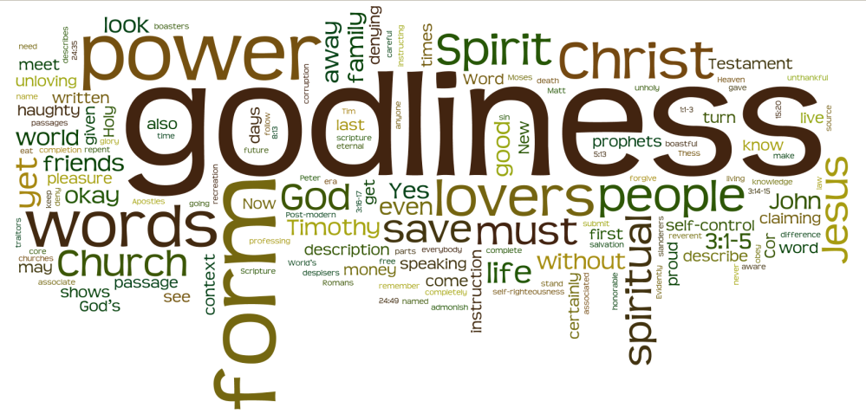
What is Sound Living?
The intentional pursuit of godliness!
Notes:
The letter reference?

Slide 15
MAIN TAKEAWAY:
SOUND LIVING IS NOT ACCIDENTAL.
IT’S INTENTIONAL.
YOU DON’T BECOME GODLY ON ACCIDENT.
What does an intentionally godly life look like?
Notes:
The question we are will attempt to answer in today’s lesson.

Slide 16
1 Timothy 4:1-5
GODLINESS IS NOT….
…. FOLLOWING RULES!

Slide 17
Why can stricter rules appear more spiritual?
Visible
Measureable
Controllable
Can rules transform the heart?
NO! Look at Paul’s example.

Slide 18
Paul’s example: 1 Timothy 1:13-14
Pharisee
Followed the law
Ignorant
Blasphemer
Violent man
What changed Paul’s heart & mind?
Grace poured out along with Faith & Love in Christ Jesus.
Notes:
The Law is good if one uses it properly. Meaning rules can be good but they must conform the the gospel of Jesus Christ. Paul is not against standards. In the this letter Paul cared deeply about behavior right? How men prayed, how women worshiped, how leaders conduct themselves, how we treat one another. Behavior matters. The real issue is where that behavior comes from… and that connects us back to Sound Worship.

Slide 19
LUKE 18:9-15
What’s the difference between godliness and rule-keeping?
Not legalism
Not Man-Made Religion
Not Works!
Notes:
If godliness isnt produced by rules, then how is it produced?

Slide 20
Rule-keeping =
Works → Faith
Behavior → Transformation
Rules → Godliness
Godliness =
Faith → Works
Transformation → Behavior
Godliness → Sound Living
Notes:
If godliness isnt produced by rules, then how is it produced?

Slide 21
1 Timothy 4:6-10
HOW IS GODLINESS PRODUCED?

Slide 22
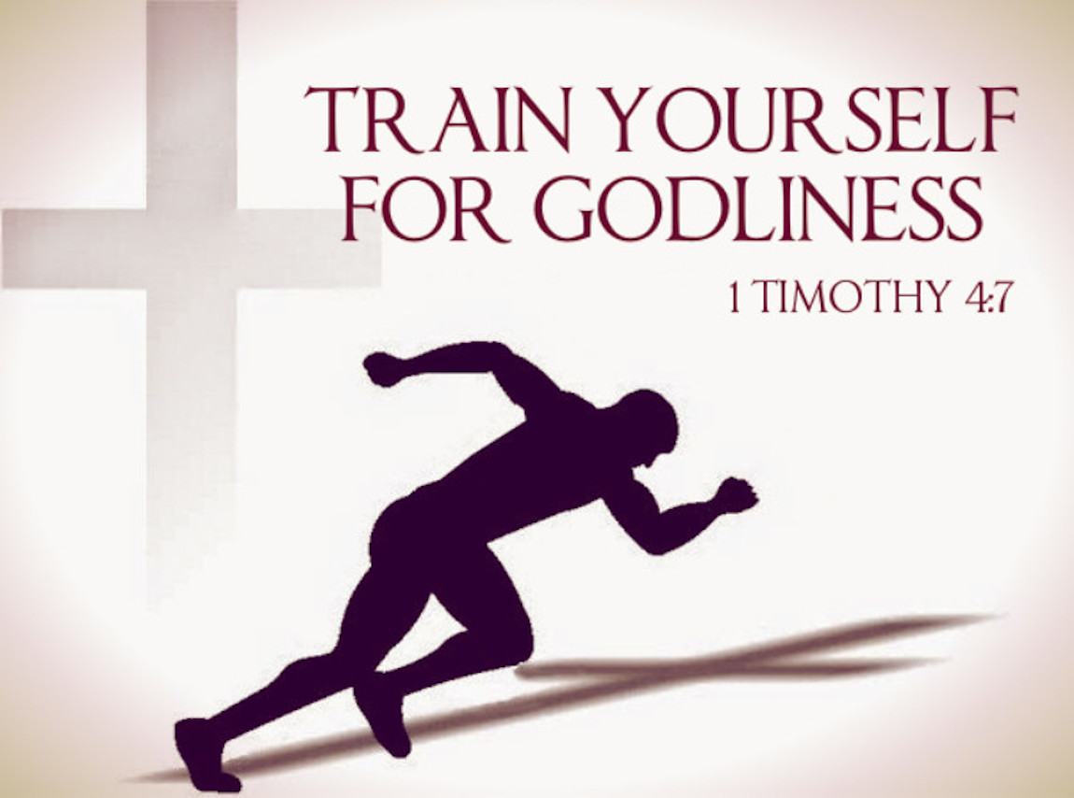
Notes:
Why doesn’t Paul say: Try harder, Why does he say Train yourself? - Can someone accidentally become physically fit? - Intention, Consistency, Discipline

Slide 23
Why does Paul compare physical training with godliness?
Training requires practice!
What are some things we can practice?
Patience, Gentleness, Faithfulness, Submission, Obedience, Being Loving, having relationships.
Jesus words! - Matthew 7:24
Notes:
Can someone accidentally become godly? - Training is not self-improvement

Slide 24
Godliness impacts every area of life!
Relationships, Decisions, Marriages, Parenting, our worship, our leadership, our discipleship, our eternity!
Physical training is valuable
Godliness is invaluable!
Notes:
This is not about self-improvement. This goes back to Sound Worship. How we respond to God and reflect his love. It’s not about rules-following, its always been about Love, that comes from a pure heart, a good conscience, and a sincere faith. - Sound Doctrine - It all connects!

Slide 25
HOLY SPIRIT POWER!
RULES CANNOT TRANSFORM THE HEART
ONLY GOD CAN DO THAT
PRAYERFULLY ASK GOD TO:
TRANSFORM YOU
PRODUCE FRUIT IN YOU
CHANGE YOUR HEART
BE MORE GENEROUS, SELF-CONTROL, PURITY, etc
MAKE YOU MORE LIKE CHRIST
Notes:
This is not about self-improvement. This goes back to Sound Worship. How we respond to God and reflect his love. It’s not about rules-following, its always been about Love, that comes from a pure heart, a good conscience, and a sincere faith. - Sound Doctrine - It all connects!

Slide 26
1 Timothy 4:11-15
GODLINESS ON DISPLAY
SET AN EXAMPLE

Slide 27
Why doesn’t Paul tell Timothy to be Godly, instead he says to be an example?
What’s the difference?
Being Godly affects you
Being an example affects others!
Notes:
Being godly was never meant to stay in private. It eventually becomes visible. Our godliness is part of our worship to God.

Slide 28
What areas does Paul specifically mention?
Which of these five is hardest for you right now?
Speech
Conduct
Love
Faith
Purity
Notes:
Being godly was never meant to stay in private. It eventually becomes visible. Our godliness is part of our worship to God.

Slide 29
Why does Paul tell Timothy not to neglect his gift?
CHARACTER BEFORE COMPETENCY!
Sound Living is intentional progress toward Christ!
Gifts grow when they are used
Strength grows when it’s trained
Skills grow when they are practiced
Godliness grows when its exercised!
Notes:
Being godly was never meant to stay in private. It eventually becomes visible. Our godliness is part of our worship to God.

Slide 30
1 Timothy 4:16
LIFE AND DOCTRINE
Why do you think Paul puts life before doctrine?

Slide 31
Life is where the fruit is!
Why is perseverance necessary?
Pay attention
Examine yourself
Stay alert
Keep growing
Keep training
Keep following Christ!
Notes:
Being godly was never meant to stay in private. It eventually becomes visible. Our godliness is part of our worship to God.

Slide 32
Nobody accidentally becomes godly!
Nobody accidentally becomes spiritually mature.
Training requires consistency.
Training requires perseverance.
Training requires commitment.
Notes:
Being godly was never meant to stay in private. It eventually becomes visible. Our godliness is part of our worship to God.

Slide 33
DISCUSSION QUESTIONS:
What’s one spiritual habit you can be more intentional about to grow in your godliness.
What spiritual gift(s) has God given you that you can train? How can you train your gift this week?
Which area in verse 12, do you need to grow the most in right now? How can you train in that area?
Verse 12 qualities: Speech, Conduct, Love for God, Love for Others, Faith, or Purity.

Slide 34
SOUND LIVING IS NOT ACCIDENTAL
SOUND LIVING IS INTENTIONAL!
Godliness is pursued.
Godliness is practiced.
Godliness is empowered by the Holy Spirit. (Stay Humble)
Godliness is displayed in a life that increasingly reflects Jesus Christ!

Slide 35
But wait there’s more!
SOUND DOCTRINE
SOUND WORSHIP
SOUND LEADERSHIP
SOUND LIVING
SOUND RELATIONSHIPS!

Slide 36
ANNOUNCEMENTS
Friday - 7pm MOVIE NIGHT @ Rodriguezes
Sunday Service - 11am @ 500 Buena Vista
Father’s Day Love Feast - Flyer & Sign Up!
Monday - Atwater Bible Talk
Tuesday - Merced Bible Talk - Oakes’ Home
Special Missions Giving - End of June!
ICMC Milwaukee - Sign up now!

Slide 37
Build My Life
LINK

