Slide 1
Living Hope
LINK

Slide 2

Midweek

Slide 3
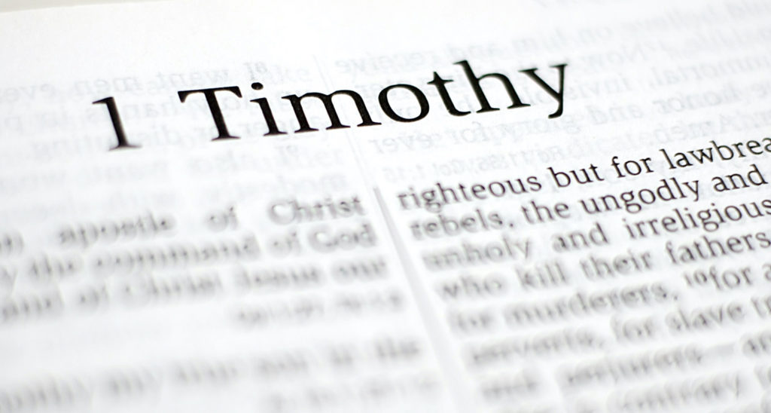
OUR FOCUS

Slide 4
FIVE MAIN THEMES OF 1 TIM
Sound Doctrine
Sound Worship
Sound Leadership
Sound Living
Sound Relationships

Slide 5
Matthew 7:15-20
Verse 20: “Therefore by their fruits you will know them.”
Recognize a tree by its fruit.
Recognize False Teaching by its fruit.
Recognize what is Sound/True by its fruit.

Slide 6
Sound Doctrine:
Beliefs that govern your life and produces good spiritual fruit!
Goal: Love coming from a pure heart, a good conscience, and a sincere faith.
Conforms to the Gospel!

Slide 7
FRUIT OF FALSE TEACHING
FRUIT OF SOUND DOCTRINE
Speculation
Pride
Confusion
Controversy
Division
Spiritual Distraction
….not Love
Humility
Godliness
Self-Control
Pure Heart
Good Conscience
Sincere Faith
Truth
Love
Grace
Peace
Mercy
Patience
Notes:
The letter reference?

Slide 8

FALSE TEACHING
SOUND DOCTRINE
SOUND WORSHIP
SOUND LEADERSHIP
SOUND LIVING

Slide 9

SOUND RELATIONSHIPS

Slide 10
ICEBREAKER:
What’s one word or phrase that describes an ideal family?
Write your answer on a piece of paper and place it in the bowl.

Slide 11
Possible Answers:
Love
Trust
Patience
Grace
Support
Safety
Fun
Forgiveness
Acceptance
Caring
Be Known
Unified

Slide 12
Paul’s Battle Against False Teaching
False Teaching > Poor Relationships
Poor Relationships > Division
Sound Doctrine > Sound Relationships
Sound Relationships > Unity

Slide 13
1 Timothy 5:1-2

Slide 14
Paul Doesn’t Say:
Paul uses family language.
❌ Treat older men like members
❌ Treat older women like attendees.
❌ Treat younger men like volunteers.
❌ Treat younger women like acquaintances.
✅ Fathers
✅ Mothers
✅ Brothers
✅ Sisters

Slide 15
What’s the difference between attending church and belonging to God’s family?

Slide 16
Attending Church
Belonging to God’s family
Presence
Convenience
Little responsibility
Checking off a box
Participation
Commitment
Sacrifice
Drawn together by love and unity

Slide 17
Sound Relationships begin when we stop viewing the church as something we attend and start viewing it as a family to which we belong to.

Slide 18
1 Timothy 5:3-16

Slide 19
Verse 4: “Put their religion into practice.”
Why do you think Paul sees caring for our biological family as practicing our faith?
God does not disregard the family we were born into. One of the greatest testimonies of the gospel is how we treat the people closest to us.

Slide 20
The family we are born into is the first place God calls us to practice our faith.

Slide 21
Which of these qualities is most difficult to consistently practice in a your family? Why?
Love
Trust
Patience
Grace
Support
Safety
Fun
Forgiveness
Acceptance
Caring
Be Known
Unified

Slide 22
Verse 8: “If anyone does not provide for his relatives… he has denied the faith.”
Family responsibility is a spiritual issue.
Paul sees a direct connection between what we believe and how we care for the people God has entrusted to us.

Slide 23
Sound Relationships require responsibility.

Slide 24
Which is harder or easier for you?
Loving your biological family or loving your spiritual family?
Why?
**No Wrong Answers***

Slide 25
Which is harder or easier for you?
Receiving love from family?
Or taking responsibility for family?
Family is a place where we receive and give care.
Family is something we contribute to.

Slide 26
1 Timothy 5:17-25

Slide 27
Honor and Accountability
Why do you think Paul places such an emphasis on honoring leaders?
Leadership carries responsibility, burdens, accountability, and difficult decisions.
Why do you think Paul moves so quickly from honor to accountability?
Honor without accountability is unhealthy
Accountability without honor is cynical
Notes:
Paul wants integrity

Slide 28
Honor, Accountability, & Fairness
Why do you think fairness matters so much in relationships?
When fairness disappears, trust, respect, and unity usually disappear with it. Relationships become easily damaged.

Slide 29
Honor, Accountability, & Fairness
Why is it easy to either idolize leaders or criticize leaders?
Paul chooses neither:
Honor them, Pray for them, Respect them but maintain integrity and accountability.

Slide 30
What do you think Paul is teaching Timothy here?
Verse 22: “Don’t be hasty…”
Verse 24: “The sins of some are obvious….”
Verse 25: “In the same way, good deeds are obvious”
Not to rush to judgement. Do not be hasty. Give time to reveal character, integrity, and fruit.
Eventually what is hidden becomes visible.
Notes:
Paul is concerned about fruit and false teaching

Slide 31
Honor and Accountability with Leaders
How can we honor leaders without idolizing them?
And how can we hold leaders accountable without becoming critical?
Healthy families honor one another, tell the truth, protect one another, and hold one another accountable.

Slide 32
Sound Relationships require both honor and accountability.

Slide 33
1 Timothy 6:1-2

Slide 34
Authority
Why do you think Paul includes this relationship in a lesson about God’s household?
Disciples don’t just honor people when it’s easy. Our true character is revealed most clearly in difficult relationships.
What happens when we only honor authority we agree with?
Eventually every authority figure becomes a problem.

Slide 35
Authority - Verse 2
Why do you think it would be easy to take a disciple leader, friend, or family member for granted?
Familiarity can sometimes reduce appreciation!
The closer we become, the easier it can be to stop valuing them.
SERVE THEM BETTER!

Slide 36
John 13:33-35
A new command I give you: Love one another. As I have loved you, so you must love one another. By this everyone will know that you are my disciples, if you love one another.”

Slide 37
Sound Relationships reflect the love of Christ.

Slide 38
Conclusion:
Older men and women, younger men and women, widows, family members, church leaders, people in authority.
The gospel should change the way we treat people.
Sound Doctrine > Sound Relationships
Produces healthy relationships, families, churches, and disciples.

Slide 39
SUMMARY:
Sound Doctrine: Truth that produces love.
Sound Worship: Lives that honor God.
Sound Leadership: Character that influences others.
Sound Living: The intentional pursuit of godliness.
Sound Relationships:
The visible fruit of the gospel at work in our lives.
.

Slide 40
ANNOUNCEMENTS
Friday - 7pm Bonfire Worship @ Aguilar's
Sunday Service - 11am @ 500 Buena Vista
Monday - Atwater Bible Talk
Tuesday - Merced Bible Talk - Oakes’ Home
Special Missions Giving - End of June!
ICMC Milwaukee - Sign up now!

Slide 41
SOUND LEADERSHIP
The people who should lead God's church are people whose lives can be trusted.
People of character.
People of integrity.
People who are faithful with a few things.
People who reflect Christ.
WE SHOULD ALL ASPIRE TO BE THE KIND OF PEOPLE GOD CAN TRUST WITH THE CARE OF HIS CHURCH.

Slide 42
Bind Us Together
LINK

